Slide 1
APUSH Review: Unit 1 Learning Objective E (Topic 1.5)
Explain how the growth of the Spanish Empire in North America shaped the development of social and economic structures over time.

Slide 2
APUSH Test Tip
This topic covers the structure of the Spanish Empire in the Americas. This will be important to know for the next unit (#2) when you will be expected to compare and contrast the Spanish Empire with other European Empires. Make sure you can explain the major characteristics of the Spanish Empire.

Slide 3
The Growth Of The Spanish Empire
Spanish Conquistadores:
Hernan Cortes - conquered Mexico in 1519
Francisco Pizzerò - conquered Peru in 1521
Spain quickly conquered much of present-day Latin America during this time period
Treaty of Tordesillas (1494)
Treaty between Spain and Portugal that gave much of Latin America to Spain

Slide 4
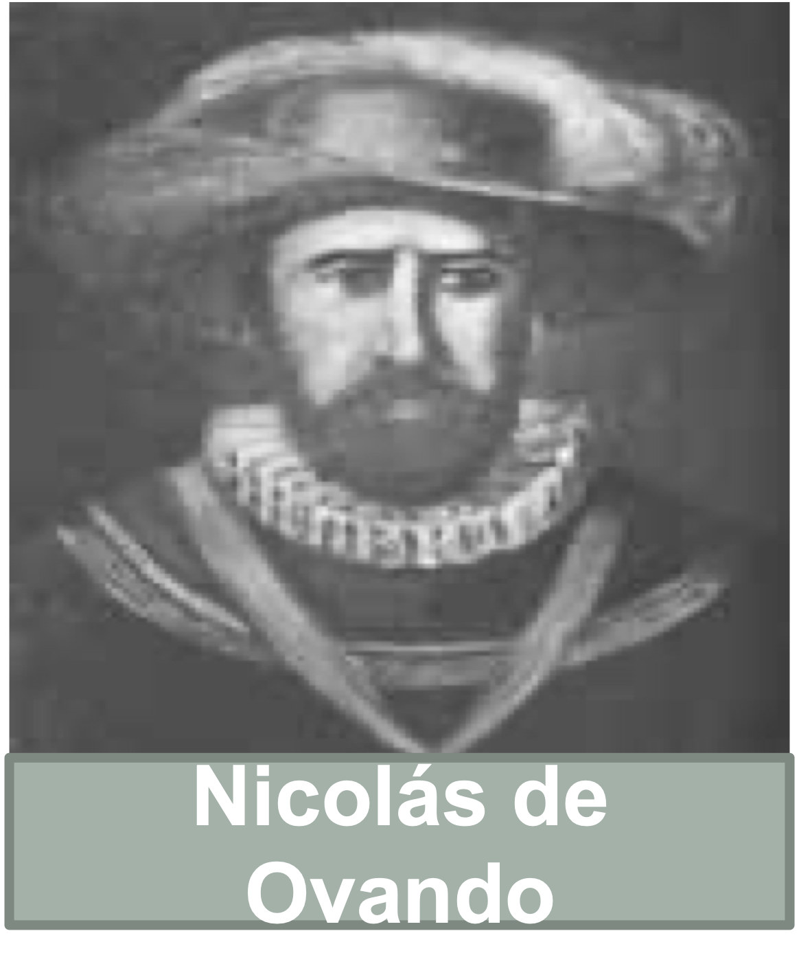
Encomienda System
Native American labor was marshaled (arranged, assembled) on plantations
The goal was to use labor for agriculture and precious metals in mines
Eventually, the system was replaced by African enslaved labor

Slide 5
Growth Of Slavery
Europeans partnered with some West African groups that practiced slavery:
Forcibly extracted slave labor for the Americans
Spanish imported enslaved Africans to labor on plantations and mines
Sugar plantations in the West Indies
Check out this map

Slide 6
Social Structure Of New Spain
Diverse group of individuals (Europeans, African, and Native Americans)
Spanish Caste System:
Incorporated diverse group and defined their position in society
The farther down the caste system, the less rights and political power one had
The more European an individual was, the higher up the caste system they were

Slide 7
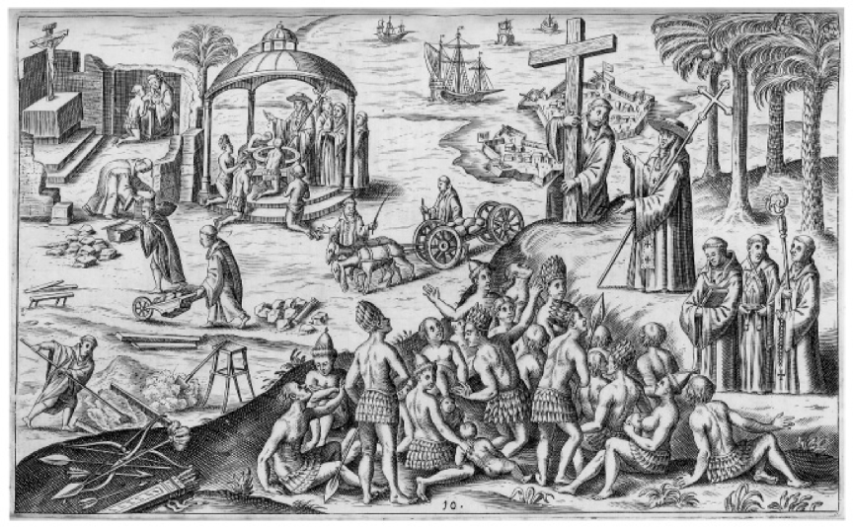
Part II - Document Analysis
What is the Point of View of the above image?
Positive towards Spanish colonization
Spain is Christianizing Natives
What is specific historical evidence that could be used to challenge the above illustration?
Encomienda System, Spanish Caste System
Spanish Colonization Illustration from 1621

Slide 8
See You Next Time For Objective F (1.6)

