Slide 1
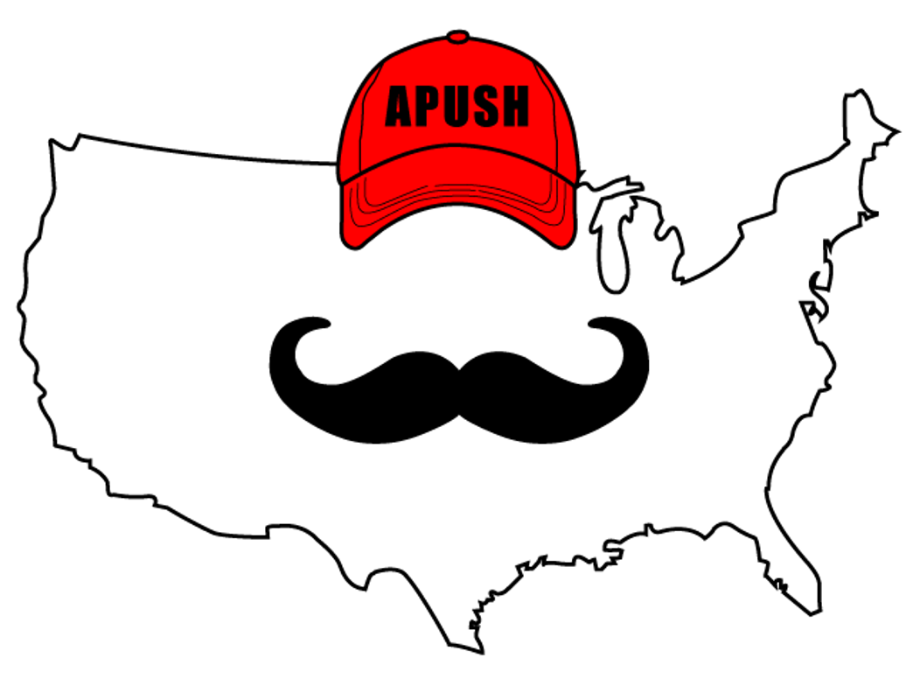
APUSH Review: Learning Objective F (Topic 1.6)
Explain how and why European and Native American perspectives of others developed and changed in the period.

Slide 2
APUSH Test Tip
It’s important to understand that no two Native tribes were the same or shared the same beliefs. However, there were general differences in the views between Native Americans and Europeans.

Slide 3
Different Worldviews of Native Americans and Europeans
Religion:
Many Natives were polytheistic
Contrast with monotheistic Christianity
Many Spanish settlers (and some English - Unit #2) will seek to convert Natives to Christianity
Gender and Family:
Many Native societies were matrilineal - traced hereditary through mother’s side. Property was often inherited from their mother’s side
Contrast with European societies tracing hereditary through father’s side

Slide 4
Different Worldviews of Native Americans and Europeans
Land Use:
Land was not individually owned in Native American tribes
Contrast with Europe where wealth was determined by how much land one owned
Europe practiced the enclosure movement - fencing off land

Slide 5
Adapting Useful Aspects Of Each Other’s Culture
How did Native Americans adapt European culture?
New European technology - construction of forts and the flintlock rifle
Horse (Learning objective B, topic 1.2) - drastically altered life for Natives in the Great Plains

Slide 6
Adapting Useful Aspects Of Each Other’s Culture
How did Europeans adapt Native American culture?
New farming techniques for the different climate and soil than Europe
New foods (Potato, maize, beans) that helped sustain and grow European population

Slide 7
Debates Over How Non-Europeans Should Be Treated
Valladolid Debate (1550 - 1551):
Debate between Bartolome de Las Casas and Juan de Sepulveda
Las Casas argued for humane treatment of Native Americans and was against enslavement of Natives
Sepulveda argued that Natives were less than human and enslavement was justified

Slide 8
Justifications For Subjugation Of Africans And Natives
Religious:
Curse of Ham - used as biblical justification for slavery
Cultural:
Many Europeans saw Natives and Africans as “savages”
Racial:
Theories that human races were different origins
Used to subjugate Natives and African Americans

Slide 9
Part II - Comparing/Contrasting Worldviews of Natives and Europeans
In the chart below, compare and contrast the similarities and differences of Native Americans and Europeans in their worldviews.
Native Americans | Similarities | Europeans

Slide 10
See You Back Here For Learning Objective G (1.7) End of Period 1!

