Slide 1
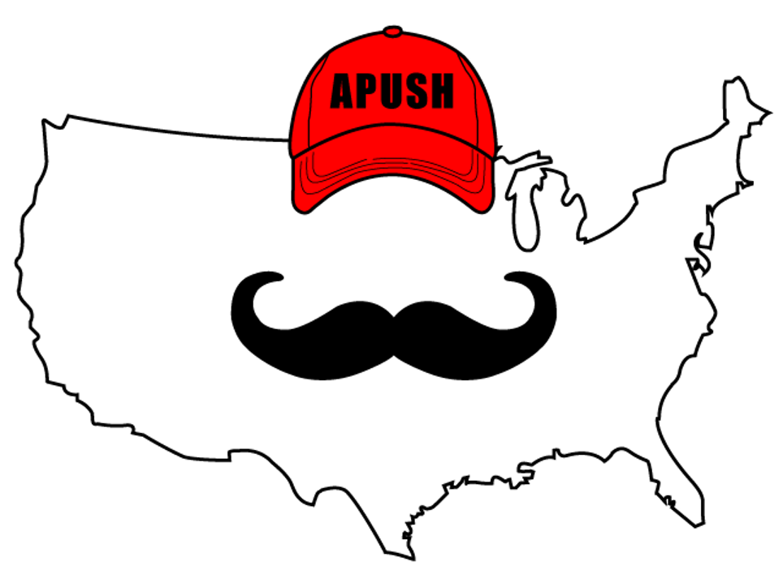
APUSH Review: Everything You Need To Know About The Liberator To Succeed In APUSH
www.APUSHReview.com

Slide 2

The Liberator (January, 1831 - 1865)
Background info:
    Prior to The Liberator, many abolition plans aimed at gradually ending slavery, compensating enslavers for ending slavery, or sending former enslaved people to Africa (American Colonization Society)

Slide 3
The Liberator (January, 1831 - 1865)
Enter William Lloyd Garrison
  William Lloyd Garrison advocated for an immediate and uncompensated end to slavery
  His newspaper was published weekly for 34 years until the ratification of the 13th amendment

Slide 4
The Liberator (January, 1831 - 1865)
Effects:
  The newspaper was widely read in the North
  Helped reshape the goals of the abolitionist movement

Slide 5

Thanks For Watching! See You Tomorrow For Another Video
www.APUSHReview.com

