Slide 1
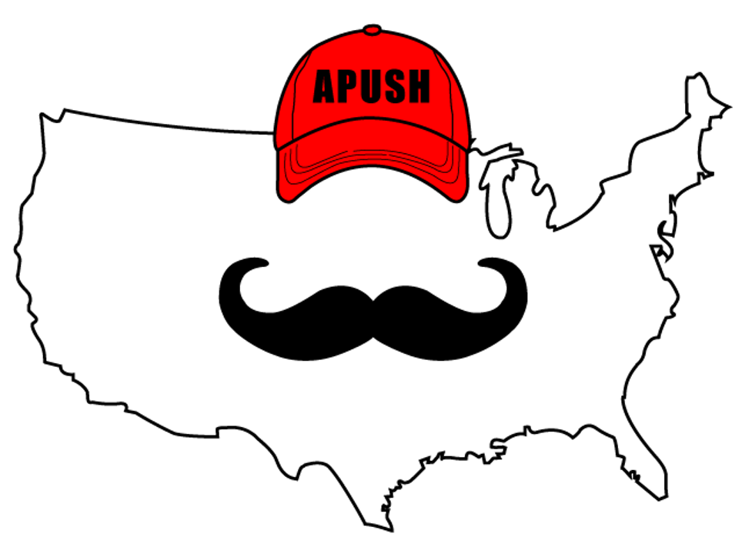
APUSH Review: Everything You Need To Know About A Gilded Age Political Cartoon To Succeed In APUSH
www.APUSHReview.com

Slide 2
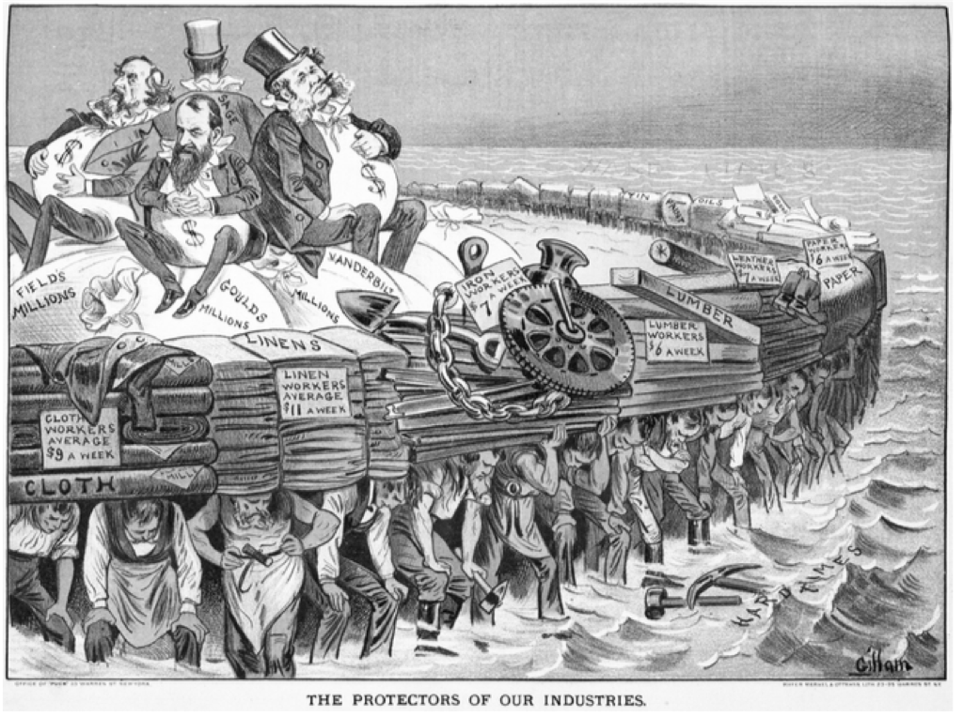
The Protector Of Our Industries

Slide 3
Breaking Down The Image
How does the image portray industrialists (business owners)?
As wealthy due to exploitation of workers
How does the image portray workers?
As holding up the business owners, as the backbone of the economy

Slide 4
Breaking Down The Image
What led to the sentiments/conditions portrayed in the image?
Trusts/monopolies
Social Darwinism
How did workers respond to the conditions depicted in the image?
By forming unions

Slide 5

Thanks For Watching! See You Tomorrow For Another Video
www.APUSHReview.com

