Slide 1
APUSH Review: Containment, The Truman Doctrine, and The Marshall Plan
www.Apushreview.com
Everything You Need To Know About Containment, The Truman Doctrine, and The Marshall Plan To Succeed In APUSH

Slide 2

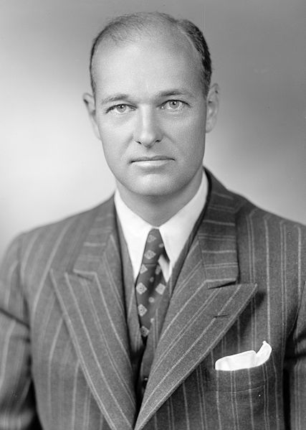
George Kennan and containment
Who was he?
  Foreign Ambassador to the Soviet Union
What did he write?
  Author of the “Long Telegram”
What is he known for?
  Father of ***Containment*** – to keep Communism from spreading
Impact of Kennan?
  Helped end the US policy of isolation
The cap = containment and keeps the water “Communism” from spreading
Communism

Slide 3
The Truman Doctrine
Background info:
  Britain could no longer provide aid to Greece and Turkey
  US feared the Soviets would take control or gain influence
Truman requested, and received, $400 million for military and economic aid to Greece and Turkey
Impact of the Truman Doctrine?
  America is further ripped from isolation
"It must be the policy of the US to support free peoples who are resisting attempted subjugation by armed minorities or by outside pressures."

Slide 4
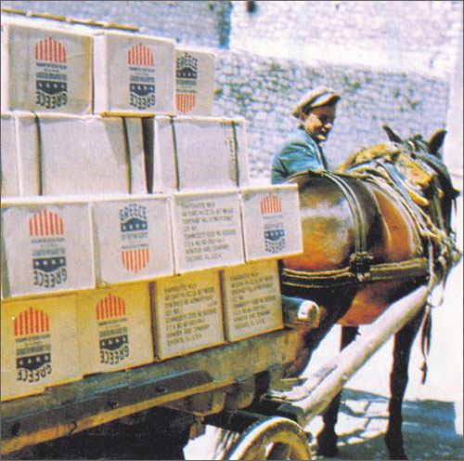
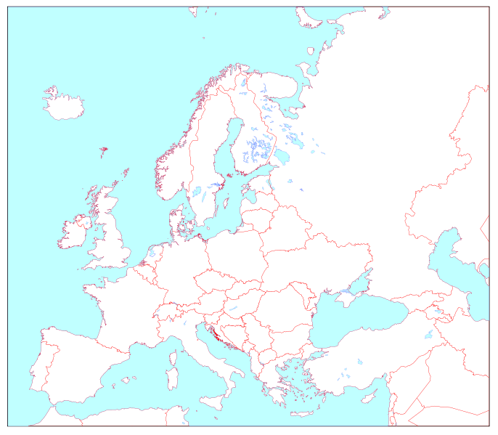

Slide 5
The Marshall Plan
Secretary of State
What was it?
Policy that the US would spend billions of dollars over next several years to improve European economic recovery
Why was this policy pursued?
  Containment!
  To make communism less appealing to European countries

Slide 6

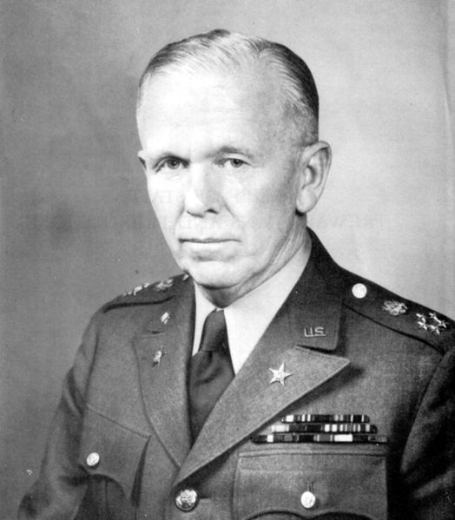


Slide 7
Quick Recap
The goal of ***Containment*** was to keep Communism from spreading
The Truman Doctrine and Marshall Plan are both forms of ***Containment***
Be able to identify George Kennan
Containment helped end US isolation and the US became increasingly involved in world affairs

Slide 8
Thanks for watching!
  Subscribe to my channel
  Help spread the word
Questions? Comments? Ideas for videos?
  Leave in comments
Subscribe
Down here!

