Slide 1
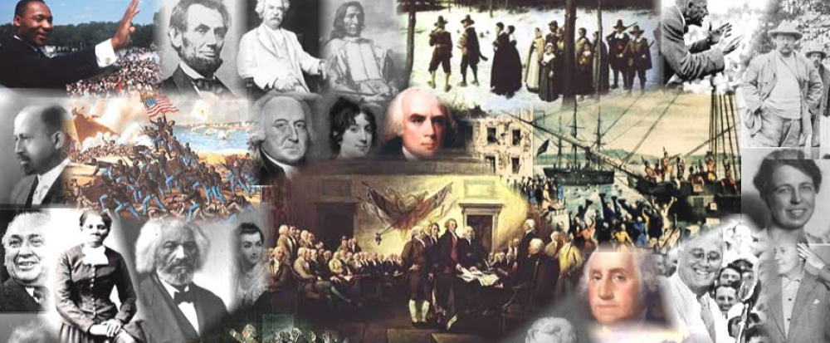
www.Apushreview.com

Slide 2
APUSH Review: Important Presidential Elections
Everything You Need To Know About Important Presidential Elections To Succeed In AP

Slide 3
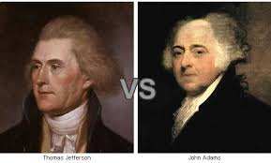
Election of 1800
The Main Players:
  John Adams (Federalist)
  Thomas Jefferson (Democratic-Republican)
  Aaron Burr (VP Candidate for Jefferson)
The result?
  Jefferson and Burr tie, House settles dispute, elects Jefferson
“Revolution of 1800”
  Peaceful transition of power between political parties
  “We are all Republicans, we are all Federalists”

Slide 4
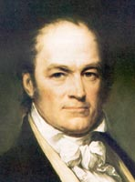
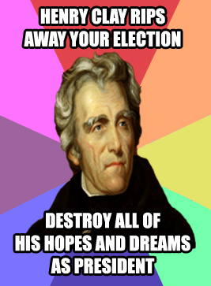
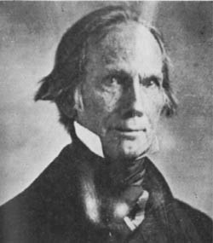
Election of 1824
The Main Players:
  John Quincy Adams, Henry Clay, William Crawford, Andrew Jackson
The result?
  No electoral majority, yet Jackson gets most votes
  House decides on top 3 (12th amendment)
    Sorry Clay ☹
  Clay (Speaker of House) throws support behind Adams
“The Corrupt Bargain”
  Clay becomes Secretary of State
  Jackson cries “A Corrupt Bargain”

Slide 5
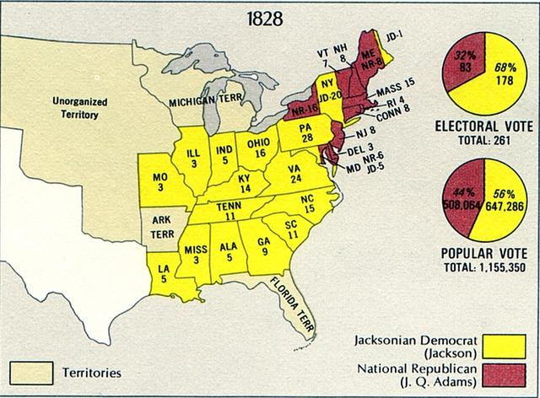
Election of 1828
The Main Players:
  John Quincy Adams (National Republican)
  Andrew Jackson (Democrat)
The result?
  Jackson wallops Adams
Significance?
  1st President from West
  1st “common man”
  Increased voter turnout
  Universal white male suffrage

Slide 6
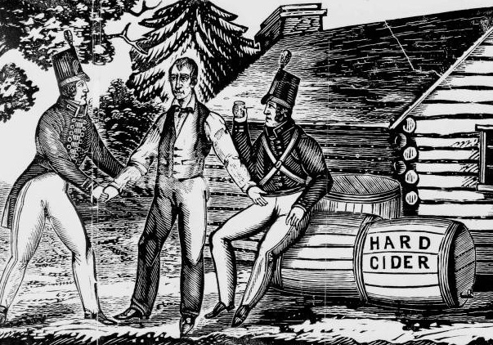
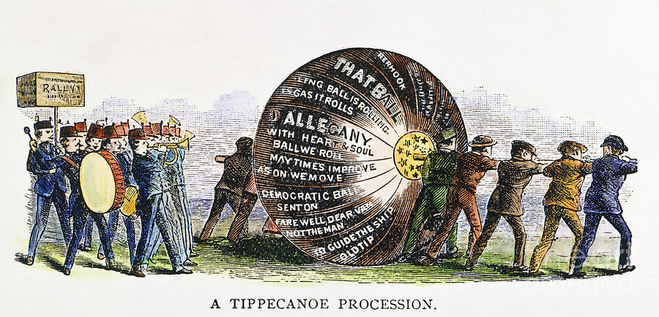
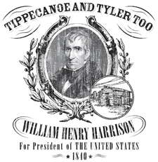
Election of 1840
The Main Players:
  Martin Van Buren (Democrat)
  William Henry Harrison (Whig)
The result?
  Harrison wins
  MVB hurt by Panic of 1837
Significance?
  Massive voter turnout
  Use of slogans
    “Tippecanoe and Tyler Too”
    “Get the ball rolling”
    “Log cabin and hard cider”

Slide 7
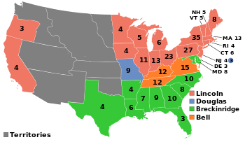
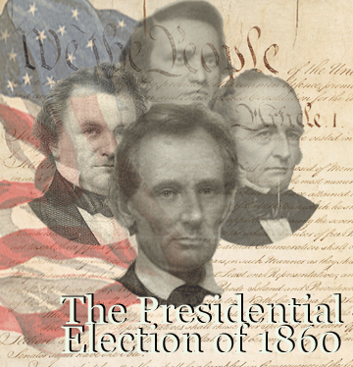
Election of 1860
The Main Players:
  Stephen Douglas (Democrat – North)
  John C. Breckinridge (Democrat – South)
  Abe Lincoln (Republican)
    ***Non-extension of slavery, high tariffs, land for farmers***
  John bell (Constitutional Union Party)
The result?
  Lincoln wins 40% of vote
Significance?
  “Fire-eaters” promised to secede if Lincoln won, South Carolina follows through

Slide 8
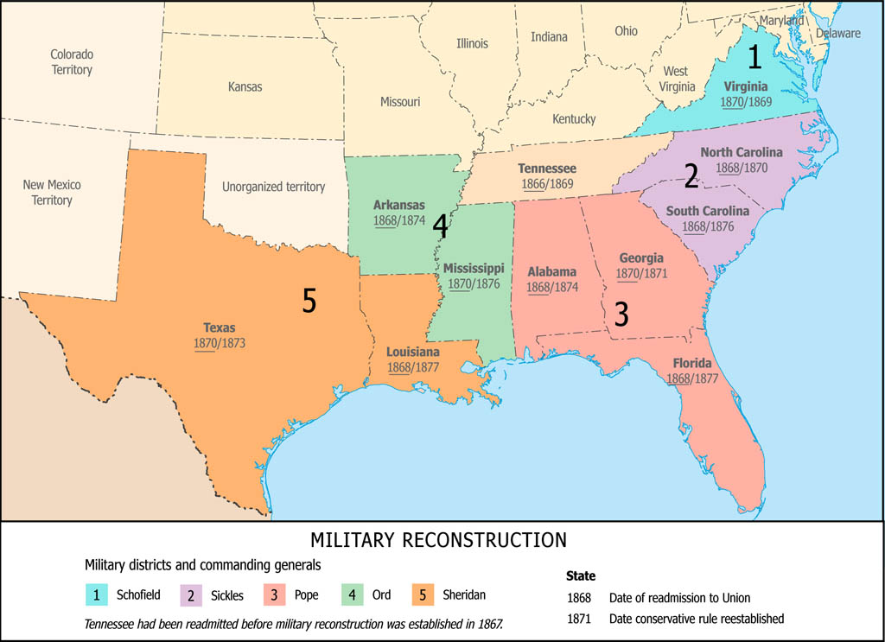
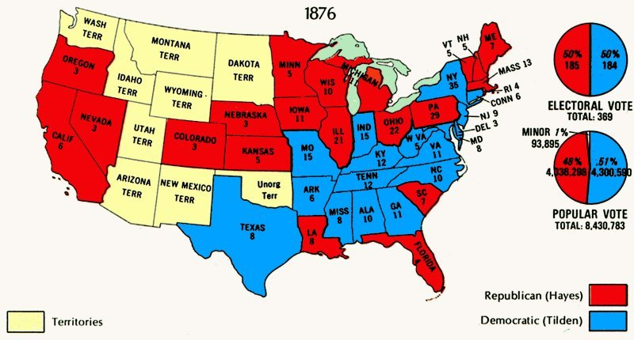
Election of 1876
The Main Players:
  Samuel Tilden (Democrat)
  Rutherford B. Hayes (Republican
The result?
  After no one received an electoral majority, Hayes becomes president – Compromise of 1877
Significance?
  Hayes wins, despite not winning popular majority
  RECONSTRUCTION ENDS!
  Military rule in the South is OVER!

Slide 9
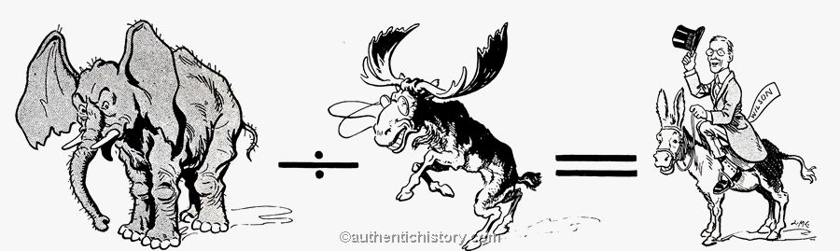
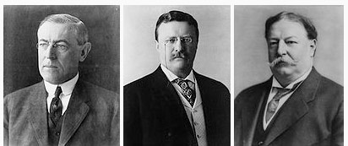
Election of 1912
The Main Players:
  William Howard Taft – incumbent (Republican)
  Woodrow Wilson (Democrat)
  Theodore Roosevelt (Bull Moose Party)
  Eugene V. Debs (Socialist Party)
The result?
  Two “Republicans” running split the vote
  Wilson becomes president
Significance?
  Continuation of the Progressive Era
  “New Freedom”

Slide 10
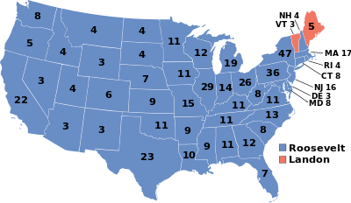
Election of 1936
The Main Players:
  Franklin Roosevelt – incumbent (Democrat)
  Alfred Landon (Republican)
The result?
  Roosevelt wins
  New Deal programs
Significance?
  African-Americans switch to Democratic Party

Slide 11
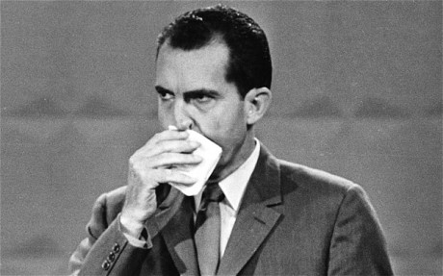
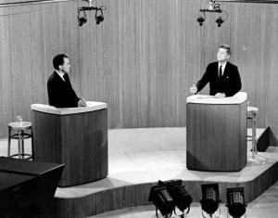
Election of 1960
The Main Players:
  JFK (Democrat)
  Richard Nixon (Republican)
The result?
  JFK narrowly wins
Significance?
  TV plays a significant role in the election
  First Catholic President

Slide 12
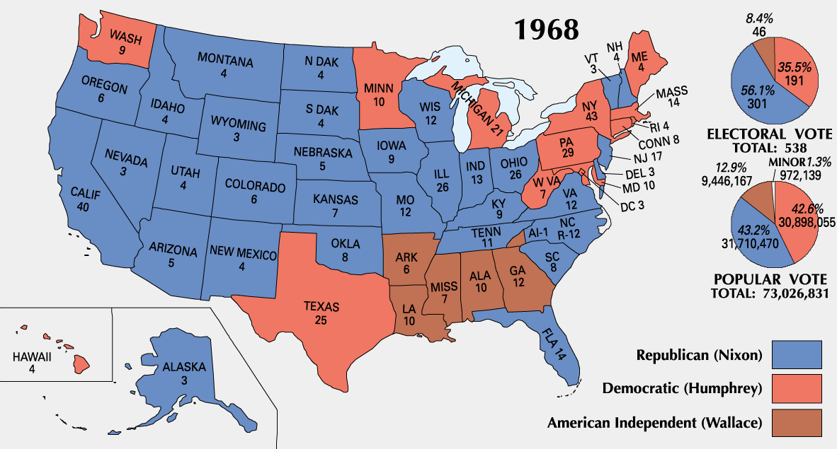
Election of 1968
The Main Players:
  Herbert Humphrey (Democrat)
    Riots in Chicago
  Richard Nixon (Republican)
  George Wallace (American Independent Party)
    Against war protestors and big government
    Pro segregation
    Favored escalation of Vietnam War
The result?
  Nixon wins
Significance?
  KNOW George Wallace and his 3rd Party

Slide 13


Thanks for watching!
  Subscribe to my channel
  Help spread the word
  Good luck on your tests!
Subscribe
Down here!

