Slide 1
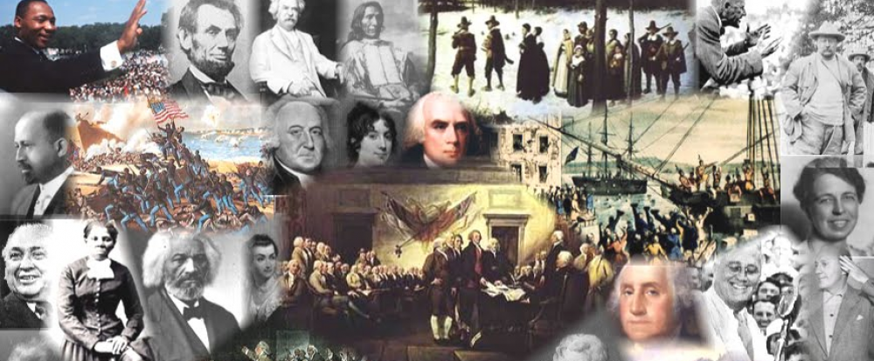
www.Apushreview.com

Slide 2
APUSH Review: Marbury v. Madison and Judicial Review
Everything You Need to Know About Marbury V. Madison To Succeed In APUSH

Slide 3
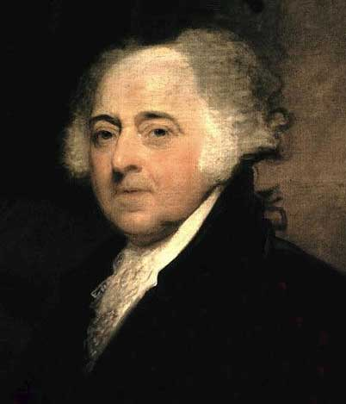
Judiciary Act of 1801
What was it?
Passed in 1801, last months in Adams’ administration
Increased the number of federal judges
Adams could appoint the new judges
“Midnight Judges” since they were appointed in his last days in office
Why was it created?
Federalists lost many positions in the election of 1800
Federalists sought to control the judicial branch

Slide 4
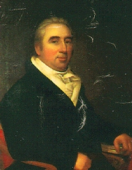
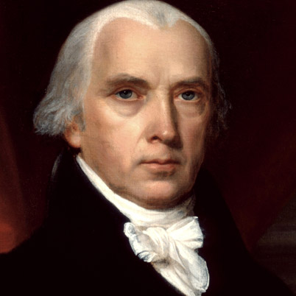
Why is Marbury Suing Madison?
Who was Marbury?
One of Adams’ “midnight judges”
He never received his commission, or papers
What’s James Madison’s role?
As Jefferson’s Secretary of State, Madison should have given Marbury his commission, but refused….
So….. Marbury sues Madison

Slide 5
The Supreme Court’s Ruling
Woohooo???
Too soon???
The court ruled Marbury had a right to his commission
Victory for Marbury????
Not quite
Judiciary Act of 1789:
Stated that the court could enforce the delivery of commissions
The Supreme Court declared this unconstitutional
(Only the executive branch could enforce)

Slide 6
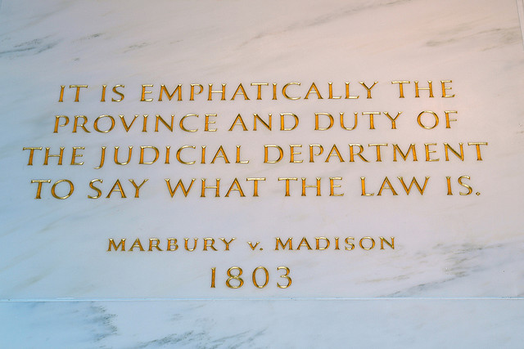
Significance of case???
This case established the principle of judicial review
The Supreme Court is the sole interpreter of the Constitution
It can declare laws unconstitutional
This greatly expands the power of the Supreme Court (Judicial Branch)
Helps establish the judicial branch as an equal branch to legislative and executive branches

Slide 7
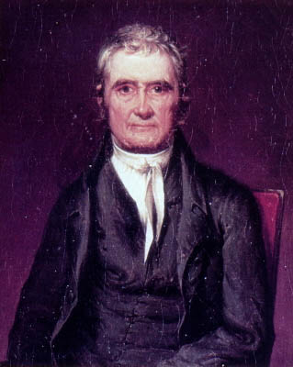
Who is John Marshall?
Chief Justice that presided over case
Served 34 years (1801 – 1835)
Ideas to remember with John Marshall
He helped increase the power of the Federal Government
Decisions helped promote business and the economy
Federal Government became more powerful at the expense of the state governments
Want more info on his cases?
APUSH Review: Key Court Cases Under John Marshall

Slide 8
Question to Ponder
How does judicial review affect the theory of nullification?

Slide 9
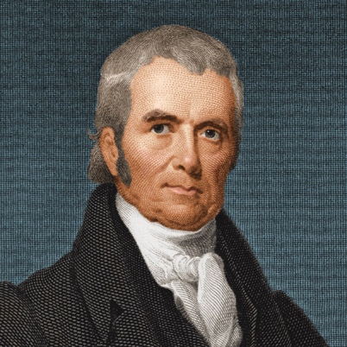
Thanks for watching!
Subscribe to my channel
Help spread the word
Questions? Comments? Ideas for videos?
Leave in comments
It would be unconstitutional NOT to subscribe.
Subscribe
Down here!

