Slide 1
APUSH Review: Schenck v. United States (1919)
www.Apushreview.com
Everything You Need To Know About Schenck v. United States To Succeed In APUSH

Slide 2
Key Ideas Before The Case
US entered World War I in 1917
Espionage Act of 1917:
  Made it illegal to interfere with military operations, including the draft
  Illegal “to cause … or incite … insubordination, disloyalty, mutiny, or refusal of duty, in the military or naval forces of the United States”
Sedition Act of 1918:
  Made it illegal to criticize the government

Slide 3
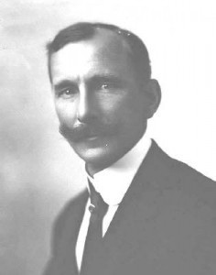
Who was Schenck?
Socialist that opposed the war
Schenck passed out flyers urging individuals to resist the draft
  Violation of the Espionage Act
  Schenck argued the Act violated the 1st amendment
Schenck appealed to the Supreme Court

Slide 4
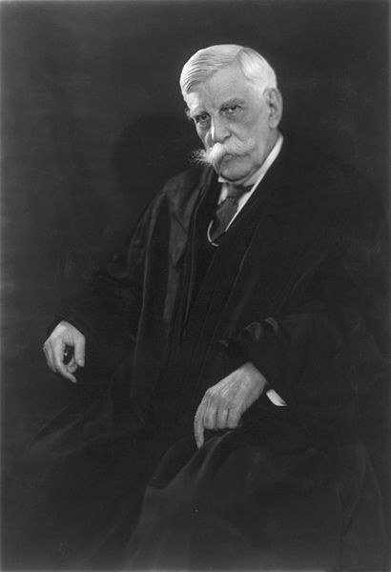
The Supreme Court decision
The most stringent protection of free speech would not protect a man in falsely shouting fire in a theatre and causing a panic. [...] The question in every case is whether the words used are used in such circumstances and are of such a nature as to create a clear and present danger that they will bring about the substantive evils that Congress has a right to prevent.
"The question in every case is whether the words used are used in such circumstances and are of such a nature as to create a clear and present danger that they will bring about the substantive evils that the United States Congress has a right to prevent. It is a question of proximity and degree. When a nation is at war, many things that might be said in time of peace are such a hindrance to its effort that their utterance will not be endured so long as men fight, and that no Court could regard them as protected by any constitutional right."
The Supreme Court unanimously agreed that Shenck broke the law
Justice Oliver Holmes, Jr.
Free speech does not allow you to yell fire in a theater
Does free speech allow you to yell theater in a fire hall?????

Slide 5
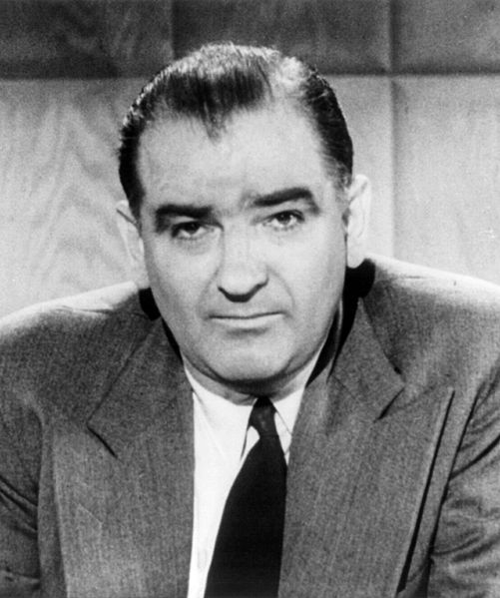
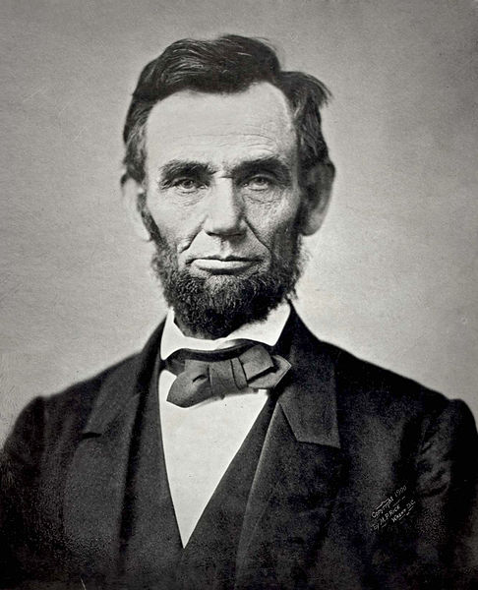
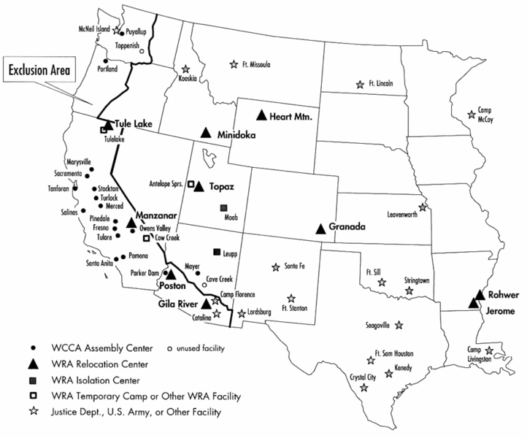
Effects of the Case
Redefined the 1st amendment
In times of war and crisis, personal liberties decrease
  Seen in:
    The Civil War – suspension of habeas corpus
    World War II – Internment Camps
    Cold War – 2nd “Red Scare”

Slide 6
Thanks for watching!
  Subscribe to my channel
  Help spread the word
Questions? Comments? Ideas for videos?
  Leave in comments
Who has the better mustache?
Subscribe
Down here!

