Slide 1
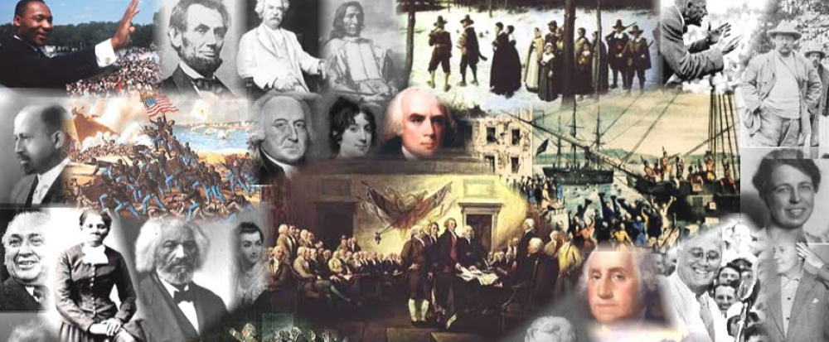
www.Apushreview.com

Slide 2
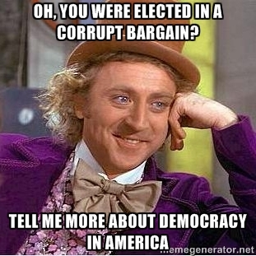
APUSH Review: The Corrupt Bargain
Everything You Need to Know About The Corrupt Bargain To Succeed In APUSH
Download a video guide for this and other videos at www.apushreview.com

Slide 3
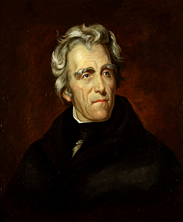
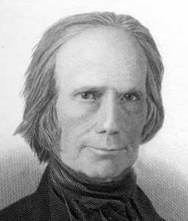
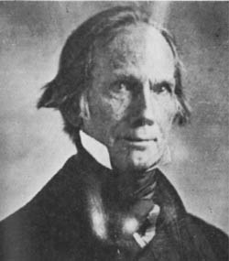
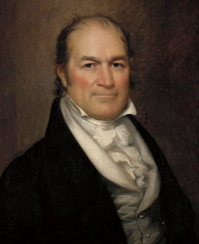
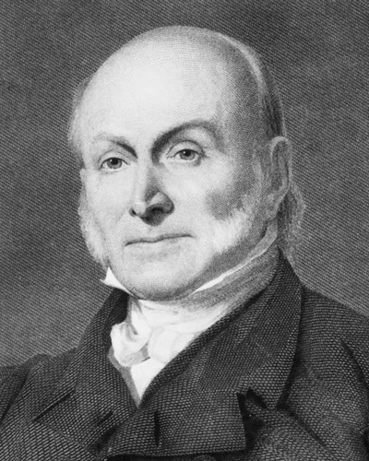
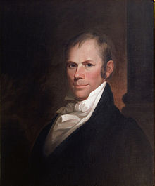
The Key Players
John Quincy Adams: (Massachusetts)
  Son of John Adams
  Secretary of State under Monroe
  Great Diplomat
Andrew Jackson: (Tennessee)
  Military hero from War of 1812
  Congressman and Senator
William H. Crawford: (Georgia)
  Secretary of Treasury
Henry Clay: (Kentucky)
  War Hawk from War of 1812
  Speaker of the House
  “American System”

Slide 4
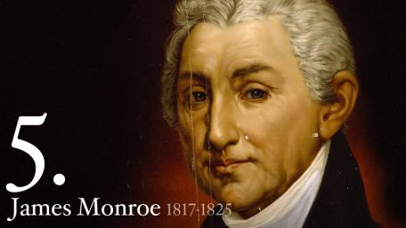
Background Info
James Monroe’s 2nd term would end in early 1825
Secretary of State was the “stepping stone” to the presidency
  Thomas Jefferson, James Madison, and James Monroe were all Secretaries of State
In the election of 1824, many candidates emerged

Slide 5
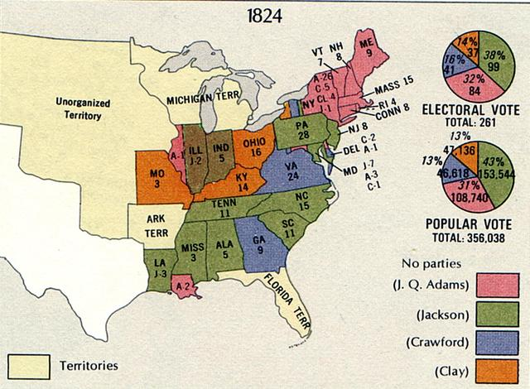
Election Results
Finishing order:
  Jackson receives the most popular and electoral votes (99)
  Adams received 2nd most electoral votes (84)
  Crawford finished 3rd with 41 electoral votes
  Clay finished 4th with 37 ☹
No candidate received a majority of electoral votes
  According to the Constitution (12th Amendment), if no candidate received a majority, the top 3 candidates would be voted on by the House
  Sorry Clay ☹
However, as Speaker of the House, Clay had tremendous influence

Slide 6
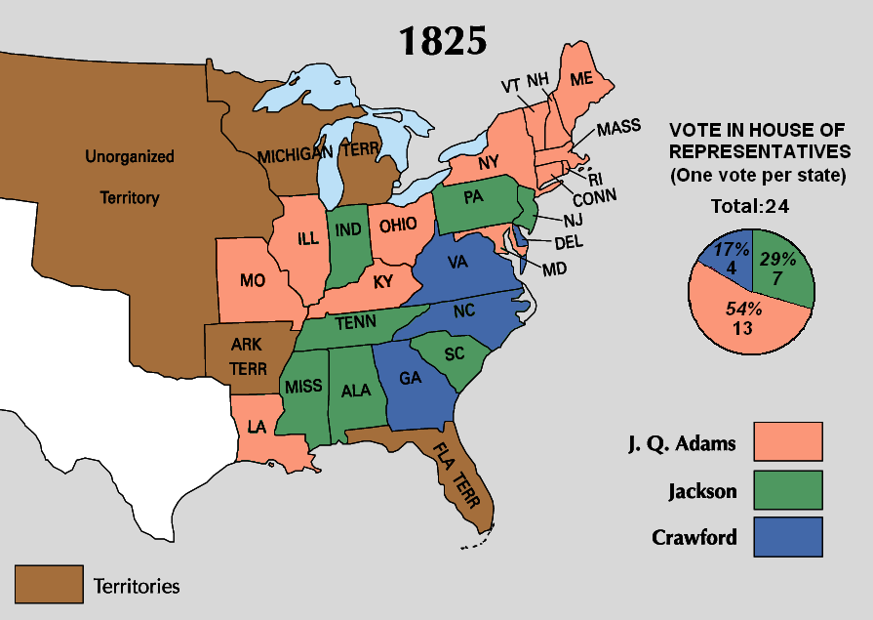
The “Corrupt Bargain”
In the House, each state would get one vote for president
Clay encouraged states to vote for Adams
  Considered Jackson a “military chieftan”
A few days after the House elects Adams, Clay becomes Secretary of State
  He hopes to be the next president
Jacksonian’s cry a “Corrupt Bargain”
This haunts Clay and Adams for the rest of their careers

Slide 7



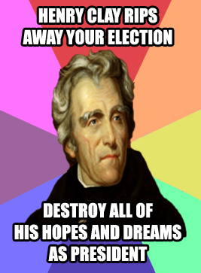
Thanks for watching!
  Subscribe to my channel
  Help spread the word
Questions? Comments? Ideas for videos?
  Leave in comments
Subscribe
Down here!

