Slide 1
APUSH Review: The Election of 1840
www.Apushreview.com
Everything You Need To Know About The Election of 1840 To Succeed In APUSH

Slide 2
Key Trends Before The election
Beginning in the 1820s, white, male suffrage increased drastically
  Elimination of property requirements
Eligible voter participation increased drastically throughout the 1820s and 1830s

Slide 3
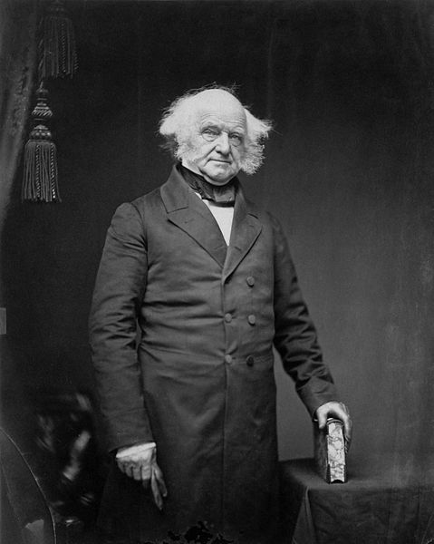
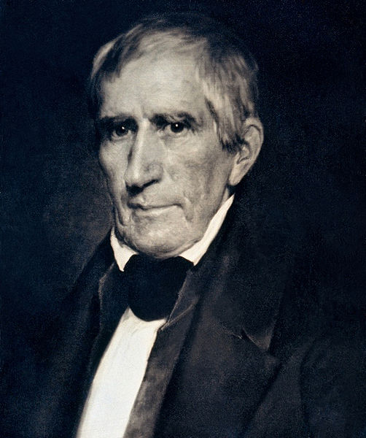
The Candidates in 1840
Democrats nominated Martin Van Buren
Whigs nominated “Tippecanoe and Tyler Too”
  William Henry Harrison was from the Battle of Tippecanoe from the War of 1812
  John Tyler was a former Democrat that disliked Jackson
Martin Van Buren was hurt by the Panic of 1837

Slide 4
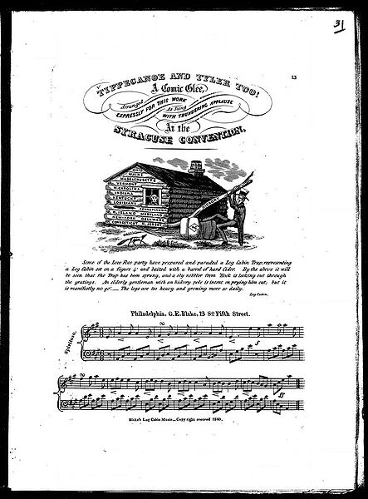
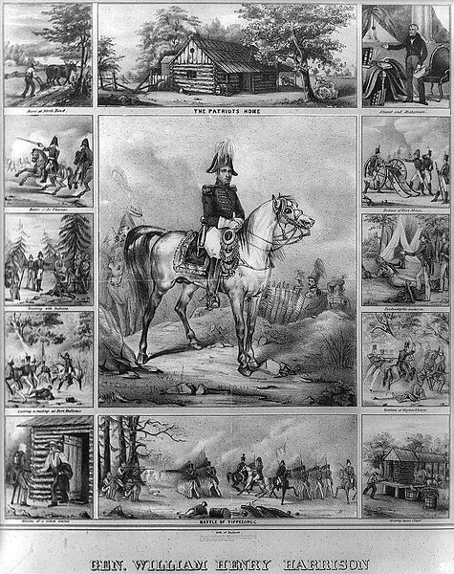
Campaigning in 1840
The Whigs portrayed William Henry Harrison as a poor man born in a log cabin
  In reality he was not poor
Slogans develop around the campaign
  “Log Cabins and Hard Cider”
  “Get the ball rolling”
  “Tippecanoe and Tyler Too”

Slide 5
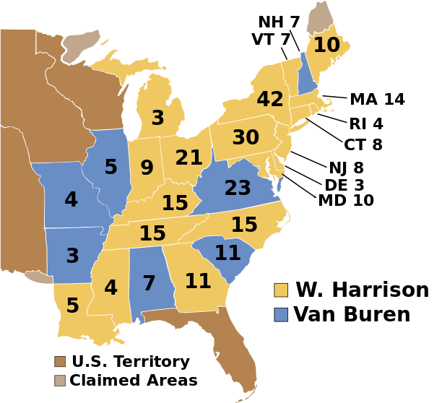
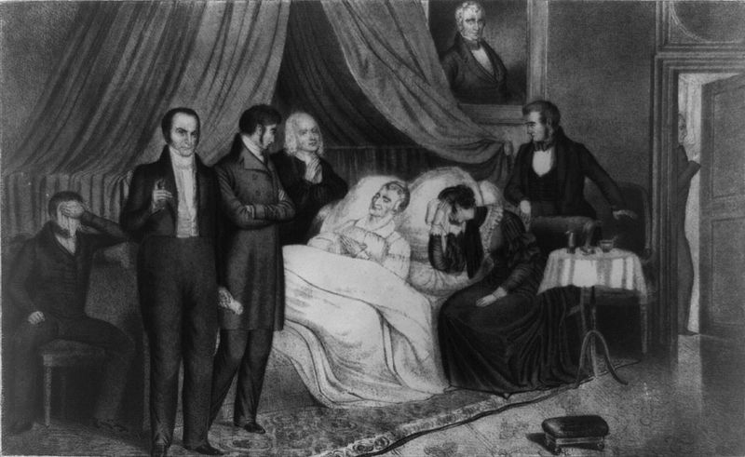
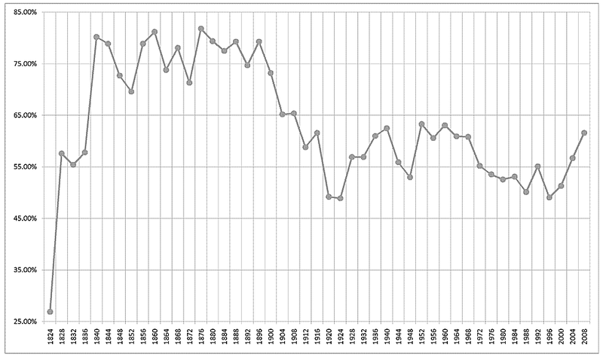
The Results and impact
William Henry Harrison defeats MVB
One of the largest turnouts of eligible voters in history
Slogans become popular for future elections
Harrison dies 30 days into office, Tyler becomes President
  Will feud with Whigs

Slide 6
Thanks for watching!
  Subscribe to my channel
  Help spread the word
Questions? Comments? Ideas for videos?
  Leave in comments
Please subscribe below!
Subscribe
Down here!

