Slide 1
APUSH Review: The Election of 1844
www.Apushreview.com
Everything You Need To Know About The Election of 1844 To Succeed In APUSH

Slide 2
Background Info
John Tyler (Whig in name, Democrat by ideology) is NOT running for re-election
“Manifest Destiny” is taking over the nation
Many in US want Texas to join the union
Check out They Might Be Giants’ “James K. Polk”

Slide 3
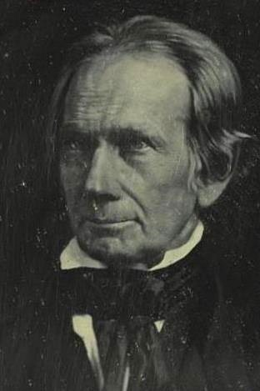
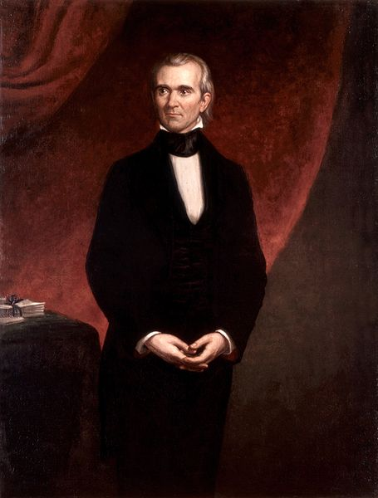
The Candidates
Woooohoooo. I’ll finally be President!
Nooooo?!?!?! Too Soon????
Democratic Candidate:
  Many different candidates vie for the nomination
  Eventually, they settle on a “Dark-horse” candidate
    James K. Polk – “Young Hickory”
      “54°40’ or Fight!”
Whig candidate:
  Henry Clay!
Most Americans (including Clay) thought Clay would win in a landslide…….

Slide 4
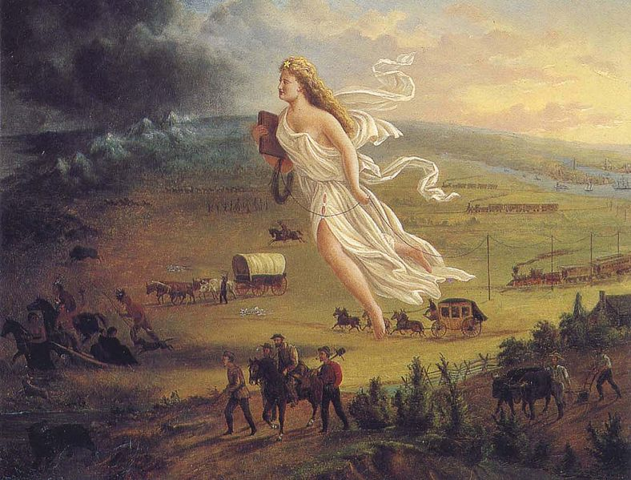
The Issues
Manifest Destiny
  Belief that it was America’s “God-given” right to expand from coast to coast
Texas
  Many Americans wanted Texas to join the Union (its own country)
  Polk favored the annexation
  Clay flip-flopped on the issue of Texas
Slavery:
  With Manifest Destiny and Texas, slavery was always in the forefront
Tariffs
  Polk advocated lowering the tariff rates (Democrat = Down)

Slide 5
The Results and Impact
Polk defeats Clay, 170 – 105
As a lame-duck president, Tyler pushes for the annexation of Texas
America completes Manifest Destiny under Polk’s administration
  Oregon Territory
  Mexican Cession

Slide 6
Thanks for watching!
  Subscribe to my channel
  Help spread the word
Questions? Comments? Ideas for videos?
  Leave in comments
Don’t I look like I’m from “Whoville?”
Subscribe
Down here!

