Slide 1
APUSH Review: Wilson’s 14 Points And The Treaty of Versailles
www.Apushreview.com
Everything You Need To Know About Wilson’s 14 Points And The Treaty Of Versailles To Succeed In APUSH

Slide 2
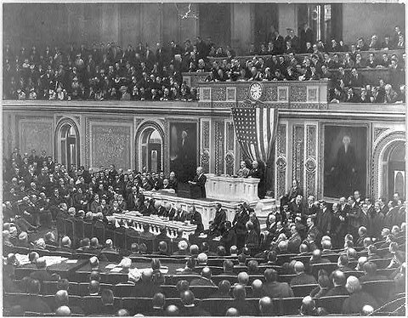
Wilson Vs. The World
Wilson’s two goals:
“A war to end wars”
“To make the world safe for democracy”
US and Europe had different views for post-WWI Europe

Slide 3
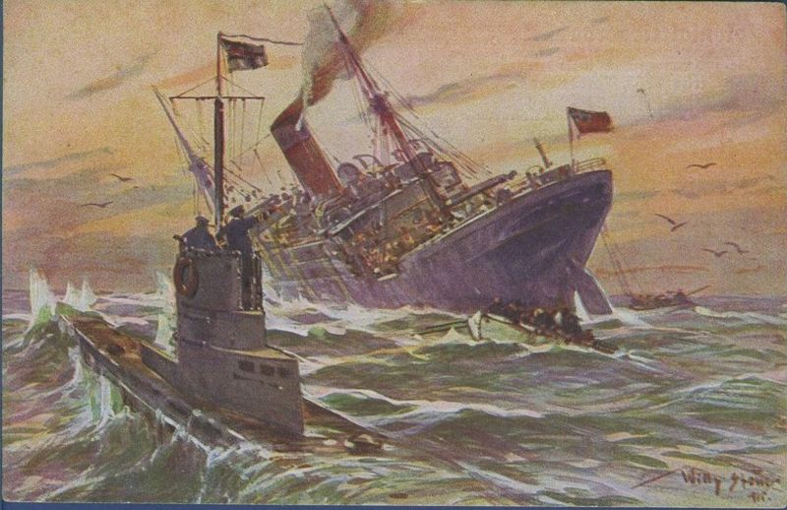
Wilson’s 14 Points
Delivered to Congress in 1918
1. Open covenants of peace, openly arrived at, after which there shall be no private international understandings of any kind but diplomacy shall proceed always frankly and in the public view.
No secret alliances
2. Absolute freedom of navigation of the seas, outside territorial waters, alike in peace and in war, except as the seas may be closed in whole or in part by international action for the enforcement of international covenants.
No unrestricted submarine warfare

Slide 4
Wilson’s 14 Points Continued
3. The removal, of all economic barriers and the establishment of equality of trade conditions among all the nations consenting to the peace and associating themselves for its maintenance.
Free trade (no tariffs)
4. Adequate guarantees given and taken that national armaments will be reduced to the lowest point consistent with domestic safety.
No Militarism
Democrats want to Decrease tariffs

Slide 5
Wilson’s 14 Points Continued
5. A free, open-minded, and absolutely impartial adjustment of all colonial claims, based upon a strict observance of the principle that in determining all such questions of sovereignty the interests of the populations concerned must have equal weight with the equitable claims of the government whose title is to be determined.
Reduce imperialism, self-determination
14. A general association of nations must be formed under specific covenants for the purpose of affording mutual guarantees of political independence and territorial integrity to great and small states alike.
Prelude to the League of Nations

Slide 6
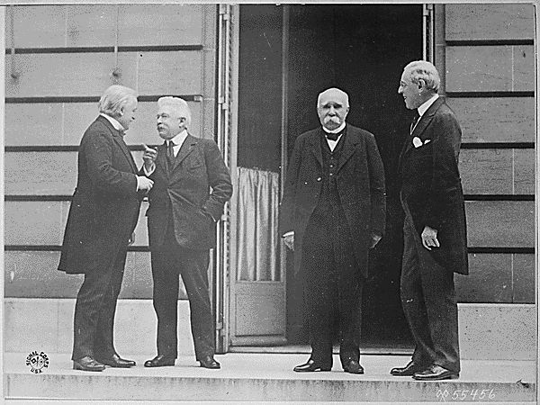
Conference at Versailles
Germany and Russia were excluded
US, France, GB, and Italy each had own goals
Article X:
Created the League of Nations
Article 231: “War Guilt Clause”
Germany must accept full responsibility for war
Some European countries gained self-determination, but not imperialized countries in Africa and Asia

Slide 7
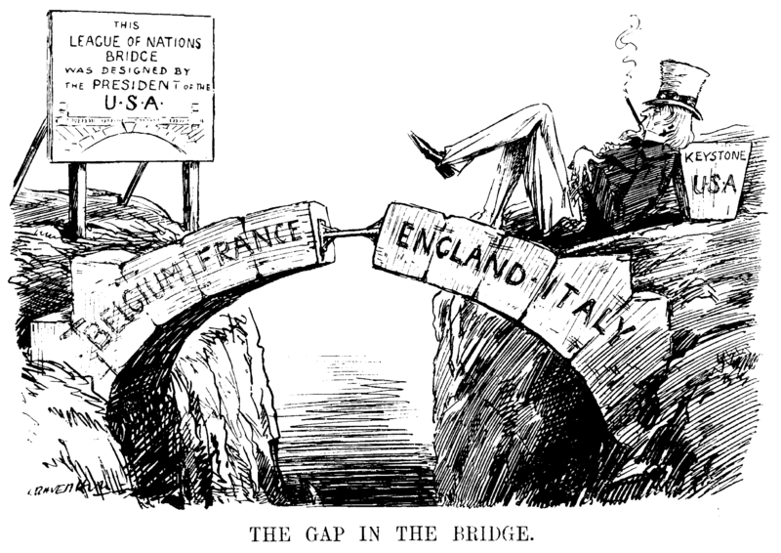
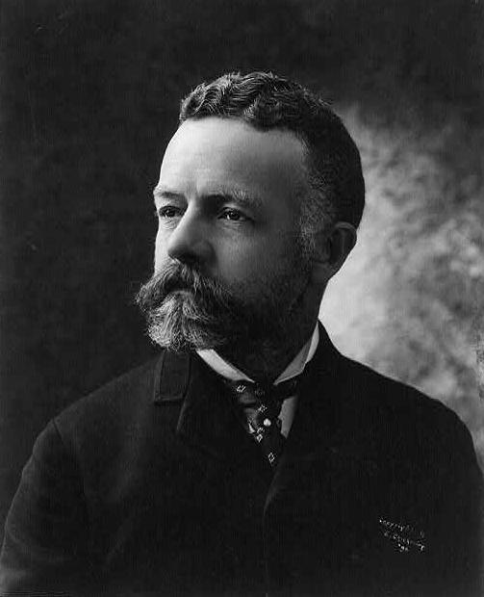
The Lodge Reservations
Henry Cabot Lodge (Republican Senator) was against the treaty
Wrote 14 reservations
Many senators detested Article X
Would get US involved in foreign entanglements
Take war-making decision out of Congress’ hands
Wilson went on a speaking tour across the country
“Irreconcilables” followed his tour
Senate never ratifies the treaty

Slide 8
Thanks for watching!
Subscribe to my channel
Help spread the word
Questions? Comments? Ideas for videos?
Leave in comments
I have no reservations about you subscribing.
Subscribe
Down here!

