Slide 1
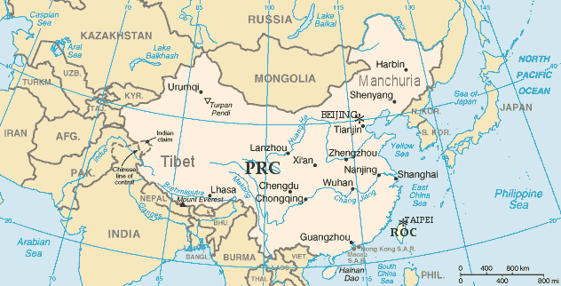
APUSH Review: US Foreign Policy, China Edition
Everything You Need To Know About Foreign Policy With China To Succeed In APUSH

Slide 2
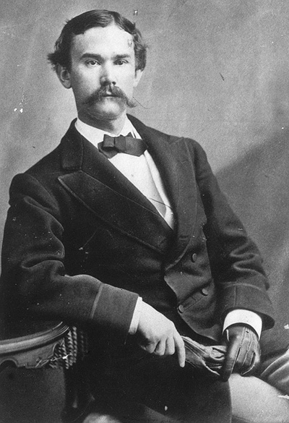
The Open Door Policy (1899)
Background Info:
  Mid-Late 1800s, Europe carved China into “Spheres of Influence”
  The US was afraid it could be shut out of China
What was the policy?
  Note by Secretary of State John Hay
  Urged Europeans to allow American businesses open access to China
This demonstrates the US’ desire for free trade in China

Slide 3
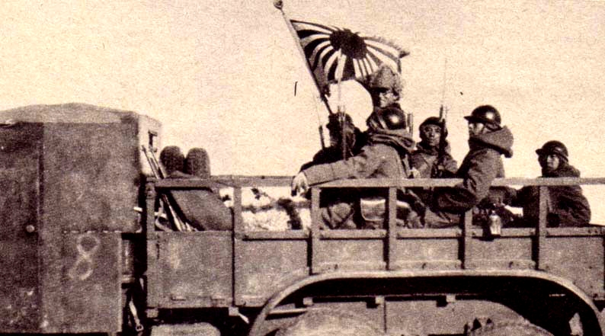
China In WWII
Japan invaded Manchuria in 1931
The US responded with the Stimson Doctrine:
  US would not recognize any Japanese territory gained by force

Slide 4
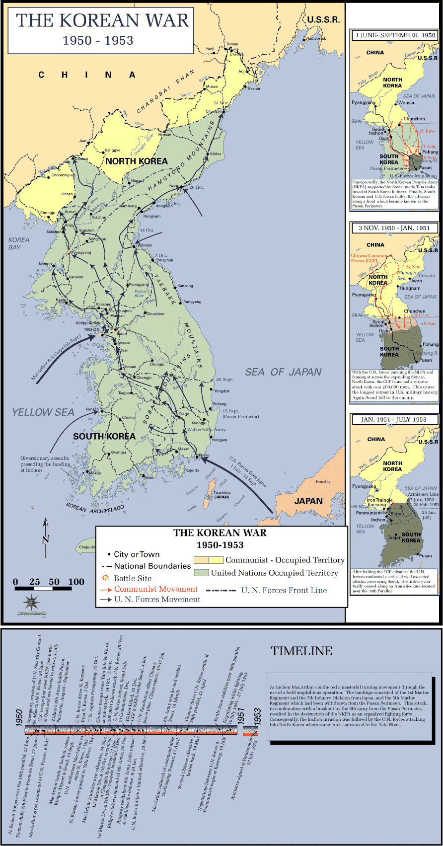
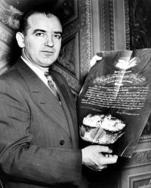
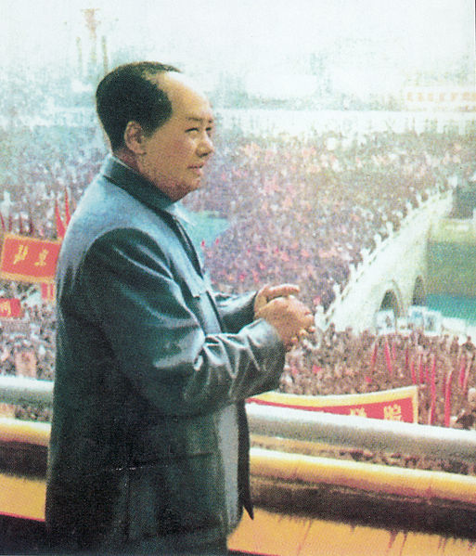
“Fall” of China (1949) And Korean War
Commie!!!
Mao Zedong and the Communists defeat the Nationalist party
  China becomes a communist nation
Impact on the US?
  Devastating blow to the Truman administration
  Fear that other countries could turn communist
  Helped contribute to the “Red Scare” in the US
Korean War:
  China sided with North Korea

Slide 5
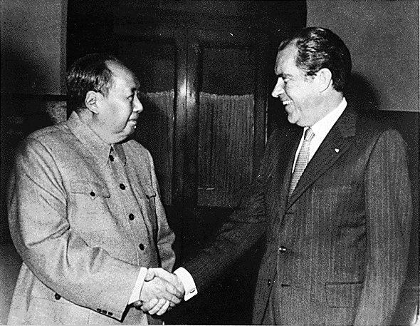
The Nixon Administration And China
Détente:
  Easing of Cold War Tensions
Nixon formally recognizes China
February 21, 1972:
  Richard Nixon traveled to China
  Improves trade with China

Slide 6


Thanks for watching!
  Subscribe to my channel
  Help spread the word
Questions? Comments? Ideas for videos?
  Leave in comments
I subscribed to Adam Norris!
Subscribe
Down here!
Me too!!

