Slide 1
APUSH Review: World War I (The Great War)
www.Apushreview.com
Everything You Need to Know About World War I To Succeed In APUSH

Slide 2
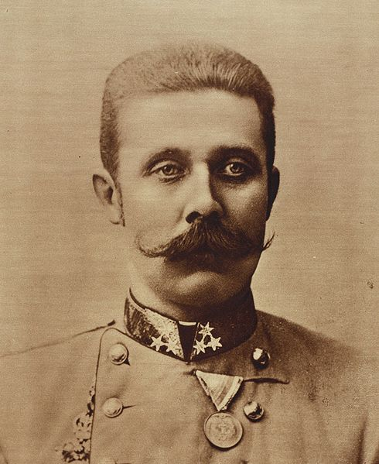
Causes Of The War
Militarism
  Countries built up their military
Alliances
  Secret alliances would drag countries into a conflict
Imperialism
  Countries competed for overseas colonies
Nationalism
  Desire to demonstrate the strength of each country
Assassination of Franz Ferdinand
  Heir to the Austrian throne
  Assassination set off a chain of events which started the war

Slide 3
The Two Sides
Allied Powers:
Central Powers:
France
Great Britain
Russia
Joined later
  US
  Italy
  Japan
Germany
Austria-Hungary
Ottoman Empire

Slide 4
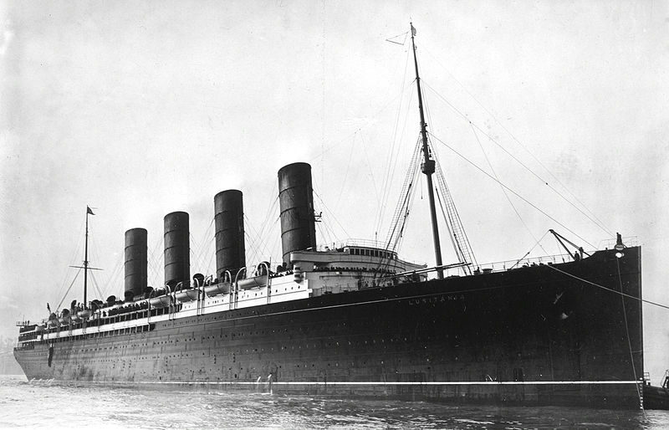
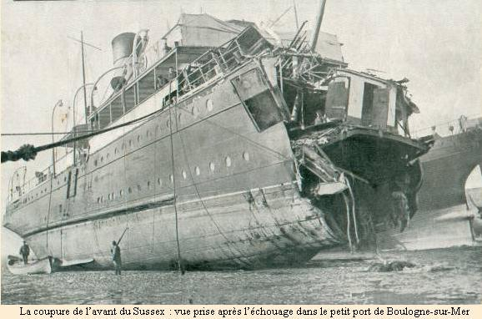
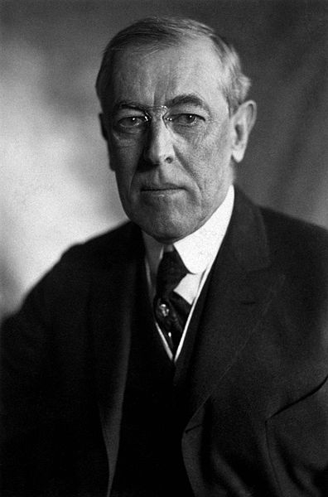
US Neutrality And Challenges
US sought to remain neutral
  Democratic slogan for Wilson for election of 1916, “He kept us out of war”
Lusitania (May 7, 1915)
  Passenger ship sunk by Germany, killing nearly 1,200 individuals, including over 100 Americans
  Germany claimed the ship had munitions (later determined to be correct)
Sussex Pledge:
  Germany damaged a French ship, the Sussex
  Germany promised not to sink merchant ships without providing a warning

Slide 5
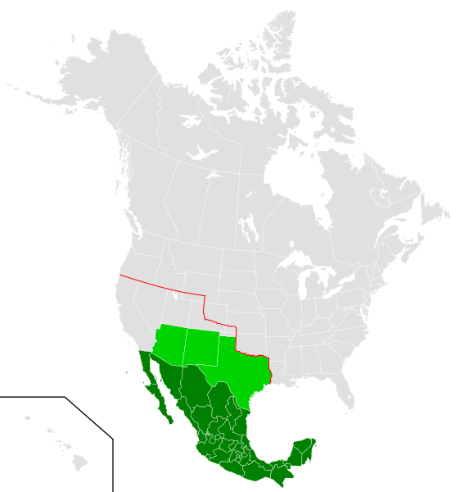
US Entrance Into The Great War
Unrestricted Submarine Warfare:
  Biggest cause for US entrance into the war
  Germany would sink all ships, including American
Zimmermann Telegram: (March, 1917)
  German proposal for an alliance with Mexico
  If Mexico attacked the US, Germany would help Mexico get land back in the SW US

Slide 6
Wilson’s 14 Points
Sought to make the world “safe for democracy”
Wilson outlined 14 ideas for post World War I World
  No secret alliances, freedom of seas, etc.
  Establishment of a League of Nations
Secret Alliances

Slide 7
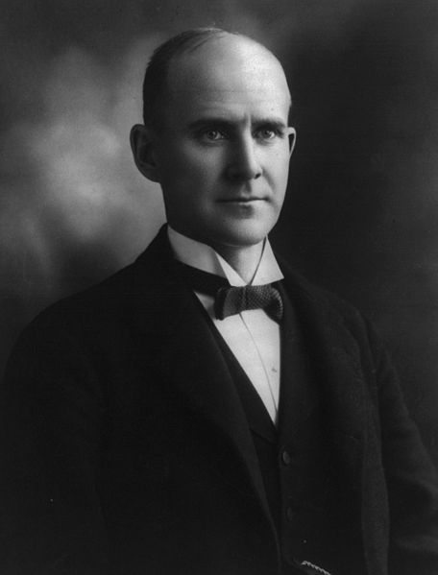
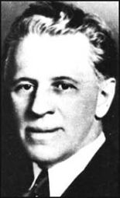
Domestic Issues During The War
Creel Committee:
  Journalist George Creel helped promote the war effort
  “Four-Minute Men” gave speeches throughout the US
Espionage Act of 1917:
  Sought to prevent interference with military operations (including the draft)
  Upheld by Schenk v. US in 1919
Sedition Act of 1918:
  Made it illegal to criticize the government
  Used to convict Eugene Debs

Slide 8
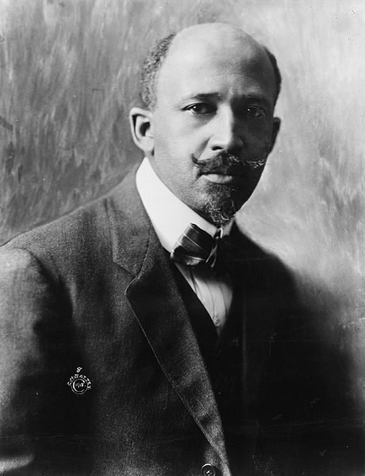
Women, African Americans, And Labor Unions During The War
Women:
  Women worked in factories and nurses
  Helped lead to the passage of the 19th Amendment
African Americans:
  Fought in segregated units, mostly did manual labor
  W.E.B. Du Bois supported the war – hoped for improved rights for African-Americans
Labor Unions:
  National War Labor Board:
    Helped oversea disputes
  AFL – led by Samuel Gompers
    Did not strike during war
  IWW – Industrial Workers of the World
    Nick-named “I won’t work”

Slide 9
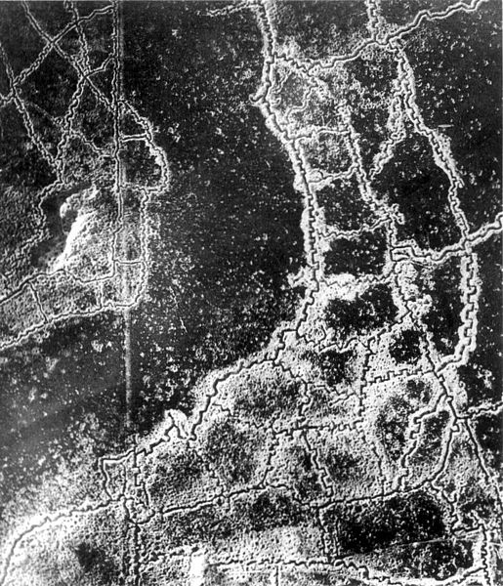
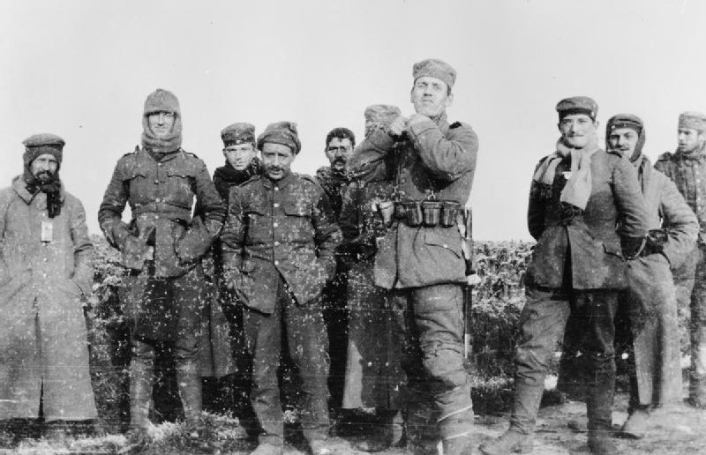
Fighting In The Great War
Trench Warfare:
  Most of the fighting occurred in man-made trenches
Christmas Truce:
  December 1914, fighting stopped
Chemical Warfare:
  Mustard Gas
Armistice agreement on November 11, 1918

Slide 10

Treaty Of Versailles
Article 231 punished Germany for starting the war
  “War-guilt” clause
League of Nations:
  Article X – called for members to give assistance to others if needed
    Congress detested this stipulation

Slide 11
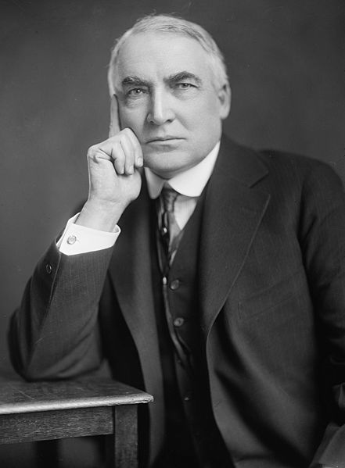
Effects Of The War
US reverts to isolation:
  Harding (1920) campaigned on a “Return to normalcy”
“Red Summer”
  Race riots in Northern cities – “Great Migration”
Fear of Communism:
  1st Red Scare
Increase in nativism

Slide 12
Thanks for watching!
  Subscribe to my channel
  Help spread the word
Questions? Comments? Ideas for videos?
  Leave in comments
Let’s stop the fighting and subscribe!
Subscribe
Down here!

