Slide 1
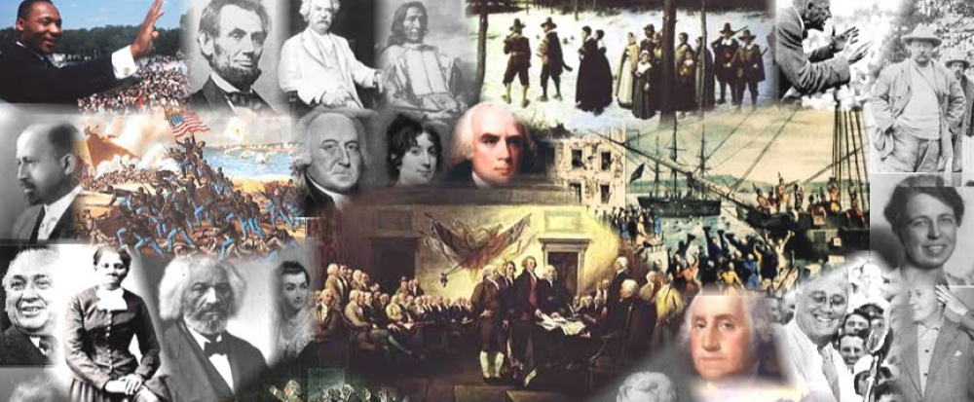
www.Apushreview.com

Slide 2
American History: Chapter 2 Review Video
Transplantations and Borderlands

Slide 3
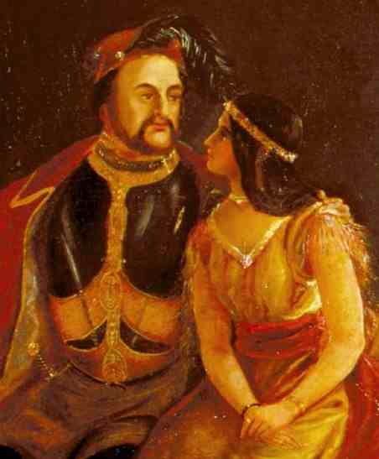
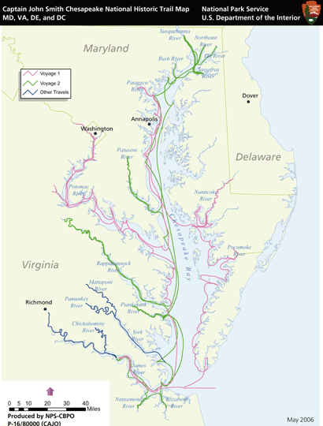
The Early Chesapeake
What is the Chesapeake?
  VA and MD
Jamestown:
  1607, first permanent English settlement
  Charter colony: group of individuals shared in profits and losses of colony
  “Starving Time”: Winter 1609 – 1610, fevers, deaths, etc.
  John Smith: helped save colony from starvation
Tobacco:
  Introduced by John Rolfe, hated by King James I
  Made $ for colonists, exhausted land, led to expansion, conflict with Natives
    Endless cycle

Slide 4
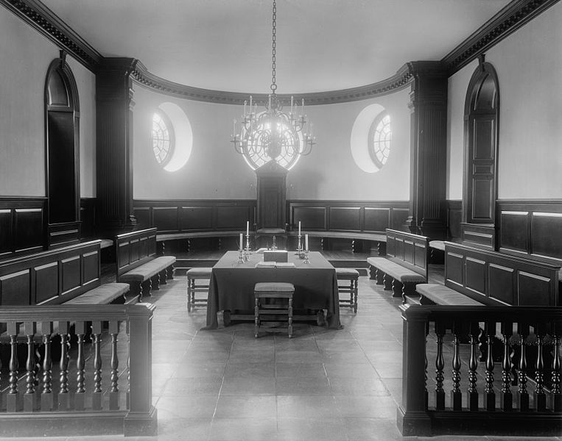
The Early Chesapeake Cont.
Expansion:
  Headright System:
    50 acres of land
    New settlers received 50 acres of land
    If someone paid the passage of an immigrant, the buyer would receive 50 acres (encouraged indentured servants)
1619: 2 Important Events
  House of Burgesses – elected representatives in VA
  1st group of Africans arrive in “America”
Conflict with Natives:
  Powhatan confederacy – no longer a threat by 1644

Slide 5
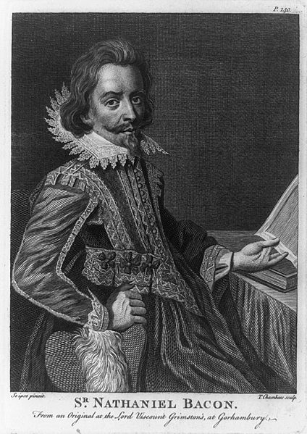
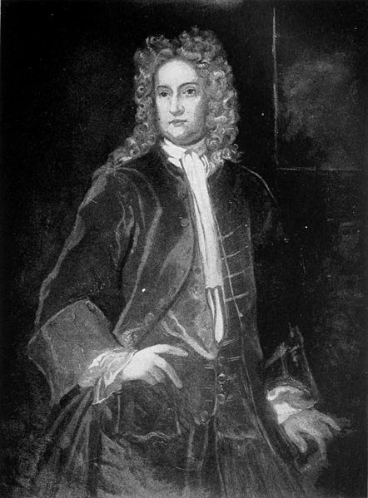
The Early Chesapeake Cont.
Stay over here farmers!
Don’t tell me where to go! Protect me and my followers from Native Americans.
Maryland:
  Founded by the second Lord Baltimore
  Fared better than early Virginians did
  Act of Toleration – Freedom of worship to all Christians
Bacon’s Rebellion (Virginia – 1676)
  Gov. Berkeley did not allow settlement past a line
  In the “west” many famers were underrepresented in the House of Burgesses
  Conflict between Natives and “westerners” like Bacon
  Bacon almost took control, died suddenly
  Significance?
    Movement towards slaves for labor
    Shows tensions between rich and poor, East and West

Slide 6
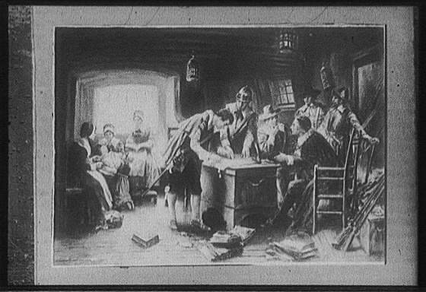
The Growth of New England
Plymouth:
  Pilgrims were Separatists – wanted to break away from the Anglican Church
  Mayflower Compact – established a government led by majority rule
  Relations with Natives – many Natives died a few years before from disease; Natives taught colonists to farm and hunt
  William Bradford – governor of Plymouth

Slide 7
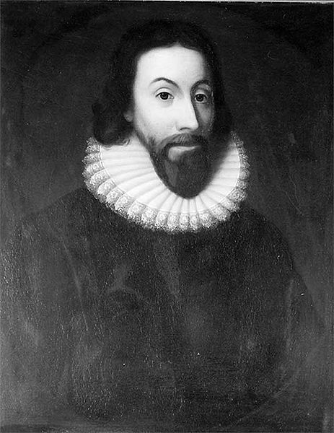
The Growth of New England Cont.
Puritans:
  King Charles I (early 17th century) began to target Puritans (wanted to purify the Church of England, not break away)
  1629 – led by John Winthrop, they received a charter and eventually settled in Massachusetts Bay
Puritan beliefs:
  Predestination, focus on reading the Bible – led to schools
  “City upon a hill”
  Church members were the only people allowed to vote or hold a political office
  Did not extend religious freedom to others

Slide 8
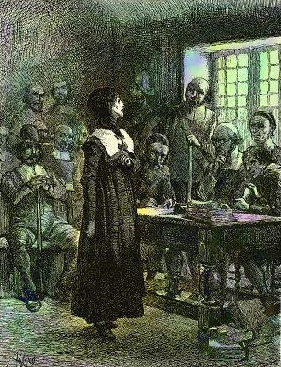
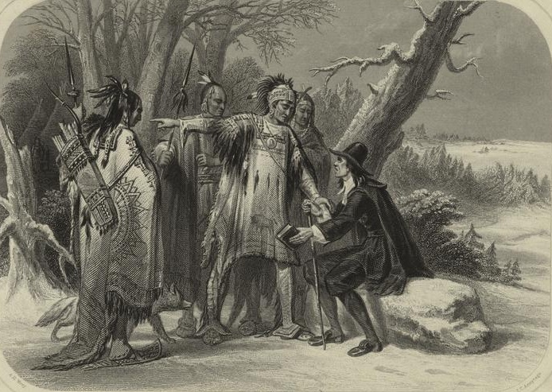
The Growth of New England Cont.
I was banished because I challenged the clergy and thought women should have more rights.
Thomas Hooker:
  Founded Connecticut; established a constitution, Fundamental Orders
Roger Williams
  Extreme Separatist, wanted MBC to completely break away from the Church
  Also advocated separation of church and state and payment to Natives for land
  Banished to RI
    All religions could worship
Anne Hutchinson:
  Challenged the power of clergy, and rights of women
  After her banishment, many churches restricted women’s rights further

Slide 9
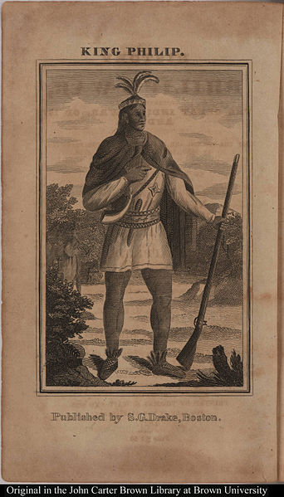
The Growth of New England Cont. – Native American Conflcts
Pequot War:
  Conflict over land and trade, Peqouts were decimated
King Philip’s War:
  Started over land, lasted several years
  Eventually the whites won, Wampanoag’s were weakened

Slide 10
The Restoration Colonies
Carolina:
  Similar to MD, headright system, religious toleration to all Christians
  North: poorer farmers, isolated
  South: wealthy plantations, aristocratic, trade with Barbados -> slavery
NY: originally belonged to the Dutch, various groups, some religious toleration and local governments
NJ: Was a proprietor colony, becomes a royal one
  Most citizens were small farmers

Slide 11
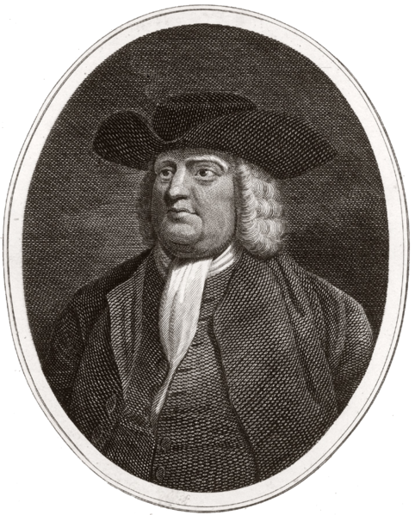
The Restoration Colonies Cont.
I wanted to make money and allow people to practice their religion freely.
Quakers:
  Believed in an “inner light”
  All could attain salvation, did not favor predestination
  Women had many rights in church – could become preachers, speak publicly
  Pacifists, no paid clergy
William Penn:
  Founded PA as a proprietor colony
  Paid Native Americans for their land
  “Holy experiment” – toleration of many religious groups

Slide 12

Borderlands and Middle Grounds
Caribbean Islands:
  Sugarcane became the most important crop – slave labor
  Harsh slave codes
  Important trading partner with British North America
Spanish in North America:
  Favored converting Natives to Christianity
  Enlisted them as trading partners
  Intermarried

Slide 13
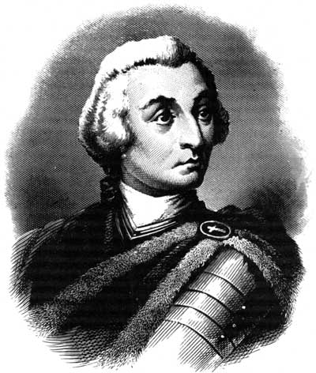
Borderlands and Middle Grounds Continued
Georgia:
  Founded by James Oglethorpe as:
    A border against the Spanish
    Haven for debtors and poor
  Originally excluded Africans, slavery, and Catholics
  Later, GA began to develop when slavery was introduced, instituted plantations modeled after SC
French settled in the interior of N.A., beneficial relationship with Natives

Slide 14
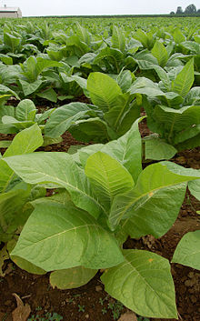
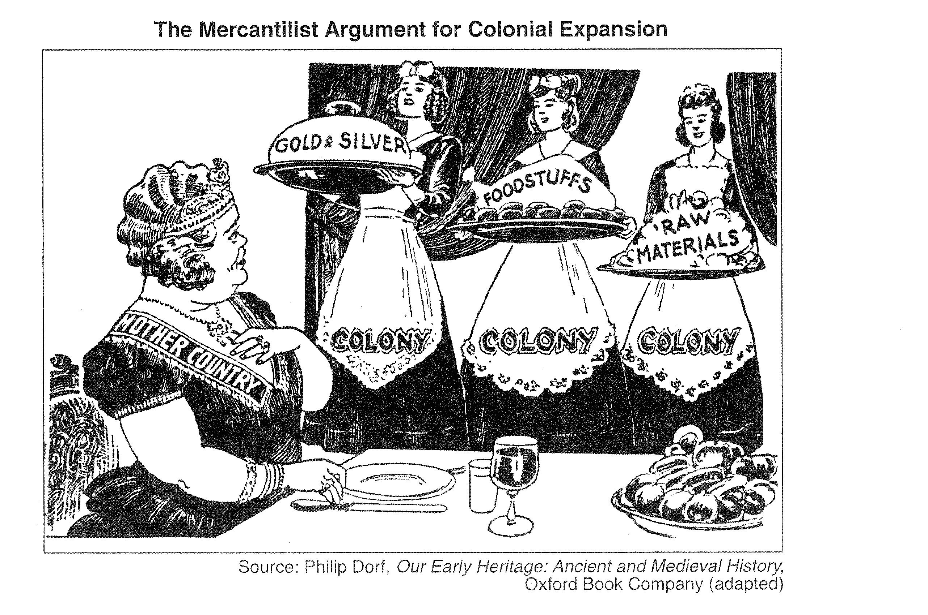
The Evolution of the British Empire
Mercantilism:
  Colonies exist for the benefit and wealth of the mother country
Navigation Acts:
  Colonists could only trade with England
  Colonists could only ship certain goods (enumerated articles) to England - tobacco
Benefits of Navigation Acts on colonies?
  Shipbuilding blossomed, growth of lumber and iron industries

Slide 15
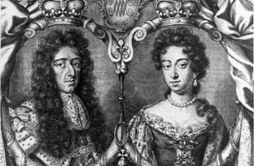
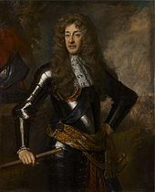
The Evolution of the British Empire Cont.
See ya Dad, I’m in charge now…. OK, half in charge.
Dominion of England:
  Created by James II, combined the control of several colonies under Sir Edmund Andros
  Andros strictly enforced the Navigation Acts, hated by many colonists
Glorious Revolution:
  James II is overthrown, William and Mary installed as joint rulers
  Andros and the Dominion of England were overthrown
  MA and Plymouth combined as a royal colony
Jacob Leisler:
  Overthrew NY leader Francis Nicholson
  Demonstrated tensions between lower class and wealthy

Slide 16
The Evolution of the British Empire Cont.
Impact of Glorious Revolution?
  Colonists successfully resisted some English policies
  Strengthened their belief that England should consider their views

Slide 17
Past Essay Topics
Compare and contrast the ways in which economic development affected politics in Massachusetts and Virginia in the period from 1607 to 1750. (2005)
In what ways did ideas and values held by Puritans influence the political, economic, and social development of the New England colonies from 1630 through the 1660s? (DBQ, 2010)

Slide 18

That’s it!
  Subscribe to my channel
  Help spread the word
Questions? Comments? Ideas for videos?
  Leave in comments
If only I subscribed, I might not have been overthrown….
Subscribe
Down here!

