Slide 1
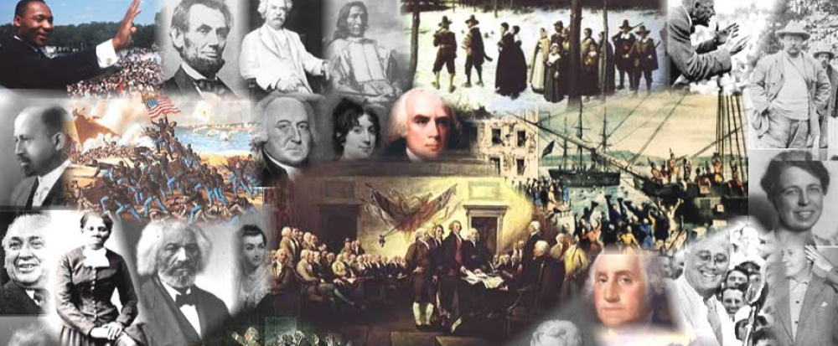
www.Apushreview.com

Slide 2
American History: Chapter 3 Review Video
Society and Culture in Provincial America

Slide 3
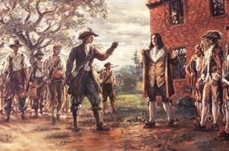
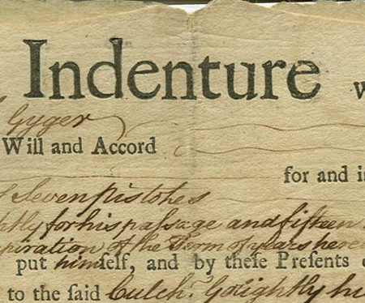
The Colonial Population
Indentured servants:
  ¾ of Chesapeake immigrants in 17th century
  Served 4-5 years of labor in exchange for passage
Factors that promoted indentured servants:
  Native population did not make good laborers
  Headright system
    50 acres of land
Decline of indentured servants:
  Indentured servants would become free
  Bacon’s Rebellion

Slide 4
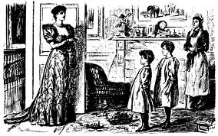
The Colonial Population Cont.
Women and Families in the Colonies:
  Chesapeake:
    High mortality rate affected traditional families
    High birth rate for married women (every 2 years)
  New England:
    Family was more stable than South – lower death rate
    Close-knit families were common
    Puritanism played a large role in daily life
  Similarities?:
    Fewer rights then men
    Had many children

Slide 5
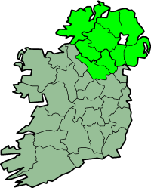
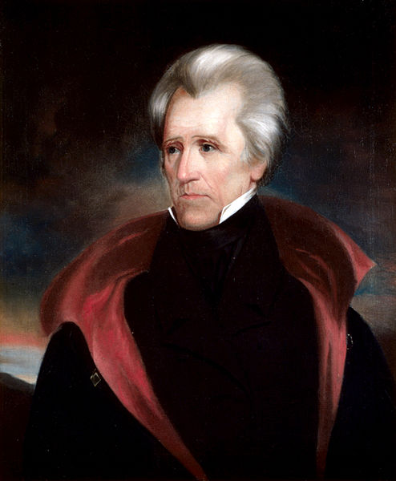
The Colonial Population Cont.
Province of Ulster
Beginnings of Slavery:
  11 million Africans were forced to come to the Americas
  “Middle Passage”
  Mid-1690s: Royal African Company of England lost their monopoly on the slave trade
  Slave Codes: laws that regulated the behavior of slaves
    Marriage, reading, etc.
Changing Sources of European Immigration:
  French, German, Irish, Scottish, etc. begin to emigrate in large numbers
    Edict of Nantes
      Allowed Huguenots (French Protestants) to practice their religions
    Germans settled in Pennsylvania
    Scotts-Irish settled in North Carolina, especially on the “frontier”
      Largest group in the 18th century

Slide 6
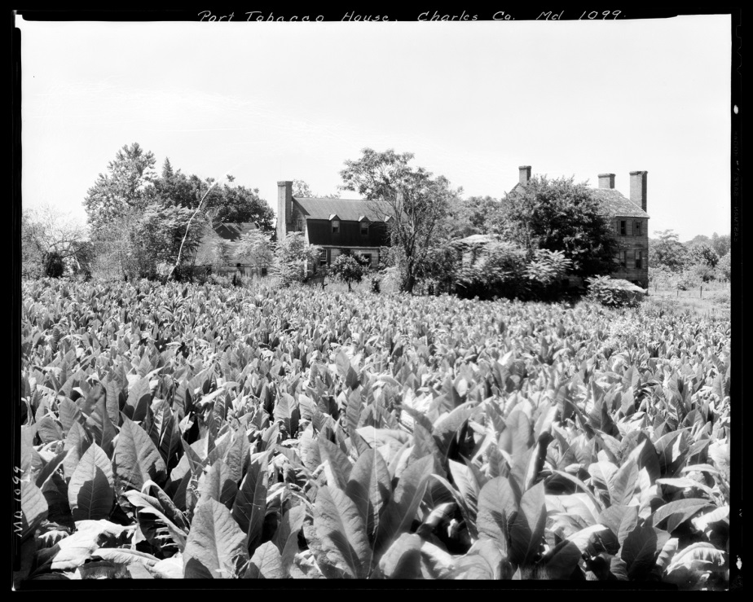
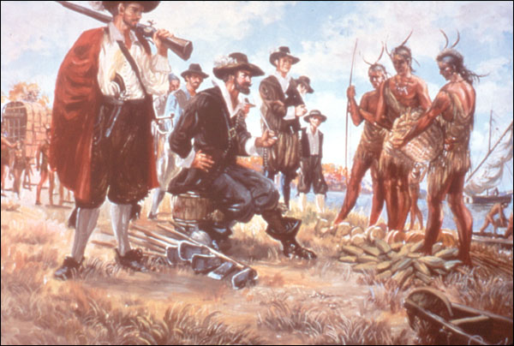

The Colonial Economies
Similarities between regions:
  Farming was common throughout
  Trade with Natives
Southern Economy:
  Tobacco in the Chesapeake:
    More tobacco = more land
    Demand caused problems of overproduction in 1640s
  GA and SC = rice
    Harsh conditions, many whites refused to do
  SC = indigo
    Important dye
  Farms and plantations dominated the South, so few cities developed

Slide 7

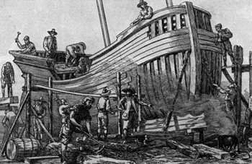
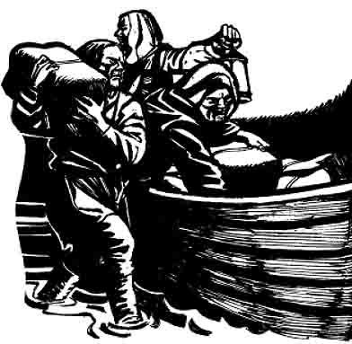

The Colonial Economies Cont.
Northern Economic and Technological Life:
  Large-scale farming did not develop in NE
    Colder climate, rocky terrain
  Middle Colonies (NY, PA) produced wheat
  Commercial economy was important
  New industries grew by 1650s:
    Lumbering, mining, fishing, ship building
The Rise of Colonial Commerce:
  Most colonists did not have specie
    (gold or silver)
  Commerce based on barter
  “Triangular Trade:”
    Interaction between Europe, Africa, and the Americas
    British Navigation Acts required colonists to only trade with Britain
      Colonists got around these laws by SMUGGLING!

Slide 8
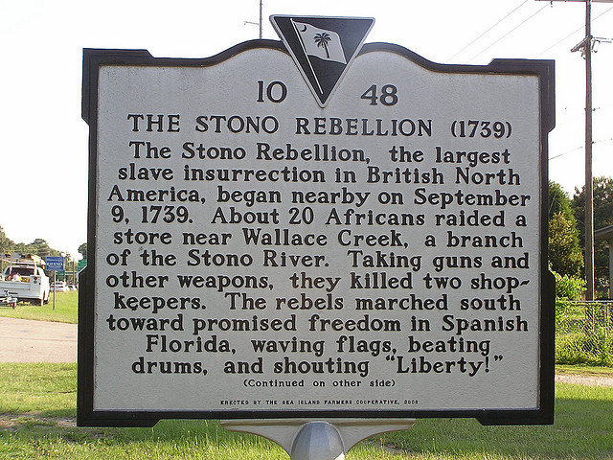
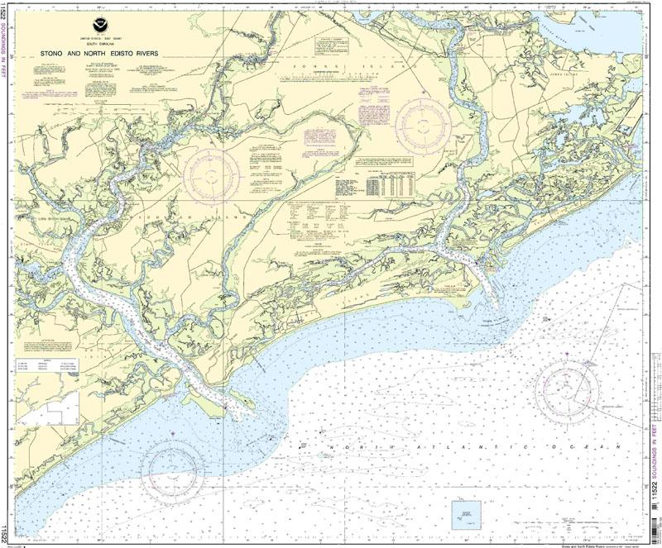
Patterns of Society
In England, most people did NOT own property; not the case in the colonies
The Plantation:
  Started in the Chesapeake – tobacco
  Plantations were far from towns -> different governments than in NE
  Large plantations may have provided schools and chapels
Plantation Slavery:
  Most slaves lived on large plantations
  Slaves developed a unique culture, religion, and family structure
  Stono Rebellion:
    SC – 1739, 100 Africans revolted, stole weapons, killed many whites
      As a result, laws became more strict regulating slaves
    Most slaves resisted slavery by running away

Slide 9
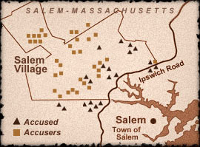
Patterns of Society Cont.
The Puritan Community:
  Town played a large role in daily life
    Divided up land, provided fields
    Town meeting – yearly elections (males, landowning, church members)
  “Halfway Covenant” – increased church membership, but sacrificed religious purity
Salem Witch Trials
  Hysteria throughout MA
  Accused tended to be wealthier, widowed, and middle-ages
  Reflected religious and social tensions
    Most of the accused were “independent” which challenged Puritan society

Slide 10
Patterns of Society Cont.
Cities:
  Philly and NY had over 25,000 by late 1700s
  Emerged as trading centers
  Established government
  New ideas emerged and spread
Inequality:
  Wealthy had increased power in churches and society
  Men had more power than women

Slide 11
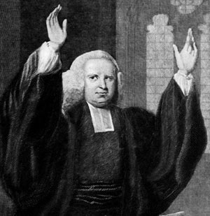
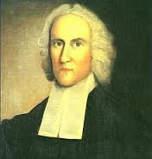
Awakenings and Enlightenments
Tensions between Protestants and Catholics (New France)
RI: Jews could worship freely
Westward expansion led to a decrease in power of church
The Great Awakening:
  1730s – 1740s, everyone can develop a new relationship with God
  George Whitefield and Jonathan Edwards
  “New Lights” v. “Old Lights”
  New sects, or branches, emerge
The Enlightenment:
  Movement away from religion
  Reason, not faith, could find knowledge
  Helped undermine the power of traditional authority
    John Locke
Sinners In The Hands Of An Angry God

Slide 12



Awakenings and Enlightenments Cont.
Education:
  MA law required every town to have a public school (1647)
    Influence of close proximity and religion
  Literacy rates were high among white males
  In most (all) instances, slaves were prohibited from reading
  Prior to 1763, 4 out of 6 colleges were founded as schools for preachers
The Spread of Science:
  Lightning Rod
  Inoculation of small pox
Concepts of Law and Politics:
  John Peter Zenger Trial
    Criticism of government officials was legal, if they were true
  Colonial governments enjoyed self-government
    Colonial legislatures were powerful
    Salutary Neglect – colonists were left alone, as long as they were profitable

Slide 13
Past Essay Topics
“Geography was the primary factor in shaping the development of the British colonies in North America.” Assess the validity of this statement for the 1600s. (2005 Form B)
Analyze the origins and development of slavery in Britain’s North American colonies in the period 1607 to 1776. (2011)

Slide 14

That’s it!
  Subscribe to my channel
  Help spread the word
Questions? Comments? Ideas for videos?
  Leave in comments
Subscribe
Down here!

