Slide 1
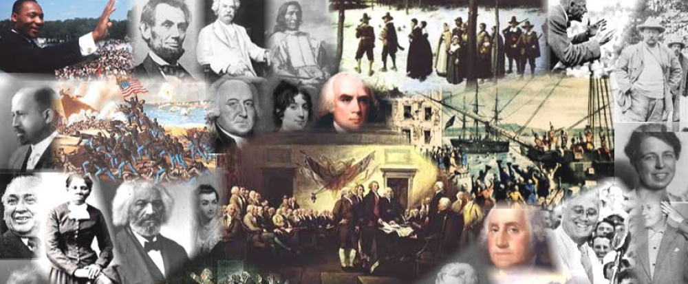
www.Apushreview.com

Slide 2
American History: Chapter 4 Review Video
Society and Culture in Provincial America

Slide 3
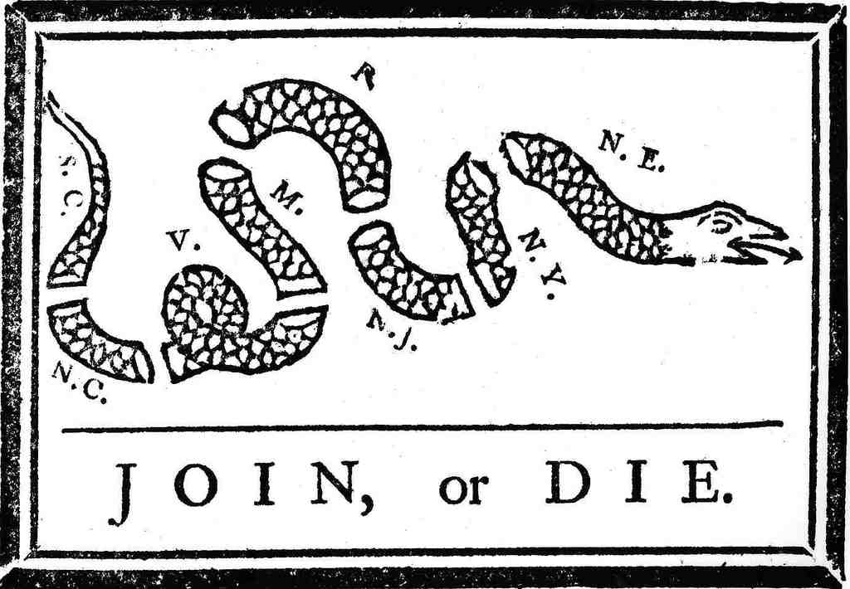
Loosening Ties
Salutary Neglect:
  PM Robert Walpole did not strictly enforce the Navigation Acts
Many colonists saw each other as foreigners – lack of permanent colonial unity
Albany Congress:
  Purpose was to form a treaty with the Iroquois
Albany Plan of Union
  Approved by delegates, rejected by colonies
  “Join or Die”

Slide 4
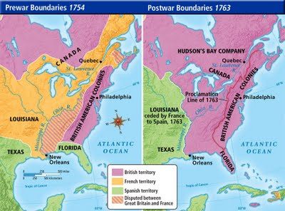
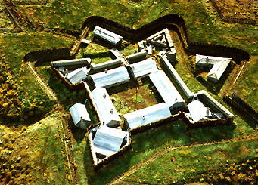
The Struggle For The Continent
French and English competed for Native loyalties:
  France was more tolerant, England had more goods
F&I (7 Years War)
  Started by George Washington (Fort Necessity) near Fort Duquesne
  Both the colonists and British fought the French
    Colonists not respected (lack of promotions)
Peace of Paris (1763)
  France is essentially removed from North America
Effects of the F&I War:
  Britain is in debt
  Needs $$$$$$

Slide 5
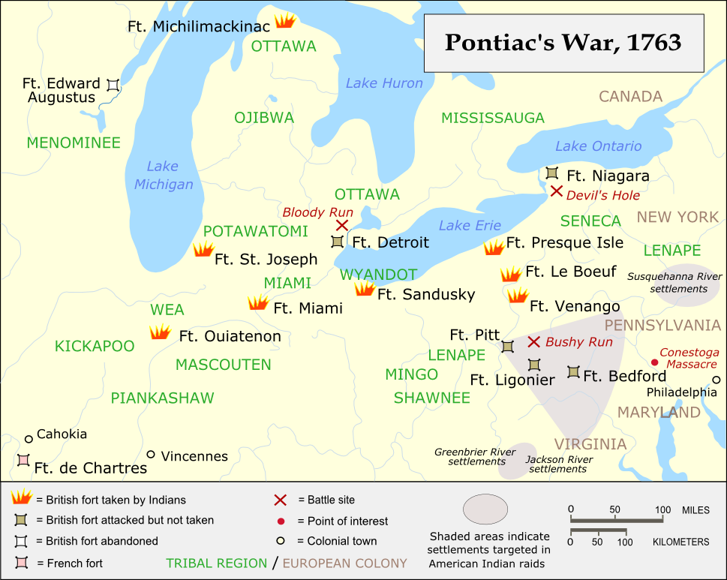
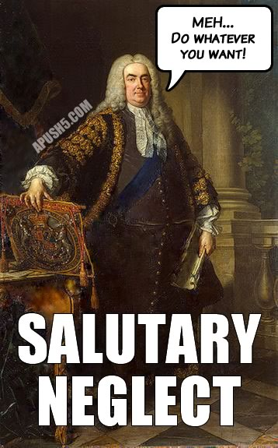
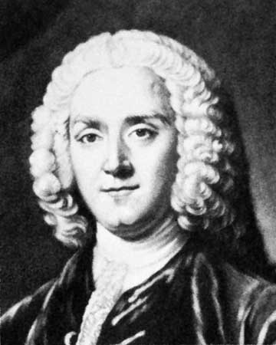
The New Imperialism
1763 – end of salutary neglect
  Britain began taxing the colonies
George Grenville:
  New PM, felt that colonists should help pay cost of war
Pontiac’s Rebellion (1763)
  Conflict in NW Territory
  Leads to the Proclamation Line of 1763
    Forbade colonial expansion beyond Appalachians

Slide 6



The New Imperialism Cont.
Sugar Act (1764):
  Tax on sugar to reduce illegal trade
  Vice-admirality courts
Currency Act (1764):
  Colonists could no longer use paper money
Stamp Act (1765):
  Tax on 50 paper documents
  Colonists were upset tax was passed without the consent of colonial assemblies
  Led to….

Slide 7
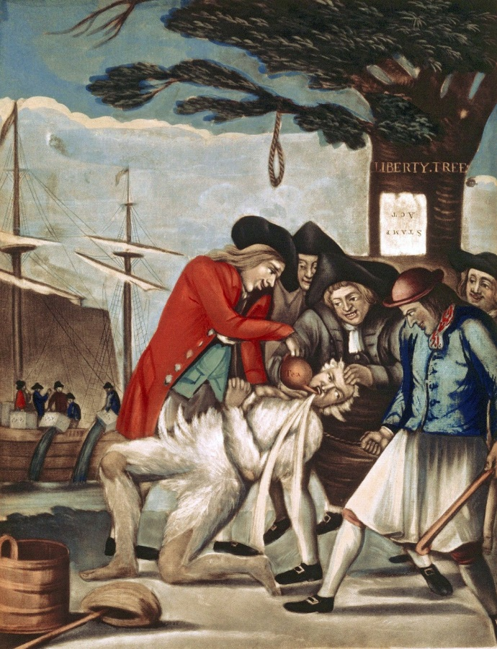
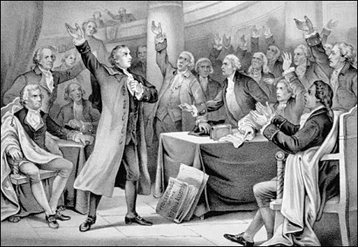
Stirrings Of Revolt
The Stamp Act Congress:
    First attempt at colonial unity AGAINST the British
Patrick Henry and the Virginia Resolves
  Belief that Americans had same rights as English
  Virginians should only pay taxes that were passed by the Virginia Assembly
James Otis:
  Called for an “intercolonial congress” to take action against the Stamp tax
Sons of Liberty:
  Terrorized Stamp tax collectors

Slide 8
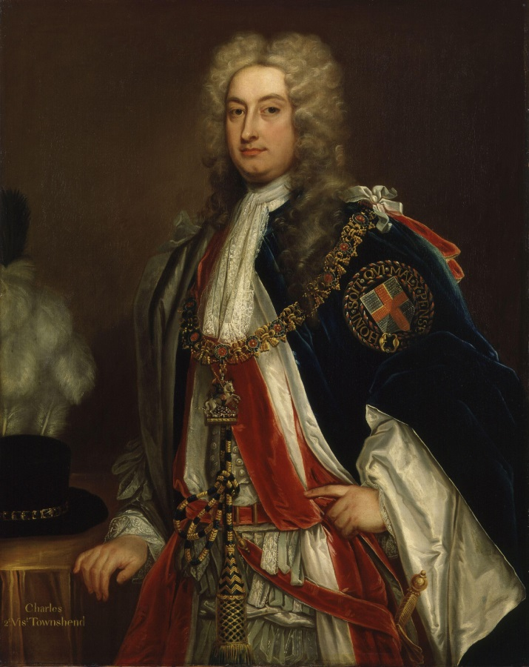
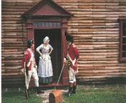
Stirrings Of Revolt
Declaratory Act:
  Passed after the repeal of the Stamp Act
  Stated Parliament could pass any laws whatsoever
Charles Townshend:
  Chancellor of the exchequer
Quartering Act of 1765:
  Colonists must provide quarters and supplies for British Troops
  NY Assembly was disbanded for not complying
Townshend Duties:
  Tax on imports (lead, paint, paper, and tea)

Slide 9
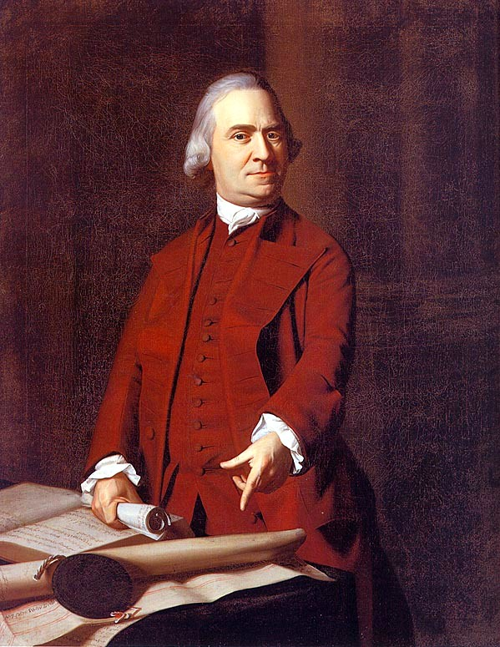
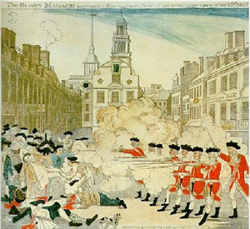
Stirrings Of Revolt
Nonimportation Agreements:
  Boycotts of British goods
  Growth of an American homespun movement
In 1770, all Townshend duties were repealed, except for the tea
Boston Massacre (March 5, 1770):
  Conflict between colonists and Redcoats
  5 colonists were killed
  Paul Revere’s engraving
Samuel Adams:
  Lead revolutionary, proposed Committees of Correspondence in 1772

Slide 10

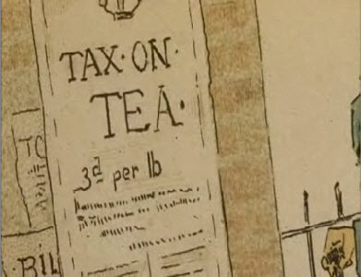
Stirrings Of Revolt
The Tax Issue:
  Americans believed that they should only be taxed with their consent
    “No taxation without representation”
  England believed in “Virtual Representation”
The Tea Issue:
  British East India Company was on the verge of bankruptcy
  Tea Act of 1773:
    Lowered the cost of tea, but was designed to bail out the British East India Company
    Angered colonists because they were against ALL British taxes

Slide 11
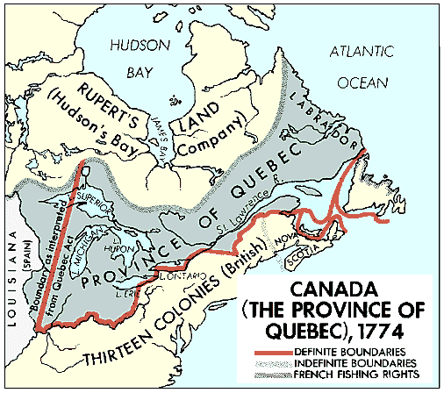
Stirrings Of Revolt
C
A
U
S
E
S
Boston Tea Party: December 16, 1773
  In response, Britain passed the Intolerable (Coercive Acts)
Intolerable Acts:
  Closed the port of Boston until damages were paid
  Extraterritoriality for British officers accused of crimes
  Reduced colonial government power
Quebec Act:
  Extended boundaries of Quebec
  Guaranteed political rights to Roman Catholics

Slide 12
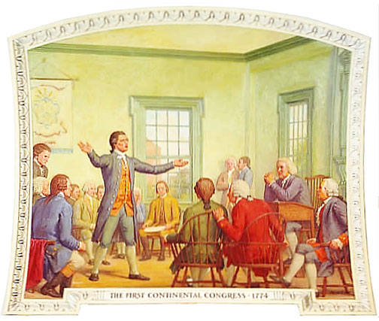

Cooperation And War
C
A
U
S
E
S
Intolerable Acts helped lead to the….
1st Continental Congress
  Met in Philly, all colonies, except GA were present
  Created a list of grievances
  Wanted to repeal most acts since 1763 (go back to salutary neglect)
  Called for military preparations
  Nonimportation and non-consumption of all trade with Britain
  Would meet again in a year
  Important note: THEY DID NOT WANT INDEPENDENCE!

Slide 13
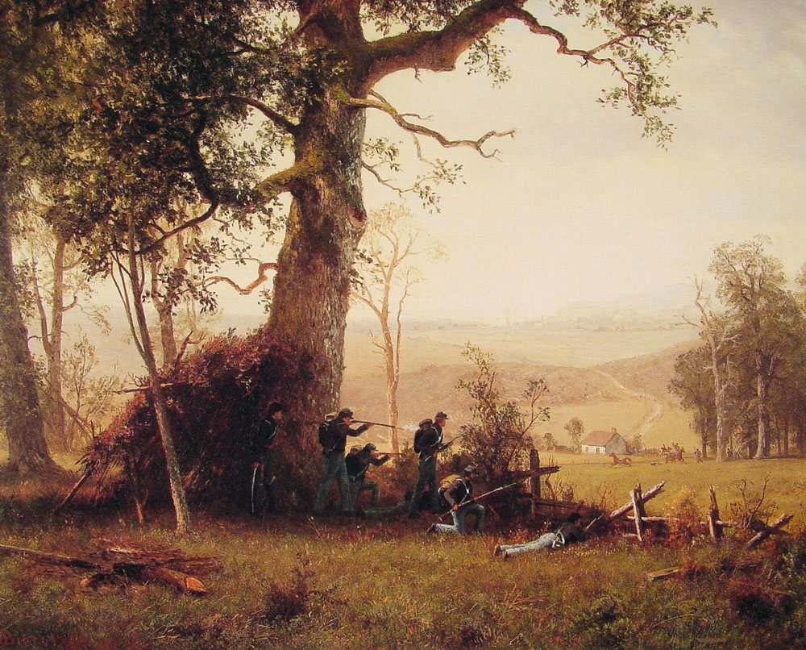
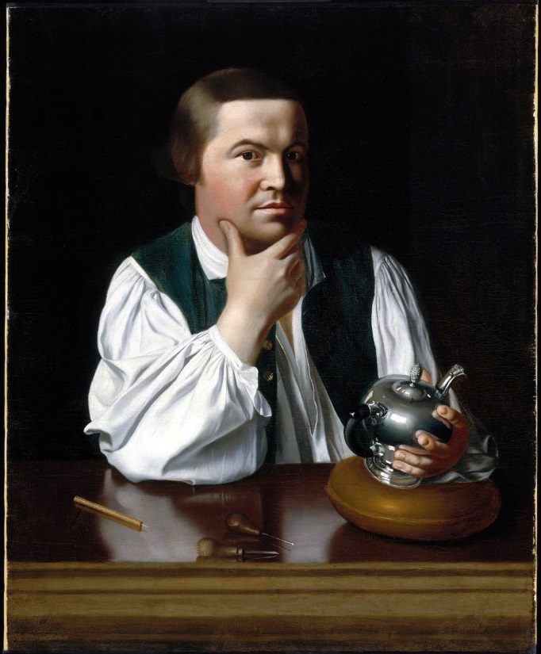
Cooperation And War
Lexington:
  British sought to arrest Samuel Adams and John Hancock
  William Dawes and Paul Revere warned of British
  8 minutemen were killed in the fighting
And Concord:
  The British moved to Concord to find ammunition
  Americans removed most of it, but the British burned some
  Americans fought the British back to Boston (guerilla warfare)

Slide 14
Past Essay Topics
Analyze the ways in which British imperial policies between 1763 and 1776 intensified colonials’ resistance to British rule and their commitment to republican values. (2009)
Analyze the effect of the French and Indian War and its aftermath on the relationship between Great Britain and the British colonies. Confine your response to the period from 1754 to 1776 (2012)

Slide 15

That’s it!
  Subscribe to my channel
  Help spread the word
Questions? Comments? Ideas for videos?
  Leave in comments
We don’t want independence, we just want you to subscribe!
Subscribe
Down here!

