Slide 1
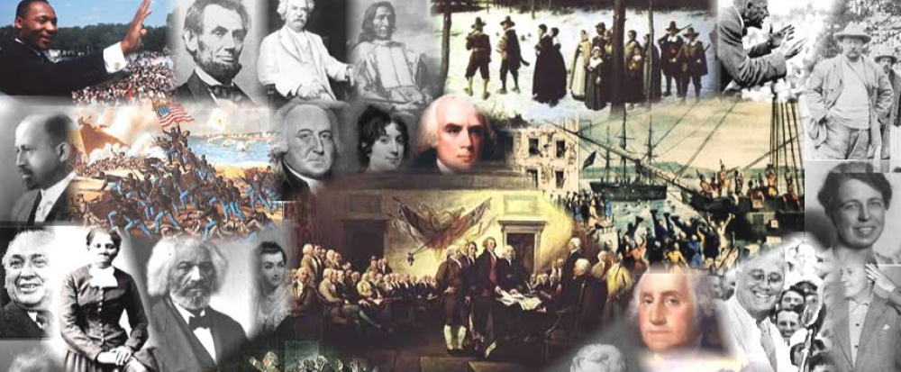
www.Apushreview.com

Slide 2
American History: Chapter 8 Review Video
Varieties of American Nationalism

Slide 3
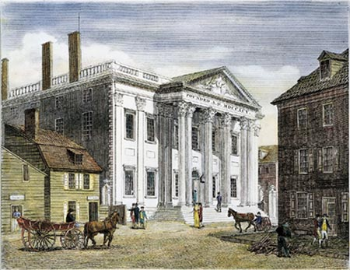
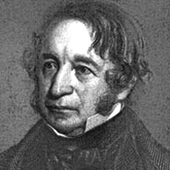
Building a National Market
1st Bank of US (BUS) expired in 1811
State banks issued notes
2nd BUS:
  Charter for 20 years in 1816
Francis Cabot Lowell:
  1st mill for spinning and weaving
Post War of 1812 Economic Problems:
  Britain flooded the US market with goods
    Hurt US economy
    Need for tariff(s)
Tariff of 1816:
  Designed to protect American industries
  Protective tariff, not just a revenue tariff

Slide 4
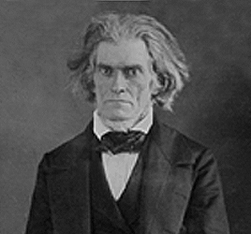
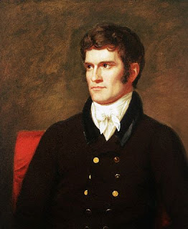
Building a National Market Cont.
Transportation improvements
  Building of roads, canals, turnpikes, etc.
  Question: who should fund, federal, or state government?
  National Road:
    Cumberland, Maryland to Wheeling, Virginia
    Funded by federal government
Calhoun’s internal improvements bill:
  Proposed for federal government to finance internal improvements
  “Let us, then, bind republic together with a perfect system of roads and canals.”
  Vetoed by Madison – believed Congress did not have authority to fund the project

Slide 5
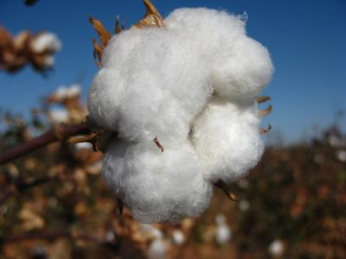
Expanding Westward
After War of 1812, many Americans moved westward
  Fewer Native Americans, less threats
  Huge increase in population
  Need for more farmland out west
    Cotton, like tobacco, exhausted land, was a large cash crop
  Building of forts on the Mississippi River and Great Lakes
  Erie Canal - 1825
1821, Mexico gains independence
  US increases trade

Slide 6
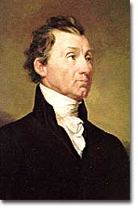
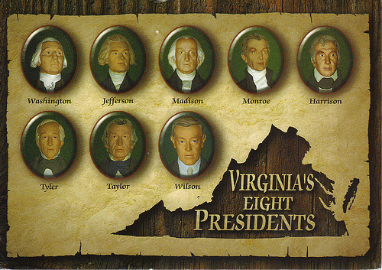
The “Era of Good Feelings”
What is it?
  Huge increase in nationalism (Post-War of 1812)
  1 political party rule (Democratic-Republicans)
  Attributed to Monroe’s Presidency, 1817 - 1825
Election of 1816:
  Continuing of the Virginia Dynasty
  Rufus King (Federalist) received 34 electoral votes
Monroe chose JQA as his Secretary of State
  Goodwill tour through the US
Florida:
  Seminole War:
    Invasion of Florida by Andrew Jackson
  Adams-Onis Treaty of 1819:
    US gained all of Florida in exchange for:
      US gave up its claim to Texas
      Spain gave up its claim to the Pacific NW

Slide 7
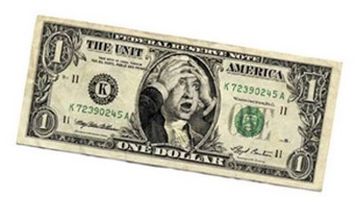
The “Era of Good Feelings” Cont.
Financial Panic:
  When in doubt, panics are caused by speculation (buying of a good in hopes of selling it at a higher price in the future)
Panic of 1819:
  Overspeculation on land
  The BUS began tightening its credit and calling in loans
  Many state banks began to fail
As a result of this depression, many Americans blamed the BUS

Slide 8
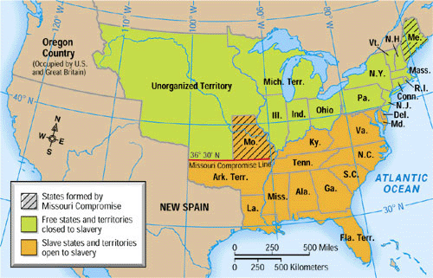
Sectionalism and Nationalism
MO Compromise:
  MO (part of LA Purchase) applies for statehood as a slave state
    This would make 12 slave states and 11 free
  Tallmadge Amendment:
    Proposed for gradual emancipation of slaves in MO
    South hated it, seen as a step towards ending ALL slavery
The Solution?
  MO added as a slave state
  ME (from Massachusetts) added as a free state
    Balance stays equal at 12 states free, 12 slave
  Slavery prohibited above 36°30’ line in the future
Impact of MO Compromise?
  Slavery would be the NUMBER 1 issue in national politics until the Civil War
  Helped lead to an increase in sectionalism

Slide 9
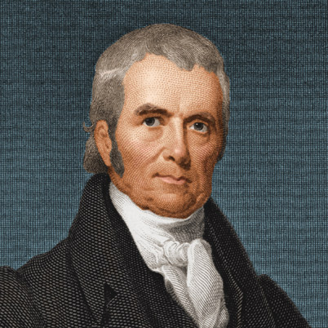
Sectionalism and Nationalism Cont.
John Marshall:
  4th Chief Justice
  During his reign, the national government became more powerful, at the expense of states
  Also, he helped improve the economy
Dartmouth College v. Woodward:
  NH government tried to change the charter
  Daniel Webster (great orator, future senator) argued the case
  Marshall said a charter is a contract that could not be changed
Cohens v. Virginia:
  Supreme Court can review state court decisions
  Again, federal government gains more power at states expense

Slide 10
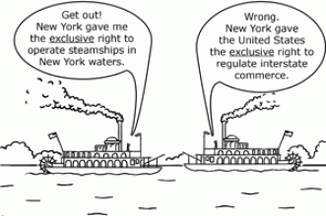
Sectionalism and Nationalism Cont.
***McCulloch v. Maryland*** (1819)
  Background: Maryland hated the BUS, tried to tax it
  Marshall and the court said the states could NOT tax a federal agency
    “the power to tax is the power to destroy”
  Essentially, the Supreme Court states the BUS is constitutional
***Gibbons v. Ogden*** (1824)
  Issue was with interstate trade (involving more than one state)
  Stated that only Congress could regulate interstate trade
    More power to federal government
Worcester v. Georgia (1832)
  Stated Georgia could not interfere with Native land
  Decision was not enforced, Natives were forced to leave

Slide 11
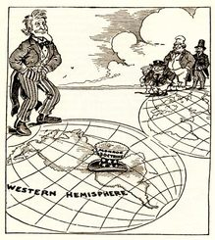
Sectionalism and Nationalism Cont.
The Monroe Doctrine
Written primarily by Secretary of State JQA
Essentially warned Europe to stay out of Latin America
  US would consider any challenge as unfriendly
In return, the US would stay out of European affairs
Impacts:
  Short-term?
    Little to none
  Long-term?
    US would be the dominant power in the Western Hemisphere

Slide 12
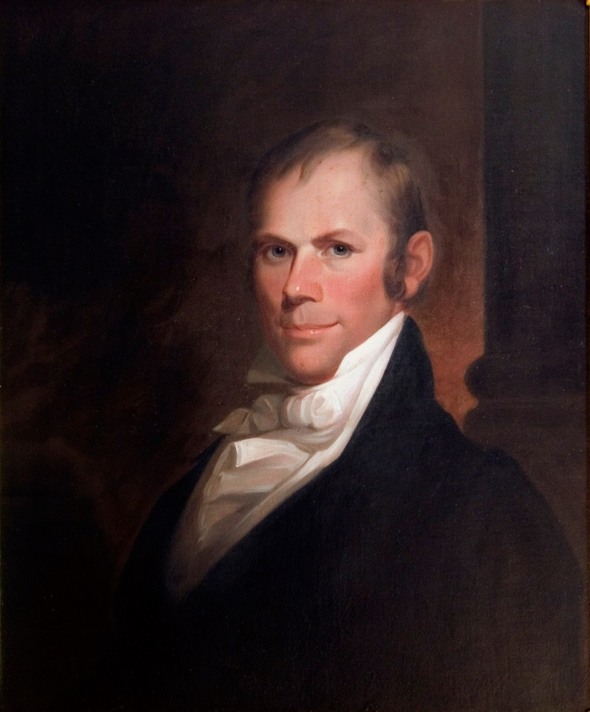
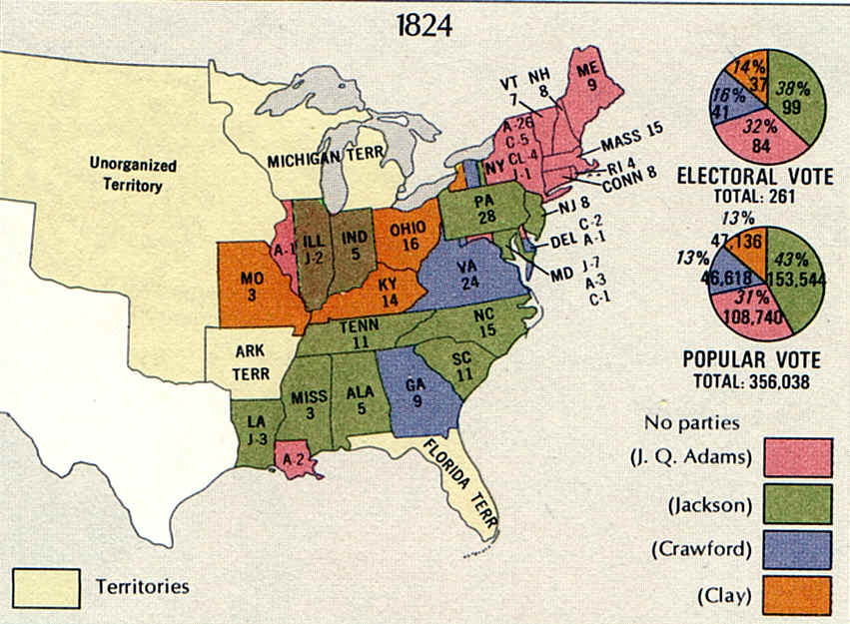
The Revival Opposition
Wooohooo, I’m guaranteed to become the next president!
No? Too soon???
The “Corrupt Bargain”:
  4 candidates for the election of 1824
  None win an electoral majority, although Andrew Jackson has most electoral and popular votes
According to the 12th Amendment, the House would then decide on the top 3 candidates
  Henry Clay (Speaker of the House), finished 4th and was out of the running
  He threw his support behind JQA
Adams becomes president, Henry Clay becomes his Secretary of State
Clay’s American System:
  Protective Tariffs, Internal Improvements, Bank of the US
Jackson and his supporters were outraged

Slide 13
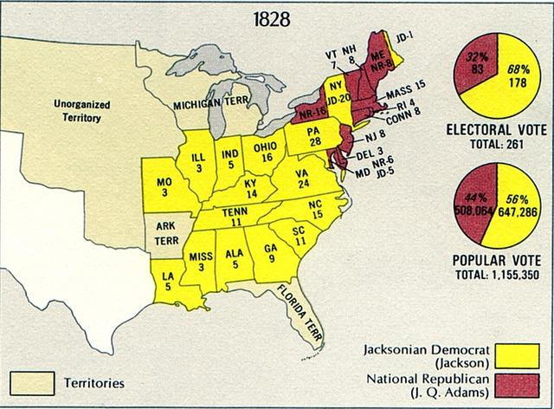
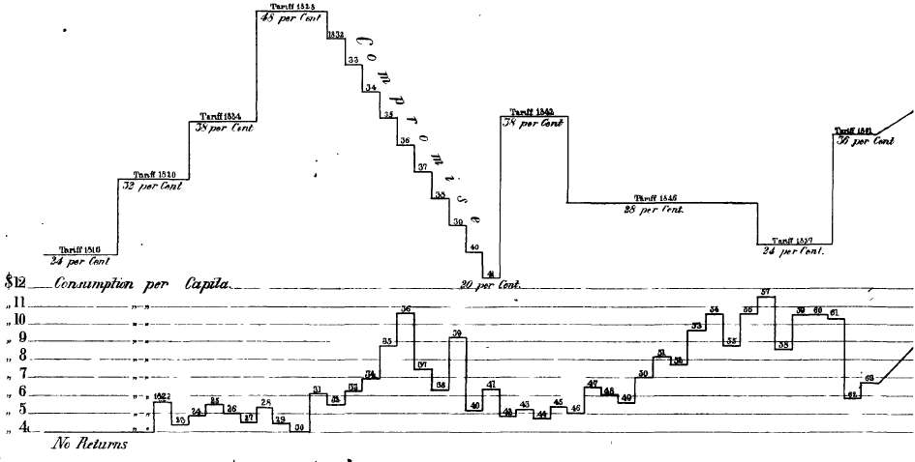
The Revival Opposition
Tariff of Abominations (1828):
  Raised tariff rates drastically
  Hated by South and West
  Favored by manufacturers in NE
Election of 1828:
  JQA v. Jackson round 2
  Jackson destroys Adams, 178 – 83
  Problems await Jackson…….

Slide 14

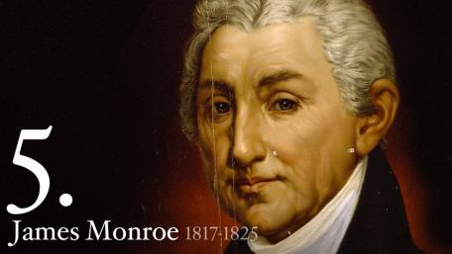
That’s it!
  Subscribe to my channel
  Help spread the word
Questions? Comments? Ideas for videos?
  Leave in comments
My warning to Europe? Subscribe to Adam Norris!
Subscribe
Down here!

