Slide 1
American History: Chapter 10 Review Video
www.Apushreview.com
America’s Economic Revolution

Slide 2
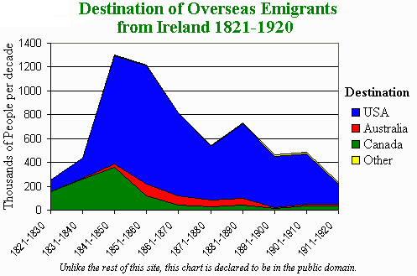
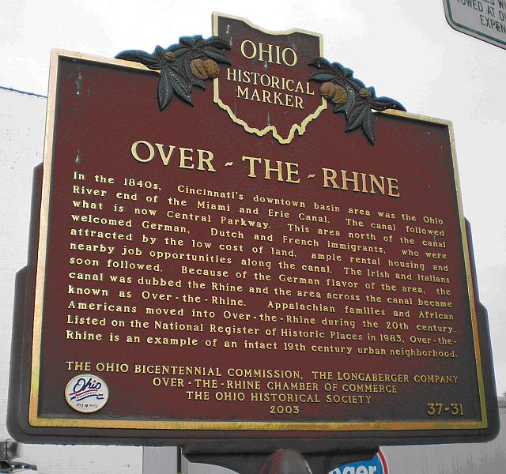
The Changing American Population
Between 1820 and 1840, the population drastically increased
  Faster rate than Europe
Immigration: increased rapidly during and after 1830s
  Most settled in urban areas of the Northeast
  Highest numbers came from Germany and Ireland
Germans:
  Tended to move to the Northwest – farmers (Cincinnati!)
Irish:
  Potato famine, move to cities

Slide 3
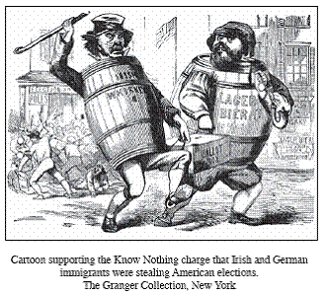
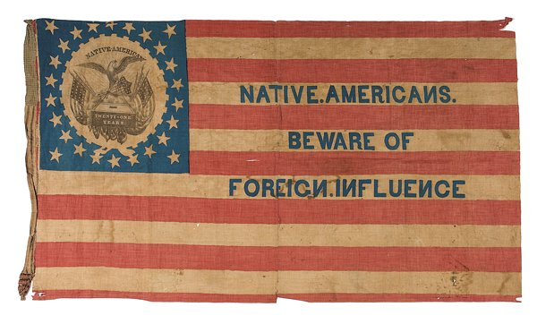

The Changing American Population Cont.
Nativism:
  Distrust and dislike of foreigners; favoring “Native-born” Americans
  Wanted to stop or slow the influx of immigrants
Reasons for Nativism:
  Immigrants would work for lower wages
  Belief that immigrants were destroying America and its culture
  Fear of the Catholic Church and Pope
  “Stealing” votes
Examples of Nativism:
  Supreme Order of the Star-Spangled Banner (“Know-Nothings” or the American Party)
  NINA

Slide 4
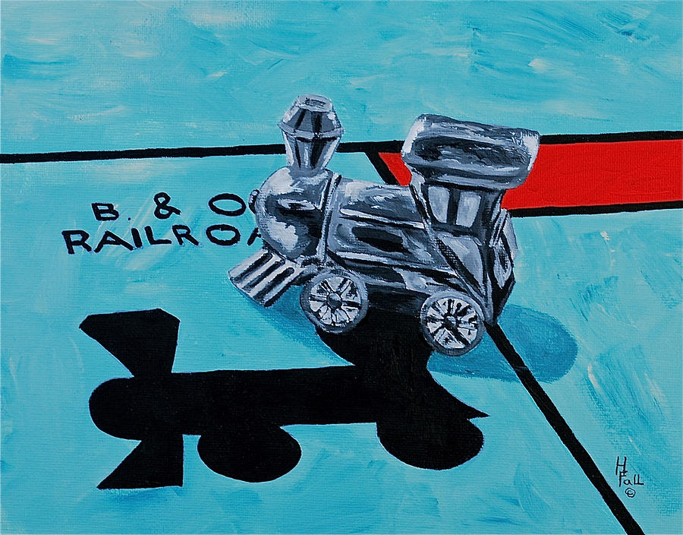
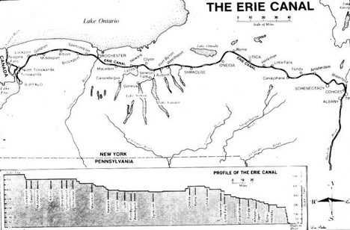
Transportation, Communications, And Technology
1820s saw an increase in canals
  NY – Erie Canal: 363 miles, Albany to Buffalo
  “Clinton’s Big Ditch”
  Built by Irish “Paddies”
  Gave NYC access to Chicago
Canals also stimulated settlement in the Northwest
Railroads:
  Baltimore and Ohio - 1830
Problems with early railroads?
  Different gauges on tracks
  Frequent accidents and erratic schedules

Slide 5
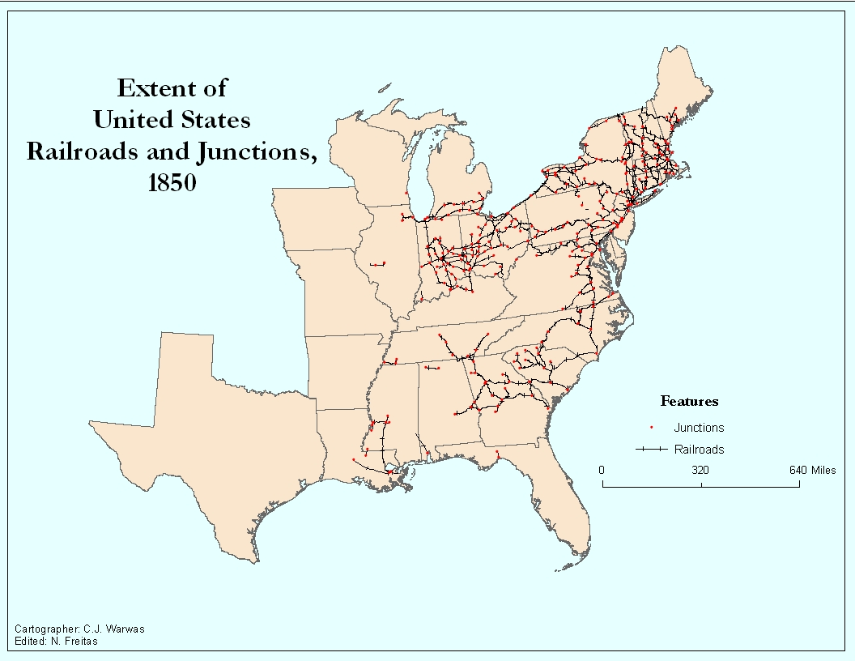
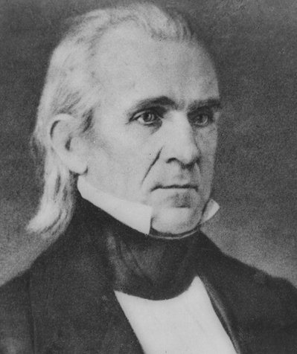
Transportation, Communications, And Technology Cont.
1850s saw a huge increase in railroad development
  “Trunk Lines” – shorter lines consolidated into longer lines
    Helped decrease importance of canals
Funding for railroads:
  State, local and federal governments
    State and local through $
    Federal through land grants
Most railroads were located in the Northeast
  Further disconnected the North and South
Morse Code:
  James K. Polk’s nomination for the Democratic Party in 1844

Slide 6
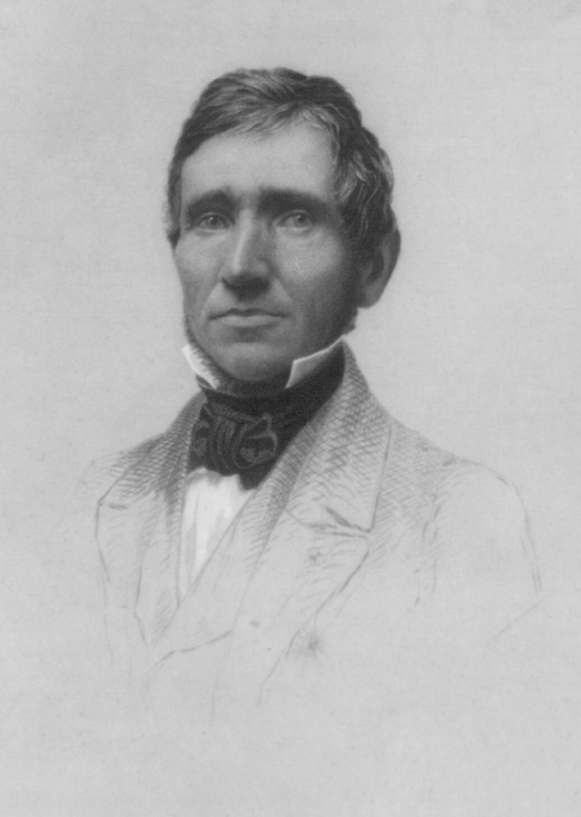
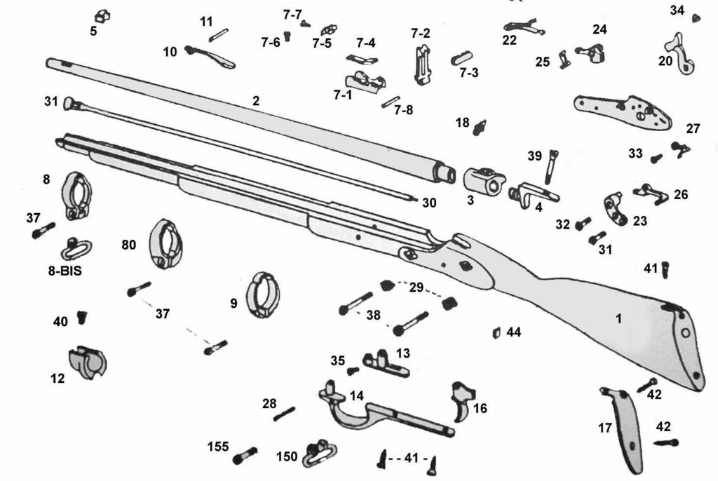
Commerce and Industry
Growth of corporations:
  Increased in 1830s which made them possible by paying a fee
Limited Liability:
  Stockholders would only lose value of stock if the corporation failed
Technological advances:
  Interchangeable parts – Eli Whitney
    Used for bicycles, sewing machines, typewriters, etc.
  Charles Goodyear:
    Rubber
  Elias Howe and Isaac Singer:
    Sewing machine
Use of coal:
  Allowed factories to move away from water
  Cities began to grow to mine coal (Pittsburgh)

Slide 7
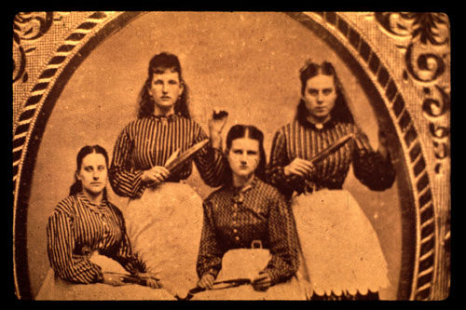
Men and Women at Work
Advancements in transportation allowed farmers to ship goods to all regions of the country
  Leads to an increase in specialization of industry
“Lowell System”
  Young, single women (farmers’ daughters) would work in a factory
  Boardinghouses for workers, curfews, churches
  High wages
Why did the “Lowell System” decline?
  Panic of 1837 hurt wages
  Increase in immigrants that worked for less

Slide 8
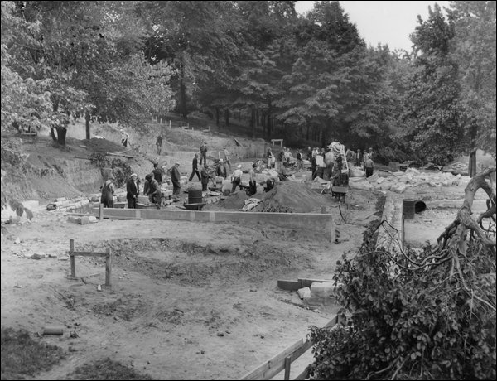
Men and Women at Work Cont.
Construction Gangs of immigrants helped build the infrastructure
Immigration helped lead to a decrease in working conditions
  Many Americans were not concerned with conditions for immigrants
Early unions:
  Skilled craftsmen unions
  Common law viewed most early unions as “an illegal conspiracy”
Commonwealth v. Hunt (1842):
  Massachusetts Supreme Court case that stated unions were legal
  Other states soon agreed
  Unions did not gain more power until the late 19th century

Slide 9
Men and Women at Work Cont.
Women were not included in unions
“Free Labor”
  Northern workers viewed freedom as an absence of slavery
Northern workers disliked slavery for two reasons:
  Lack of freedom
  Took away jobs
Free African Americans had little freedom as well
  Not considered legal citizens

Slide 10
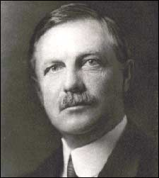
Patterns of Industrial Society
Economic growth not shared equally:
  Slaves, Native Americans, unskilled workers were left out
Urban areas saw high poverty rates
  Many were immigrants and often homeless
Free blacks in the North faced severe difficulties:
  Could not:
    Vote
    Attend public schools
    Use public services
Geographic Mobility:
  “Safety-valve” theory – Frederick Jackson Turner:
    In times of economic crisis, Americans could always move west to the frontier

Slide 11
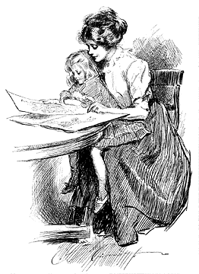
Patterns of Industrial Society Cont.
Men and women had increasingly different social roles
Women could almost never obtain a divorce
“Cult of Domesticity”:
  Women and men had “separate spheres”
  Women were encouraged to stay home and raise children and instill moral values
Single women did not have many occupational choices:
  Teachers, nurses, and domestic servants

Slide 12
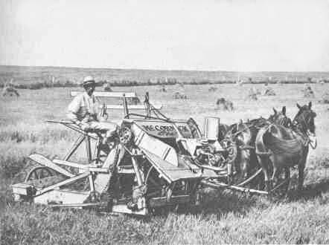
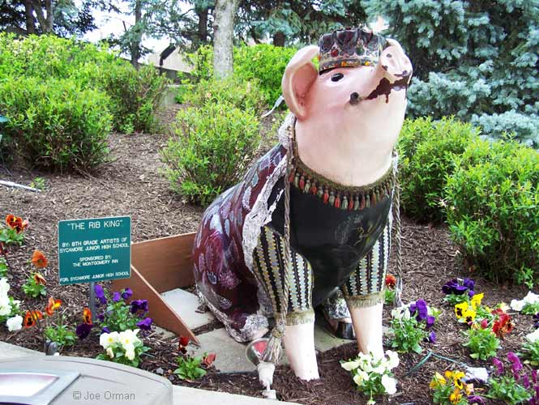
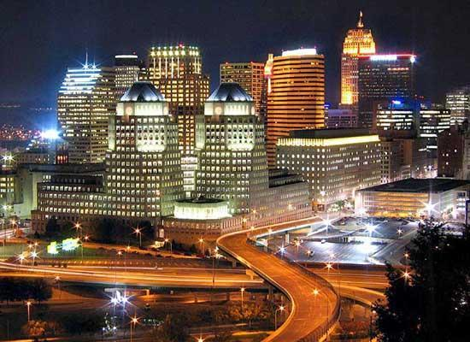

The Agricultural North
Old Northwest (OH, IL) specialized in meatpacking
  Cincinnati! (Porkopolis)
  Chicago
Specialization in Agriculture:
  West: Livestock and dairy
  South: Cashcrops
  North and Mid-Atlantic – wheat, fruits, and vegetables
Agricultural inventions:
  John Deere: steel plow
  Cyrus McCormick – mechanical reaper
    Helped with harvesting wheat
Rural Life:
  Church played a large role – brought the community together

Slide 13



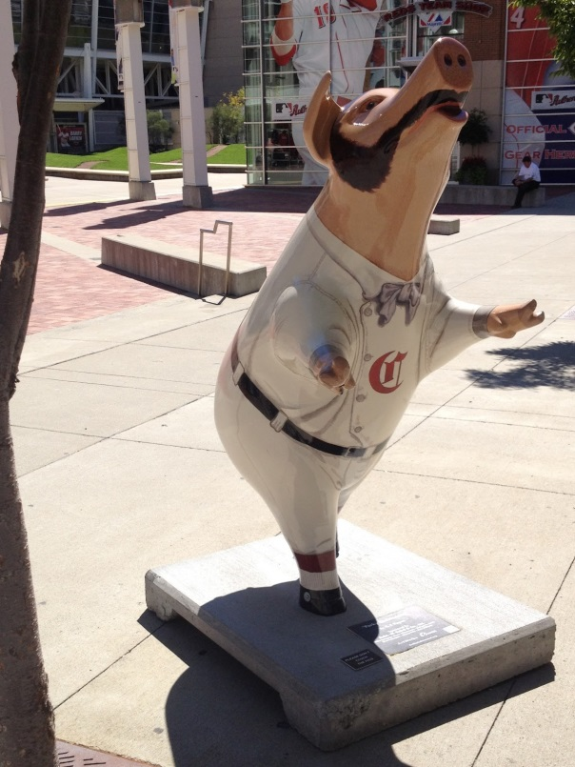
Thanks for watching!
  Subscribe to my channel
  Help spread the word
Questions? Comments? Ideas for videos?
  Leave in comments
“Go Reds!”
Subscribe
Down here!

