Slide 1
American History: Chapter 12 Review Video
www.Apushreview.com
Antebellum Culture and Reform

Slide 2
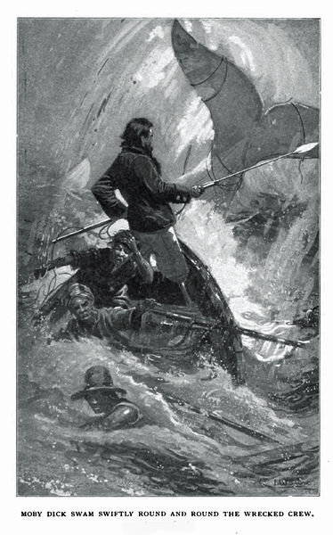
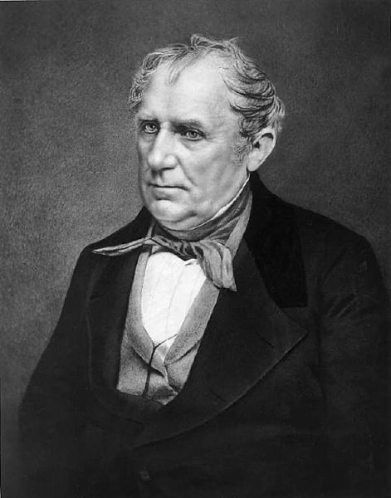
The Romantic Impulse
“Who reads an American book?”
  No one!
Painting – focused on Landscape
  Hudson River School
James Fenimore Cooper – frontier experience with Natives
  Last of The Mohicans
Walt Whitman – celebrated democracy
Moby Dick
  “Human spirit was a troubled, often self-destructive force.”
Southern Literature:
  Romanticized the plantation system

Slide 3
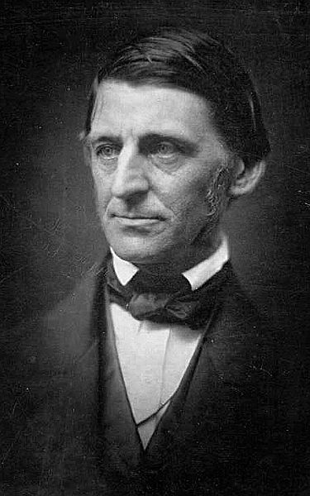
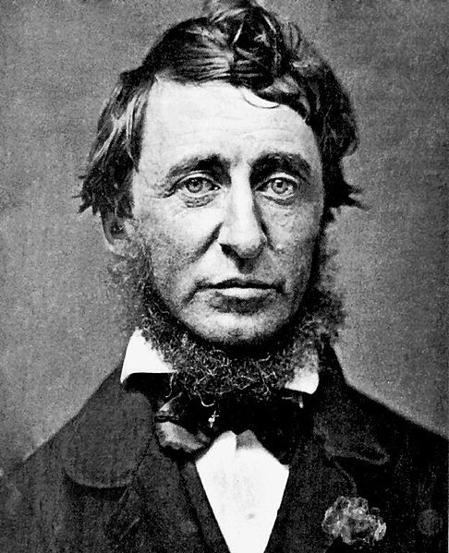
The Romantic Impulse Cont.
Transcendentalism:
  Every person possesses an inner light that can illuminate the highest truth and put him/her in direct touch with God
Ralph Waldo Emerson:
  “Self-Reliance”
Henry David Thoreau:
  Walden – Thoreau lived alone in nature for 2 years
  Civil Disobedience – “personal morality had the first claim on his or her actions, that a government which required violation of that morality had no legitimate authority.”
Utopian Societies:
  Brook Farm, MA – resident would share in labor and leisure
  New Harmony – residents worked and lived in equality
  Oneida – “Free love”, sought to achieve perfection

Slide 4
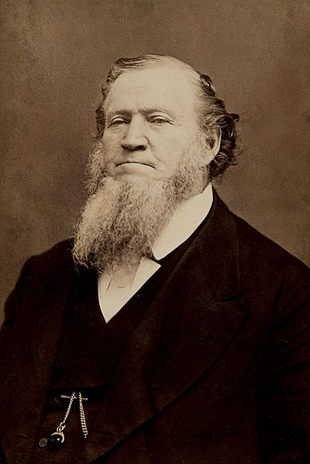
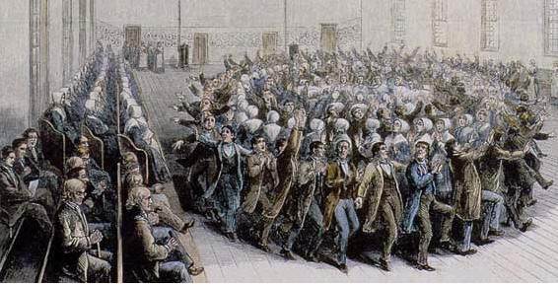
The Romantic Impulse Cont.
Religions:
  Unitarianism:
    Believe that Jesus is NOT divine
  Mormons – founded by Joseph Smith
    Led to Utah by Brigham Young
    Utah is not admitted as a state until much later due to polygamy issues
  Shakers:
    Founded by Ann Lee
    Advocated celibacy, equal rights for women

Slide 5
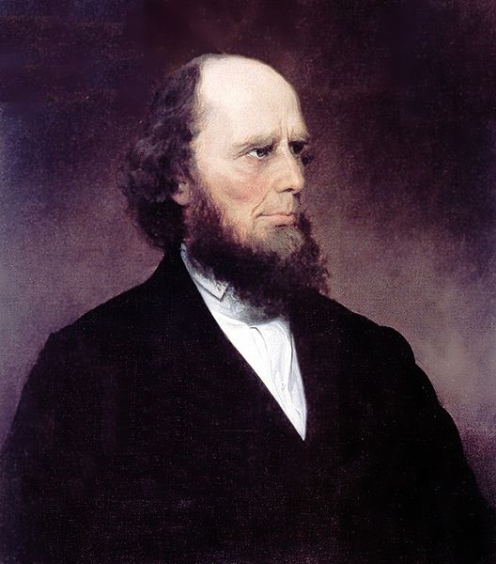
Remaking Society
2nd Great Awakening:
  Unlike 1st G.A., it inspired societal reforms
  Charles Grandison Finney – helped convert many individuals in the “Burned-Over District”
  All individuals could achieve salvation
Temperance:
  Push to limit hard alcohol, or abstain all together
  Led by women
  Maine passed a “dry” law in 1851 (Neil Dow – mayor in ME)
Medicine and Science:
  Still very primitive
  Lack of knowledge of disease was biggest obstacle

Slide 6
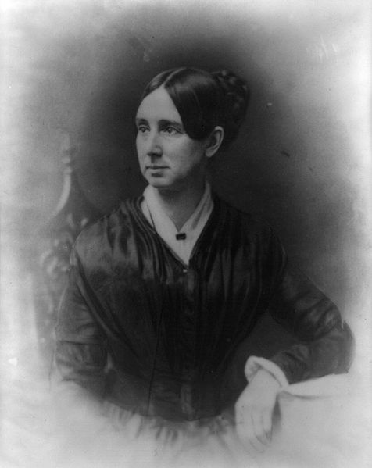
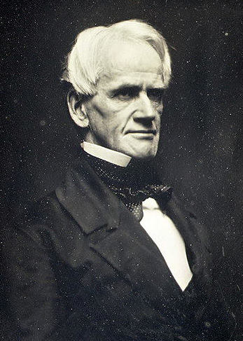
Remaking Society Cont.
Education:
  Horace Mann – “Father of Education”
    “The only way to protect democracy, was to create an educated electorate.”
  Tax-Supported elementary schools
  Schools in the South and West were inferior to the North
Prison and Mental Health Reform:
  Debtors could face prison time, “holes in the ground”
  Solitary Confinement – “Penitentiaries
  Dorothea Dix – mental health reform
Women’s Rights:
  Seneca Falls Convention (1848)
  Many women’s rights advocates were abolitionists
  Declaration of Sentiments

Slide 7
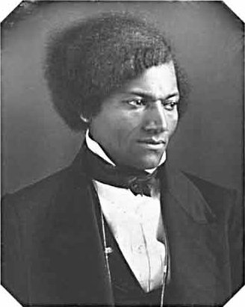
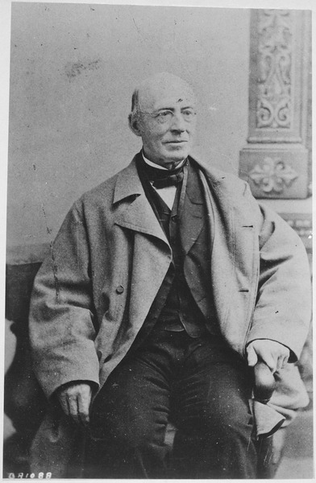
The Crusade Against Slavery
American Colonization Society:
  Goal was to have owners paid for freeing slaves, and send them to Africa (Liberia)
  Not successful, former slaves wanted to stay in America
***William Lloyd Garrison:***
  Radical abolitionist (for his time)
  Published The Liberator – immediate and uncompensated end to slavery
David Walker:
  Advocated violence to end slavery
***Frederick Douglass:***
  Former slave, great orator, women’s rights advocate

Slide 8
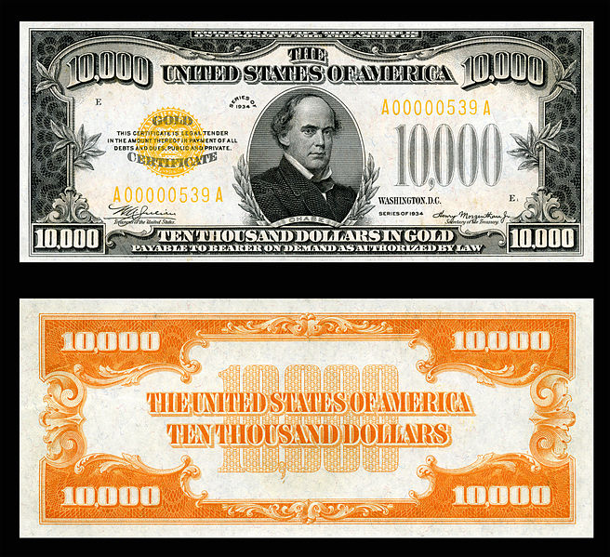
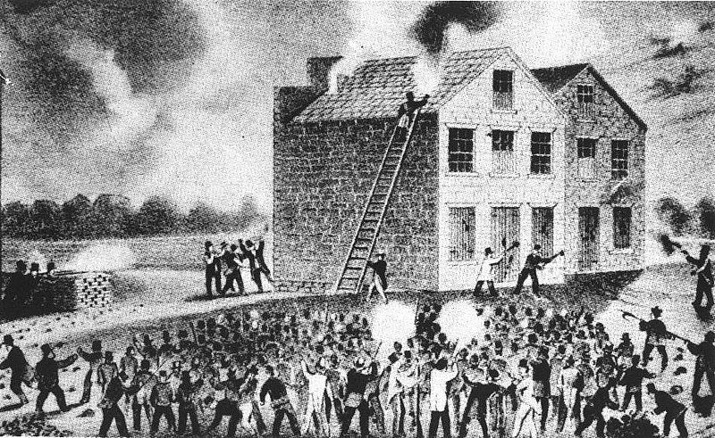
The Crusade Against Slavery
Anti-Abolitionism:
  Abolitionists in the north were in the minority
Elijah Lovejoy:
  Murdered in Illinois, outspoken abolitionist and editor of newspaper
Abolitionist movement splits over the role of women
Prigg v. Pennsylvania:
  Stated Northern states do NOT need to aid in the Fugitive Slave Law of 1793
Free-Soil Party:
  “Free soil, free labor, free men”
  Wanted to keep slavery from expanding into territories
  Claimed slavery hurt white workers
Uncle Tom’s Cabin:
  Harriet Beecher Stowe
  Showed the evils of slavery

Slide 9
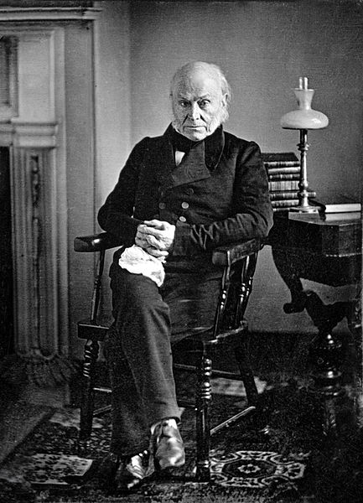
Not in the Book, but should Know
Gag Resolution (1836 – 1844)
  House resolution that tabled (did not allow the presentation or discussion of) ANY bill that went against slavery
  Eventually overturned with help of John Quincy Adams
Amos Kendall – Postmaster General under Andrew Jackson
  Forbid the delivery of abolitionist material in the South

Slide 10
Thanks for watching!
  Subscribe to my channel
  Help spread the word
Questions? Comments? Ideas for videos?
  Leave in comments
You’re learning APUSH, in part, because of me!
Subscribe
Down here!

