Slide 1
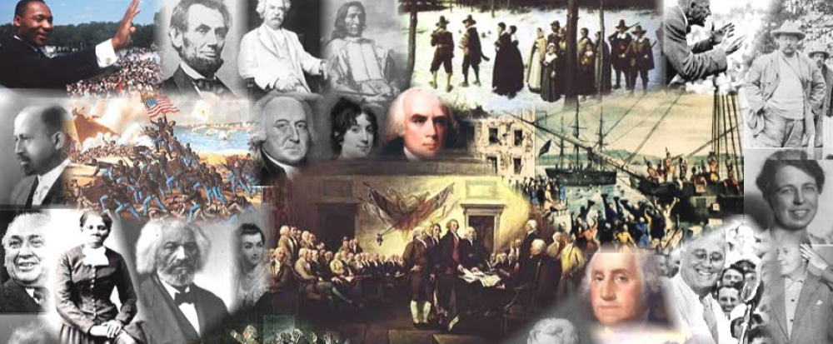
www.Apushreview.com

Slide 2
American History: Chapter 6 Review Video
The Constitution and the New Republic

Slide 3
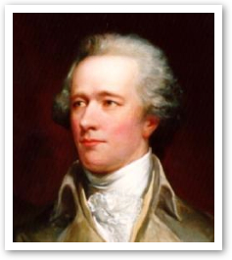
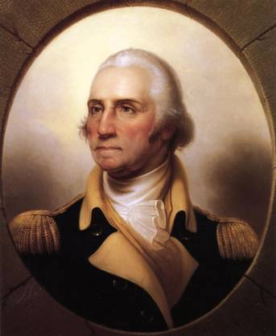
Framing A New Government
Many Americans championed a new, strong, central government
Newburgh Conspiracy
  Military members were upset about not receiving pensions
  Washington helped prevent the rebellion
Major weakness of Articles?
  Lack of ability to tax
Annapolis Convention (1786):
  5 states show up to discuss commerce
  Alexander Hamilton gains a promise to meet the following year in Philadelphia
Shays’ Rebellion helped people demand a strong central government

Slide 4
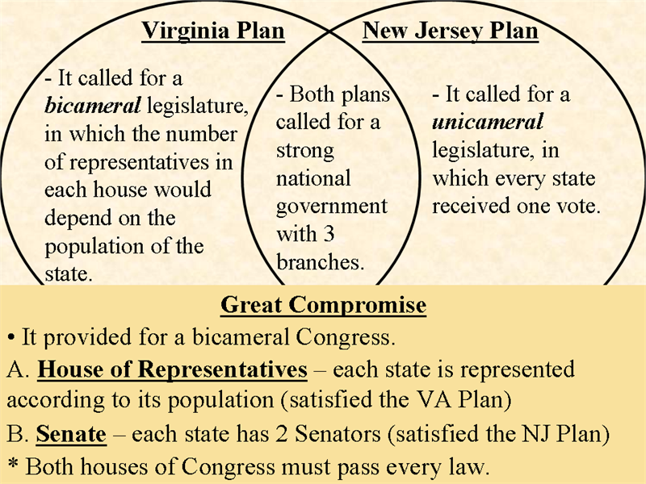
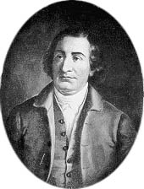
Framing A New Government Cont.
Constitutional Convention:
  55 delegates from 12 states (save RI)
Key Players:
  George Washington – president of the Convention
  Edmund Randolph (VA) – proposed 3 branches
Issue of Representation:
  VA Plan (James Madison):
    Bicameral (2-house) legislature based on representation
  NJ Plan (William Paterson)
    Unicameral (1-house) legislature with each state having equal representation
  Great (Connecticut) Compromise (Roger Sherman):
    Bicameral legislature: lower house (House of Reps) would be based on population; upper house (Senate) would have 2 representatives per state
      Side note: Senators were to be elected by state legislatures, NOT by popular vote

Slide 5

Framing A New Government Cont.
Other Compromises
  3/5 Compromise
    Slaves would count towards 3/5 of a person when determining population in the House
  Slave-Trade Compromise:
    Slave importation could not be stopped prior to 1808
  Commerce Compromise:
    Congress could tax imports (tariffs), but not exports
Sovereignty:
  Where does it lie? Who has ultimate power?
    The people – James Madison
Supremacy Clause:
  Constitution would be the supreme law of the land
Necessary and Proper (Elastic)
  Congress could make laws that are “necessary and proper”

Slide 6
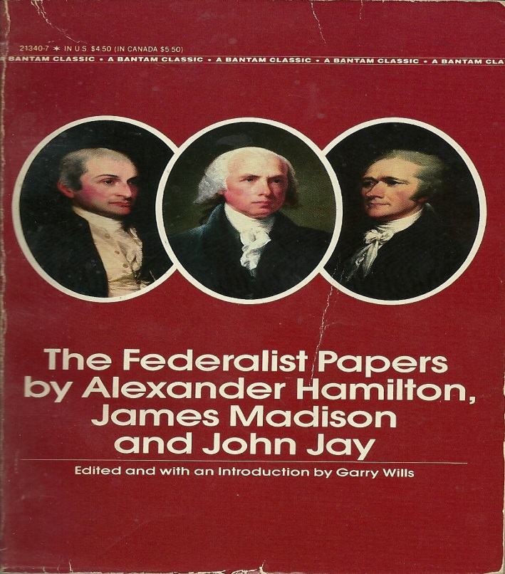
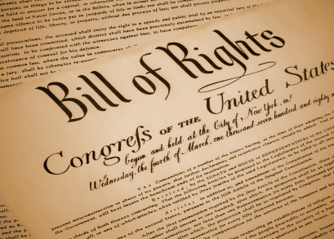
Framing A New Government Cont.
Federalists:
  Those that favored a strong central government and the Constitution
Antifederalists:
  Those that favored a weak(er) central government and were weary of the Constitution
The Federalist Papers:
  Written by Alexander Hamilton, James Madison, and John Jay
  Purpose: to gain support for the ratification of the Constitution
The Bill of Rights (1791):
  Added after the Constitution was ratified
  Federalists promised to add them to gain support of the Antifederalists
Washington was unanimously elected president and was inaugurated on April 30, 1789

Slide 7

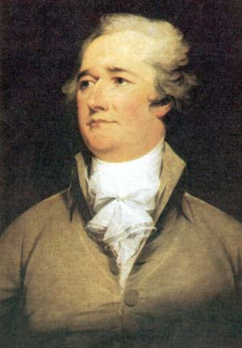
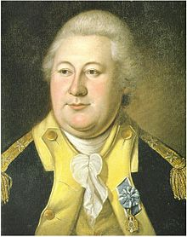
Framing A New Government Cont.
Judiciary Act of 1789:
  Created the Supreme Court with 1 chief justice and 5 associate justices
Creation of Executive Departments:
  State, Treasury, and War
The Cabinet:
  Part of “Unwritten” Constitution
  Heads are appointed by the President, approved by the Senate
    State – Jefferson
    Treasury – Hamilton
    War - Knox
  Throughout Washington’s 1st term, Jefferson and Hamilton battled over government role and philsophy
VS.

Slide 8

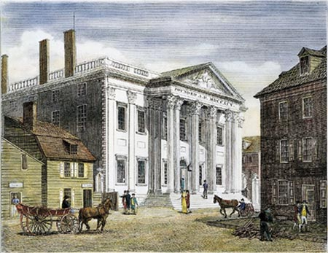
Federalists and Republicans
Federalists (Political Party):
  Led by Alexander Hamilton
  Favored a strong central government
  Supported by wealthy and merchants
Hamilton’s Financial Plan:
  Federal government would assume state debts
  Federal government would pay off debt at full face value (funding at par)
  Creation of the Bank of the US (BUS)
    Hamilton loosely interpreted Constitution, referred to the Elastic Clause
  Excise Tax – tax on manufactured goods
  Tariff – tax on imported goods
Jefferson and his supporters (Republicans) agreed to the plan when the capital was moved to the South

Slide 9
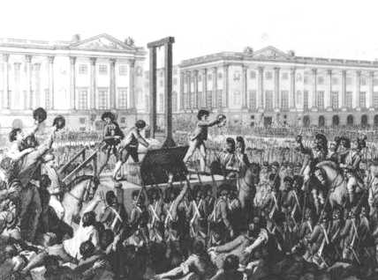

Federalists and Republicans Cont.
Republican Party (Democrat-Republicans or Jeffersonians):
  Led by Thomas Jefferson and James Madison
  Believed farmers were the backbone of the economy
  Pro-French
French Revolution
  Republicans supported the revolution, Federalists were horrified by the horror of the revolution

Slide 10
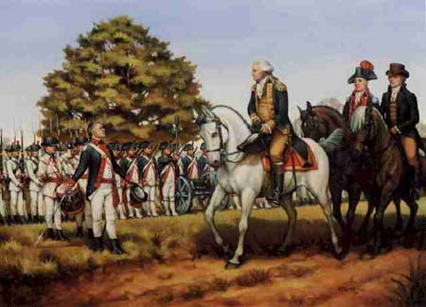
Establishing National Sovereignty
Whiskey Rebellion (1794):
  In response to the excise tax on Whiskey
  Washington summoned state militias
  Rebellion was quickly stopped
  Demonstrated the power of the new government
Native Americans:
  Were not granted citizenship
  Not considered “foreign Nations” as European countries were
  No direct representation in government

Slide 11
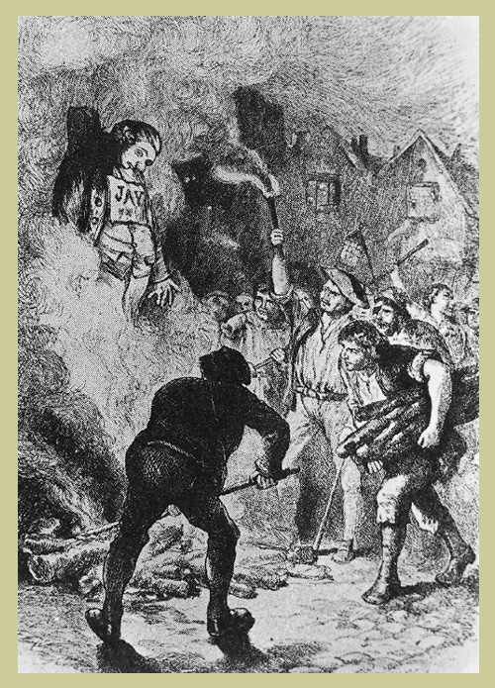
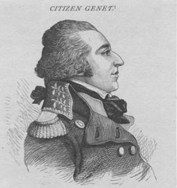
Establishing National Sovereignty Cont.
US Neutrality:
  Washington urged neutrality in war between France and Britain
“Citizen Genet”
  French diplomat that urged the Americans to go to war against Britain
Jay’s Treaty:
  Treaty with Britain
  US received compensation for damaged ships (upset the South)
  Britain promised to leave posts (forts)
Pinckney’s Treaty:
  Treaty with Spain
  US granted navigation rights on the Mississippi River (Right of Deposit) in New Orleans

Slide 12
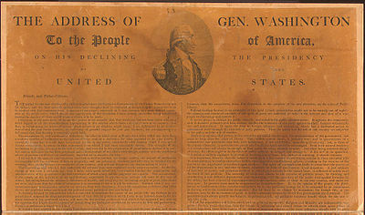
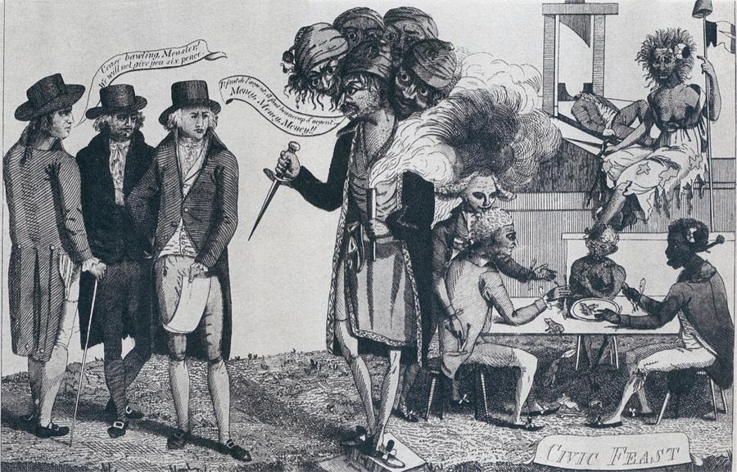
The Downfall of the Federalists
Election of 1796:
  Adams becomes President, Jefferson his VP
Washington’s Farewell Address:
  Warned against foreign alliances
XYZ Affair:
  3 US diplomats sent to France
  3 French diplomats, “XYZ” demanded a bribe
  War hysteria ensues
Quasi War:
  Undeclared naval war between US and France
  Ends with Napoleon’s reign

Slide 13
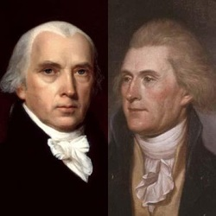
The Downfall of the Federalists Cont.
Alien and Sedition Acts (1798):
  Purpose: to punish opposition to Federalist Party and the Adams’ administration
  Alien Act:
    Increased residency requirement for foreigners to become citizens
    President could deport foreigners
  Sedition Act:
    Made it illegal to criticize the government
    10 Republican newspaper editors were convicted under the law
Virginia and Kentucky Resolutions:
  Written by Jefferson (KY) and Madison (VA):
  Urged states to nullify the Alien and Sedition Acts
  More symbolic at the time

Slide 14
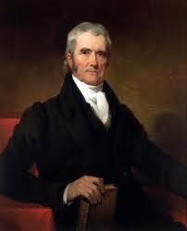
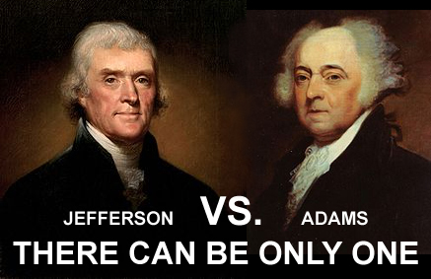
The Downfall of the Federalists Cont.
The “Revolution” of 1800
  Adams v. Jefferson in election of 1800
  Jefferson and Burr tie for presidency, Jefferson eventually wins, Burr becomes VP
Why is it called a revolution?
  Peaceful transition of power between political parties
Judiciary Act of 1801:
  Passed by Federalist Congress while Adams was still president
  Created many new federal judgeships
  Adams appointed many in his last days of office
    “Midnight Judges”
  A showdown is coming……….

Slide 15
Past Essay Topics
Analyze the reasons for the Anti-Federalists’ opposition to ratifying the Constitution (2008 Free Response)
To what extent was the United States Constitution a radical departure from the Articles of Confederation? (2005 Form B Free Response)

Slide 16


That’s it!
  Subscribe to my channel
  Help spread the word
Questions? Comments? Ideas for videos?
  Leave in comments
Subscribe
Down here!

