Slide 1
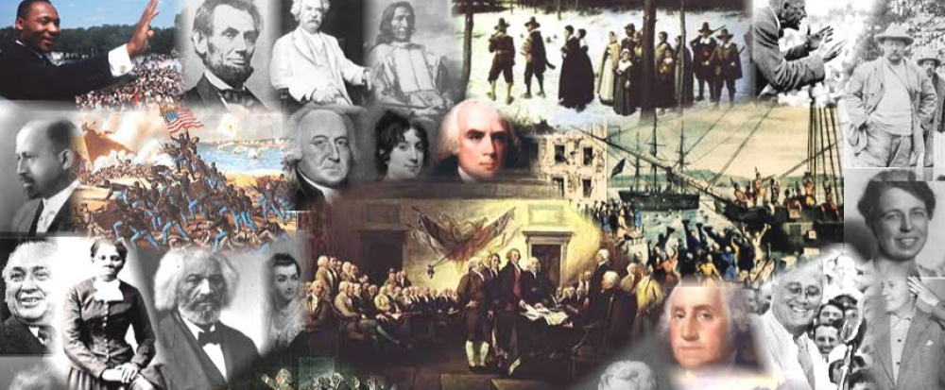
www.Apushreview.com

Slide 2
American History: Chapter 9 Review Video
Jacksonian America

Slide 3
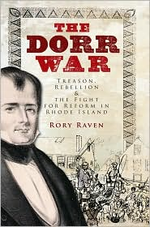
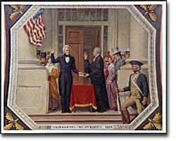
The Rise of Mass Politics
Age of Jackson??
  More Americans (white males) participated in politics
  Property requirements and taxpaying requirements disappeared in many states
  Voting did NOT extend to women or African Americans
  Western states gain more prominence
Dorr Rebellion
  Forced conservatives in RI to adopt a new constitution that expanded suffrage

Slide 4
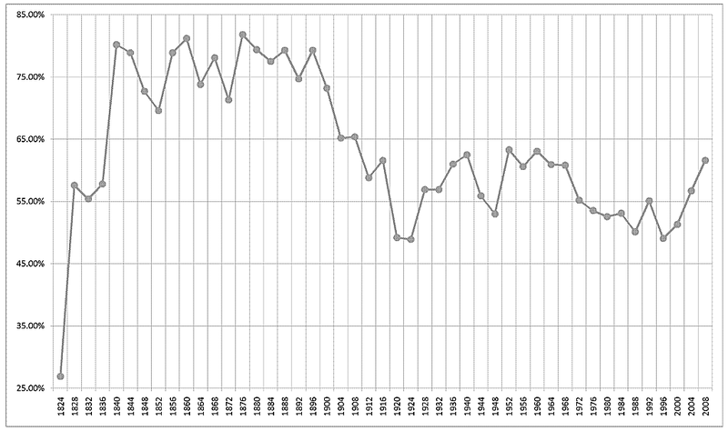
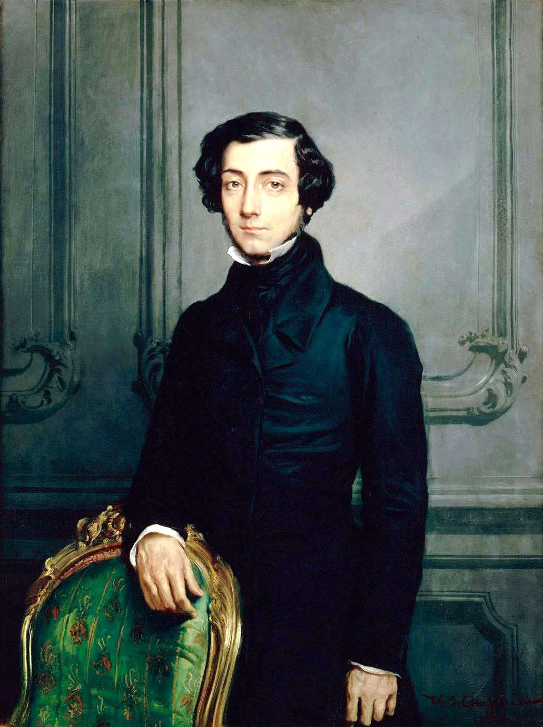
The Rise of Mass Politics Continued
Presidential electors:
  Traditionally chosen by state legislatures
  1828: all but SC allowed popular vote of electors
Presidential election trends:
  1824: 27% of adult white males voted
  1828: 58% of adult white males voted
  1840: 80% of adult white males voted
Democracy in America:
  Alexis de Tocqueville
  Argued that America lacked typical aristocracies, people could rise and fall

Slide 5
The Rise of Mass Politics Continued
The Second Party System:
  Many believed parties were essential to democracy
  Loyalty to the party was more important than ideology
    Spoils System: patronage, reward supporters with jobs
1830s: two party system at the national level
  Democrats (Jackson) and Whigs (Clay)

Slide 6
The Rise of Mass Politics Continued
The “Common Man” President
  1st president from the West (Tennessee)
  Equality for all white males
  Against wealthy, eastern establishments (BUS)
National Party Convention:
  Re-nominated Jackson in 1832
  Replaced the congressional caucus
  More power for people

Slide 7
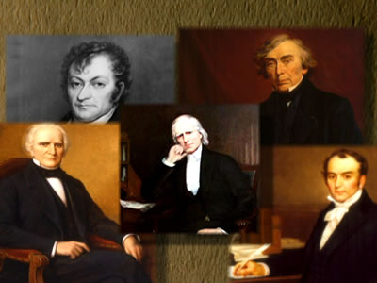
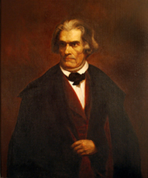
“Our Federal Union”
John C. Calhoun:
  VP under JQ Adams and Jackson (1st Term)]
  Wrote South Carolina Exposition and Protest (1828)
    Urged states to nullify the Tariff of Abominations
    Argued since the states created the federal government, they had the ability to nullify federal laws
Kitchen Cabinet:
  Group of official and unofficial advisors to Jackson

Slide 8
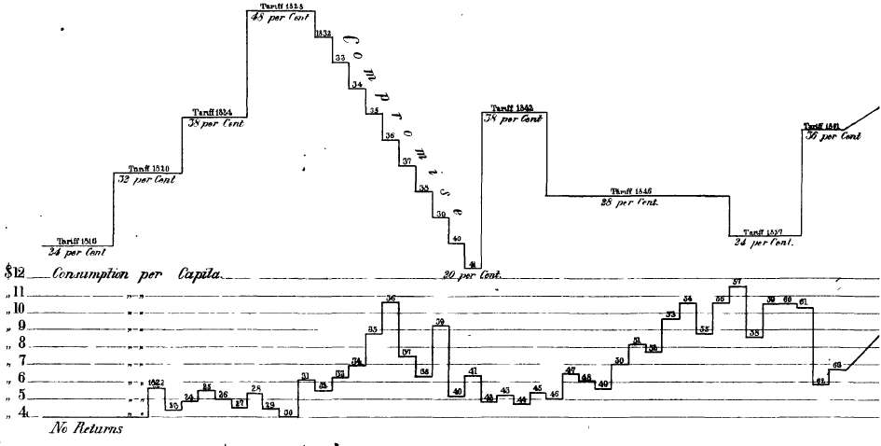
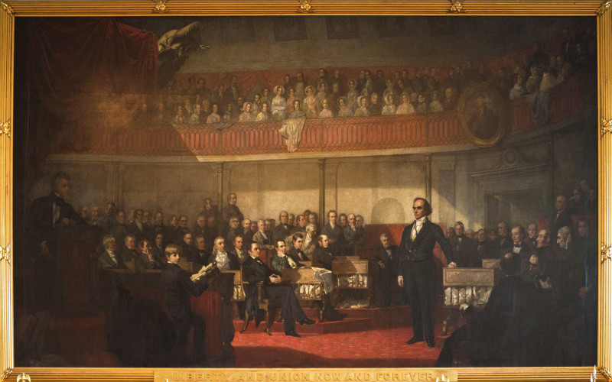
“Our Federal Union” Continued
Webster-Hayne Debate:
  States’ Rights (Hayne) v. National Power (Webster)
  Hayne advocated nullification
  “Second Reply to Hayne”
    Webster advocated national power
    “Liberty and Union, now and forever, one and inseparable.”
Nullification Crisis:
  Calhoun becomes Senator from SC
  SC nullified tariffs of 1828 and 1832
Compromise Tariff of 1833 (Henry Clay):
  Reduced tariff rates by 10% per year for 8 years
Force Bill:
  President could use military in future to collect tariffs

Slide 9
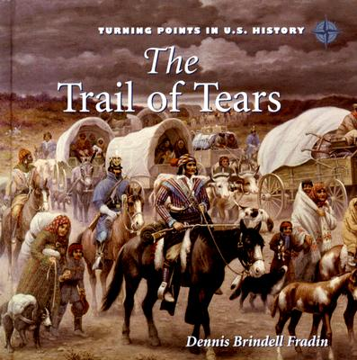
The Removal of Indians
Jackson advocated removal of Natives west of Mississippi River
“5 Civilized Tribes”
  Located in the South – GA, AL, MS, FL
Indian Removal Act (1830)
  Aimed to move southern tribes to west of MS River
Worcester v. Georgia (1832)
  Supreme Court stated Natives could NOT be forced to move
  Jackson ignores the decision
Trail of Tears:
  Winter of 1838
  Forced removal of 1,000s of Natives
  1/8 died during or shortly after arriving out west

Slide 10
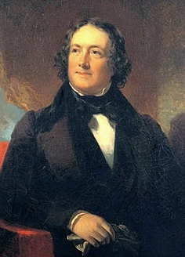
Jackson and the Bank War
Maysville Road Veto:
  Jackson vetoed bill that was part of intrastate commerce
Nicholas Biddle:
  President of the BUS
Hard Money Advocates:
  Favored payment with gold and silver
  Wealthy would favor
Soft Money Advocates
  Favored paper money
  Poor would favor, lead to inflation

Slide 11
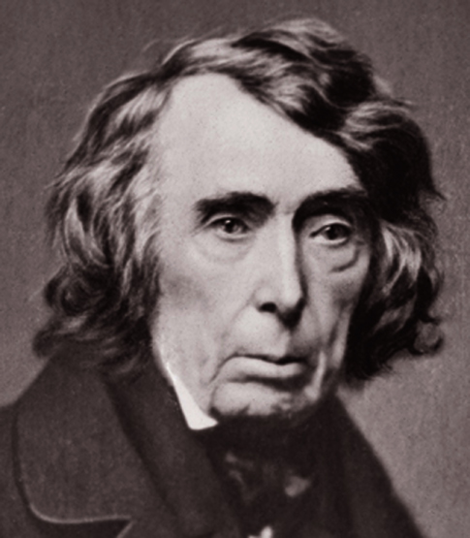
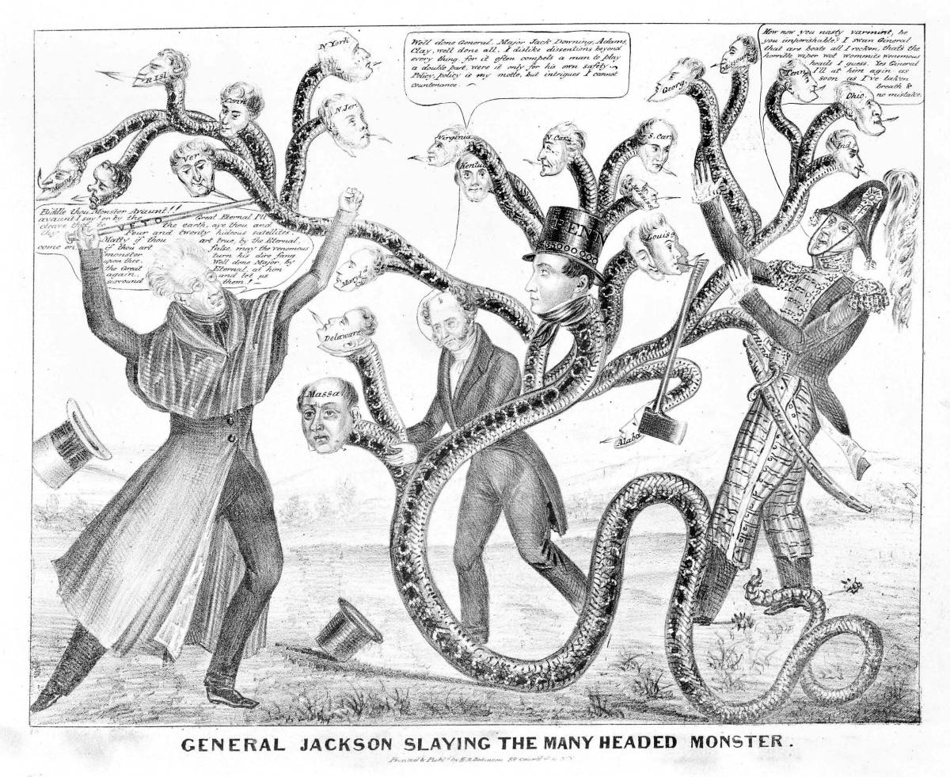
Jackson and the Bank War Continued
1832 veto:
  Jackson vetoes the re-charter of the BUS (BUS would expire in 1836)
Removal of Bank Deposits:
  Jackson removed all government deposits from the BUS and placed in state “pet” banks
  Biddle called in loans
  Economic crisis ensues
Roger B. Taney
  Jackson’s Treasury Secretary, appointed Chief Justice of the Supreme Court after Marshall died (1835)
Charles River Bridge v. Warren Bridge (1837):
  Contracts could be breached if it benefited the community
  In essence, it reversed Dartmouth College v. Woodward

Slide 12
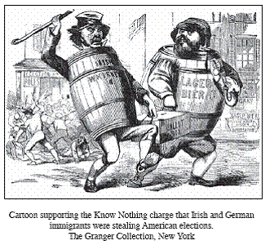
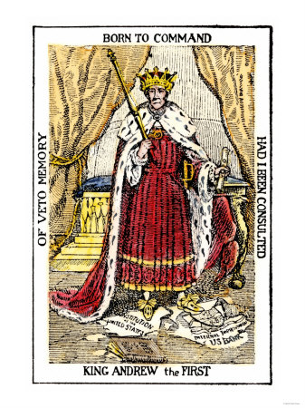
The Changing Face of American Politics
Whigs:
  Formed in response to “King Andrew I”
  Favored strong central government
  Promoted industry and internal improvements (especially in the West)
Anti-Mason Party
  1st 3rd Party
  Anti-secret society
Irish and Germans (immigrants) tended to be Democrats

Slide 13


The Changing Face of American Politics Continued
Specie Circular (1836):
  All payments for land must be in gold or silver
  Helped contribute to………
Panic of 1837:
  Causes:
    Overspeculation
    Crop failures
    Panics in Europe
  Effects:
    100s of banks failed
    Unemployment grew
    Prices of land dropped
Independent Treasury:
  Government money would no longer be in private banks

Slide 14
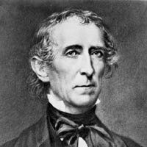
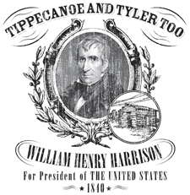
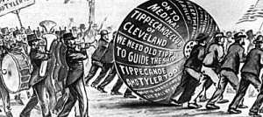
The Changing Face of American Politics Continued
Election of 1840
  MVB v. “Tippecanoe and Tyler Too”
    “Log Cabins and Hard Cider”
    “Get the ball rolling”
WHH dies 30 days into his presidency
Tyler “His Ascendency”
  Democrat at heart, hated Jackson
Caroline:
  British attack that killed 1 American
“Aroostook War”
  Conflict between lumberjacks in Maine and Canada
  Webster-Ashburton Treaty settled boundary dispute in ME
Creole:
  100 slaves took over ship, fled to Bahamas

Slide 15
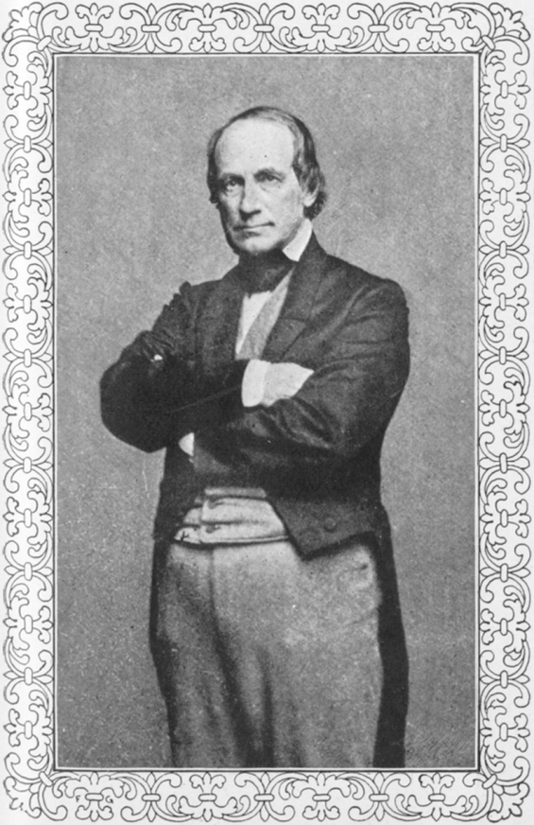
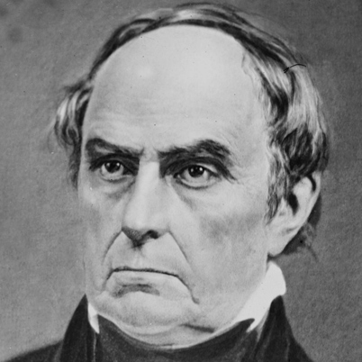
The Changing Face of American Politics Continued
Two treaties to know:
Webster-Ashburton Treaty:
  Resolved a boundary dispute between Maine and Canada
Treaty of Wang Hya (1844):
  Caleb Cushing
  Americans received trading rights in China
  Extraterritoriality

Slide 16



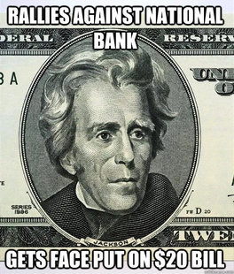
Thanks for watching!
  Subscribe to my channel
  Help spread the word
Questions? Comments? Ideas for videos?
  Leave in comments
Subscribe
Down here!

