Slide 1
Chapter 11 Review

Slide 2
The “Revolution of 1800”
Jefferson wins, Burr becomes VP
  Peaceful transfer of power among parties
  12th Amendment
Jefferson keeps virtually all of Hamilton’s policies in place (not excise tax)
“We are all Republicans, we are all Federalists.”

Slide 3
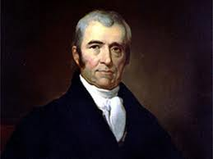
Emerging Judicial Branch
Judiciary Act of 1801
  Created 16 new judgeships and other offices
“Midnight Judges”
  Last minute appointments by Adams prior to leaving office
JOHN MARSHALL (KNOW HIM AT ALL COSTS)
  Served 34 years
  INCREASED THE POWER OF THE FEDERAL GOVERNMENT

Slide 4
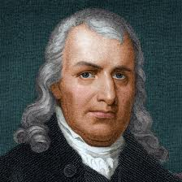
More Judicial Branch
Marbury vs. Madison (1803)
  Marbury sues Secretary of State Madison
  Part of Judiciary Act ruled unconstitutional
  ***SIGNIFICANCE***
    Judicial Branch is the sole interpreter of the constitution
    Sets the precedent that the Supreme Court can declare laws unconstitutional
Samuel Chase:
  Impeached by Republicans – due to personality
  Found not guilty in the Senate
  Significance: No real serious attempt has been made to reshape S.C. by impeachment

Slide 5
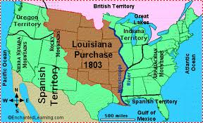
The Louisiana Purchase
Jefferson tries to buy NO from the French for $10 million.
Livingston and Monroe are offered all of Louisiana for $15 million!
Jefferson thought this was necessary to the country, but felt it was unconstitutional
Role reversal of strict vs. loose interpretation
US doubled in size

Slide 6
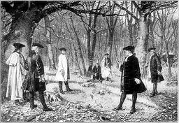
Aaron Burr
Burr plotted a secession of New England
  Burr challenges Hamilton to a duel and kills him
  His political career is over, tries to separate western part of US
Arrested and tried for treason.
  Found not guilty
  Flees to Europe and urges an alliance between France and England against US

Slide 7
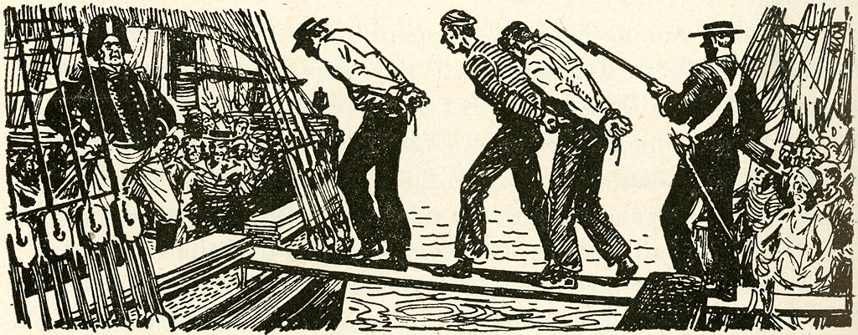
A Precarious Neutrality
America is caught between Britain and France
  Berlin Decree (1806): France would confiscate ships trading with Britain
  Orders in Council (1806): Britain’s response to France, forced ships trading with France to stop in Britain first to be loaded with goods
IMPRESSMENT:
  Forcible enlistment of American merchants and sailors into the British navy
Chesapeake Incident:
  British warship fires on American ship, kills 3, injures 18. Angers Americans greatly

Slide 8
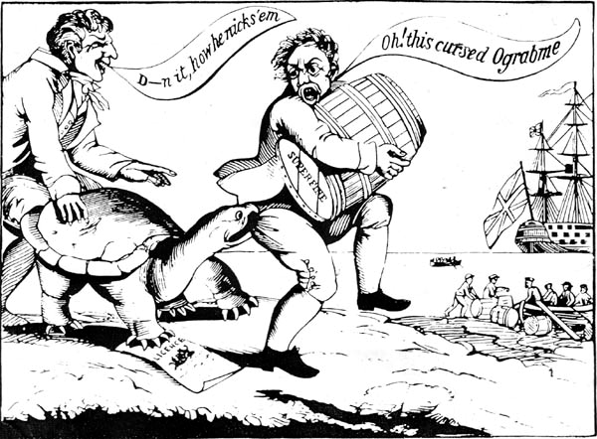
The Hated Embargo
Embargo Act of 1807:
  Forbade export of ALL goods from US, no matter the destination
  Intent was to make France and Britain respect America’s rights
The plan backfired horrifically
  Economy of US takes a huge hit
  New England was hurt the most (Federalists are angry)
  Act revoked in 1809

Slide 9
Non-Intercourse Act:
  Reopened trade with all nations of the world, except Britain and France
  US economy is still hurting, needs those two large countries to trade with
Positives of embargos?
  Beginnings of the Industrial Revolution are born
  Factories begin to pop up in New England
Jefferson, who believed agriculture should be the main industry, helped spark industry (supported by Federalist Party)

Slide 10
Macon’s Bill #2
Purpose: to entice Britain or France to repeal shipping restrictions
U.S. would maintain its embargo against the nation that didn't sign on
Leads to US embargo against Britain, helps fuel the War of 1812

Slide 11
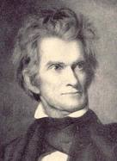
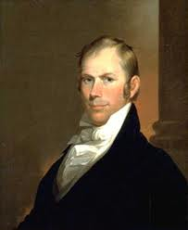
Why war with Britain and Not France?
1. War Hawks pushed Madison toward war
2. Traditional Republican (Jeffersonian) partiality toward France
3. Visibility of British impressments and arming of Amerindians.
4. Chesapeake-Leopard Affair
5. Lure of conquering British Canada: timber, fishing, fur trade.

