Slide 1
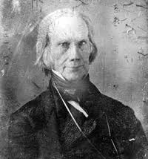
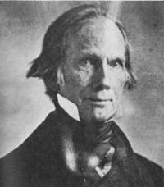
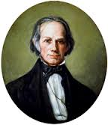
Chapter 12 Review

Slide 2
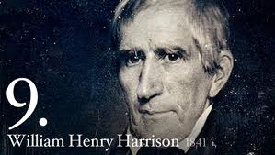
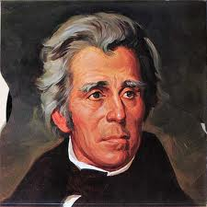
War of 1812 Military Highlights
Battle of Tippecanoe:
  William Henry Harrison defeats Native Americans
Battle of New Orleans:
  2 weeks AFTER Treaty of Ghent, Andrew Jackson defeats British
  HUGE INCREASE IN NATIONALISM
Treaty of Ghent: (HENRY CLAY!!!!)
  Ended war: armistice, no gains or losses

Slide 3
Hartford Convention
Purpose: Discuss their complaints and seek compensation for losses during the war.
Some delegates urged secession
Proposed amendment to Constitution: 2/3 of Congress must agree for embargo, new states to be admitted, or war to be declared
This was the deathblow for the Federalist Party
  Most of America experienced a sense of NATIONALLSIM!!!

Slide 4

“The American System”
Tariff of 1816:
  first tariff in American history instituted to protect industries, not raise revenue
Henry Clay’s (Speaker of the House) American System (Know all 3 parts!!!)
  Strong Banking system (provide credit) Bank of the US
  Protective tariff which would help industries
  Network of roads and canals, esp. in Ohio, valley that would help link the country together
B ank of US (2nd)
I nternal Improvements
T arrifs (1816 – 1st Protective Tariff)

Slide 5
“Era of Good Feelings”
James Monroe’s Presidency
  Coined by Boston newspaper, death of the Federalist party
  Some issues including; slavery, panic of 1819
Causes of Panic of 1819:
  Immediate cause: Overspeculation on frontier lands by banks (especially BUS)

Slide 6
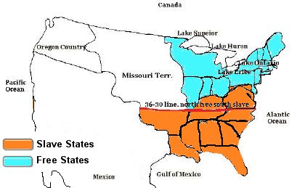
The Uneasy MO Compromise
ME = Free, MO = Slave
Balance between free and slave states at 12
36˚30’: everything above would prohibit slavery
  Most of US above that line
  Helps contribute to sectional differences
MO Compromise lasted for 34 years

Slide 7
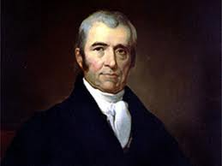
John Marshall and Judicial Nationalism
***John Marshall increased the power of the federal government***
McCulloch v. Maryland (1819)
  MD tried to tax a branch of the BUS; Marshall does not allow it
Cohens v. Virginia (1821)
  Supreme Court is allowed to review decisions of state courts.
  Again, federal government more powerful than states

Slide 8
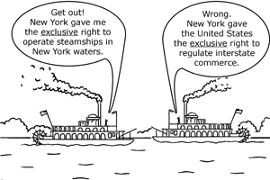
More court cases (KNOW THEM!!)
Gibbons v. Ogden (1824)
  NY grants monopoly to boat company on Hudson (involving trade between NY and NJ)
  Marshall says NO! Congress has sole control over interstate trade
Fletcher v. Peck (1810)
  States cannot “impair” contracts
  Supreme Court can invalidate state laws conflicting with Constitution

Slide 9
One more case
Dartmouth College v. Woodward (1819)
  Issue over NH trying to change charter of college
  Marshall says the charter was a contract and “the Constitution protected contracts against state encroachments”
Marshall helped fuel NATIONALISM!!!!

Slide 10
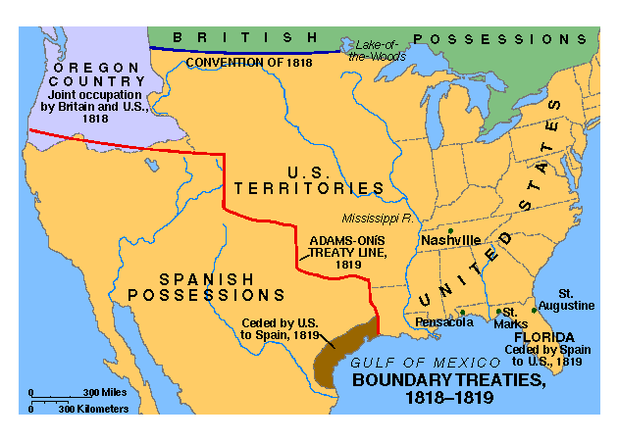
Sharing Oregon and Acquiring Florida
Treaty of 1818:
  Set the northern limits of Louisiana purchase at 49th parallel
Florida Purchase Treaty of 1819
  Spanish ceded Florida, US gives up claims to TX

Slide 11
Monroe and His Doctrine
Monroe Doctrine (1823)
  US warns all of Europe to
    Not colonize Latin America
    Not intervene in Latin America
  In return, US would stay out of European affairs
Reinforces nationalism
Europe is angry, L.A. indifferent
Doctrine has more of an impact in later years

