Slide 1
Chapter 13
The Rise of a Mass Democracy

Slide 2
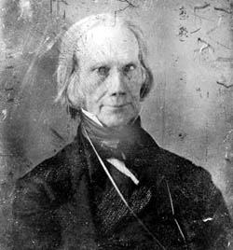
The “Corrupt Bargain” of 1824
4 candidates for president, none win majority of electoral votes; goes to House
  Vote on top 3; as per 12th amendment; Clay out
  Clay (Speaker of House) throws support to Adams
  Adams wins, Clay becomes Secretary of State
Jackson, who won majority of popular vote is furious
Death, AKA “Henry Clay”

Slide 3
John Quincy Adams
Former Secretary of State
  Did not use patronage, or spoils system
  Party members began to question why support him if there is no reward
America began to turn towards sectionalism during this time; long removed from nationalism from War of 1812

Slide 4
“Old Hickory” as President
Was seen as a “common man” since he was born in a log cabin
Democracy increases during his presidency:
  Elimination of property requirements to vote
  Universal white male suffrage
Strong unionist & nationalist (to dismay of South); federal supremacy over states.
Spoils System:
  Rewarding political supporters with public office

Slide 5
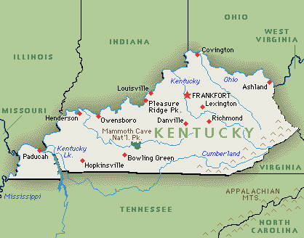
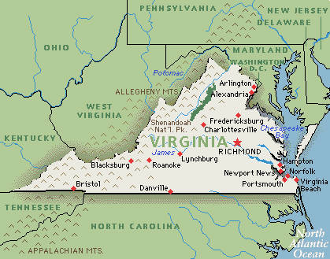
Tariffs
Jackson supporters in Congress pushed for high tariffs, hoping to make Adams look bad
  Tariffs surprisingly passes, Jackson inherits mess
  What region would most be opposed to high tariffs? Why?
Tariffs, especially this one, promote sectional differences
South Carolina proposed that the states should nullify the tariff
  What two states tried to nullify the Alien and Sedition Acts?

Slide 6
“Nullies” in South Carolina
Tariff of 1832
  Reduced the tariff amount, but still high enough to anger the South
South Carolina legislature nullifies tariff
  Threatened to secede from union if federal government tries to collect duties
Jackson threatens to hang “nullies”, including his former VP Calhoun!

Slide 7
Continued
I’m Back Baby!!!!! My 2nd Major Compromise in 13 years.
Henry Clay helps resolve issue:
Compromise Tariff of 1833:
  Tariff would be reduced by 10% per year for 8 years
  Civil war is averted
Force Bill passed by Congress as face-saving device
  President in the future could use military to collect federal tariffs if necessary.
  Dubbed "Bloody Bill" by South Carolinians.
Impact: Stepping stone to Civil War; SC eventually moves from nullification to secession

Slide 8
The Trail of Tears
1790s, US government recognizes tribes as separate nations; agrees to acquire land through formal treaties
Indian Removal Act (1830)
  Removal of Natives (inc. 5 “civilized” tribes) beyond the Mississippi River
“Trail of Tears”
  18,000 Cherokees forcibly removed from their homes and marched 1,000 miles to Indian Territory (Oklahoma).

Slide 9
2 important Court Cases
Cherokee Nation v. Georgia (1831)
  Court ruled that the Cherokee nation was not a foreign nation with the right to sue in Federal Court
Worcester v. Georgia (1832)
  Ruled that the laws Georgia had no force within the boundaries of the Cherokee land and the Cherokee could not be required to move West.
  Jackson: "John Marshall has made his decision; let him enforce it if he can."

Slide 10
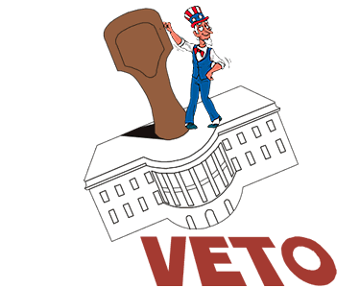
The Bank War
Jackson hated BUS, declaring it unconst.
  Vetoed new charter of bank
  Used the veto 12 times in presidency, all presidents combined for 10 vetoes prior to Jackson
  Veto is used because he doesn’t like the bank
1833, Jackson decides to bury bank by removing federal funds
  Nicholas Biddle, president of bank, calls in loans, creates a “panic”
1836, economy is spinning out of control, Jackson issues, Specie Circular:
  All public lands be purchased with “hard” currency
  Helps contribute to panic and crash in 1837

Slide 11
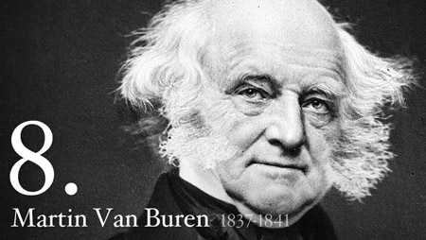
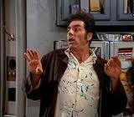
The Election of 1836
Who were the “Van Buren Boys?”
Martin Van Buren, VP during Jackson’s second term
Whigs hoped to throw election into House
MVB wins 170 – 124 (all Whigs combined)

Slide 12
Panic of 1837
What caused Panic of 1837?
  Speculation of western land
  Bank War
  Specie Circular
  Failure of wheat crops
  Hessian fly (brought to the US by Hessian soldiers during Revolutionary War)
Pet Banks:
  Banks which the government deposited funds after death of BUS
Divorce Bill:
  Separating the government from banking altogether
Independent Treasury Bill (1840)
  Later repealed, then reenacted, separates government funds from private banks.

Slide 13
Mexico and Texas
Mexico becomes independent in 1823

Slide 14
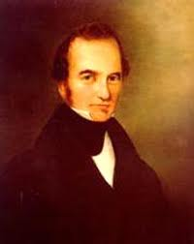
Gone to Texas
1823, a newly independent Mexico granted Stephen Austin what is today Texas:
  Immigrants were to be Catholic
  Properly Mexicanized.
1830, Mexico emancipated slaves, tensions between Mexico and US

Slide 15
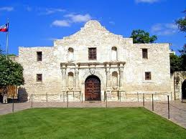
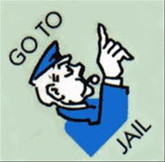
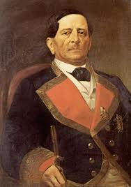
The Lone Star Rebellion
Texas declares independence in 1836
  Sam Houston named commander in chief
  Santa Anna (leader of Mexico) sends 6,000 troops into Texas
  Alamo: 13 day siege, all Americans are killed
San Jacinto:
  Sam Houston captures Santa Anna, sings 2 treaties
    Withdraws Mexican troops, recognizes boundary of Texas
Texas wants to join Union
Fear from North that about issue of slavery
Jackson recognizes Republic of Texas on last day of office

Slide 16
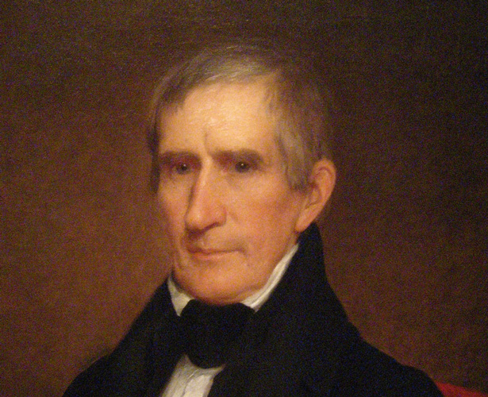
Log Cabins and Hard Cider of 1840
William Henry Harrison vs. MVB in election
WHH adopts log cabin and hard cider as campaign platform
Significance of election:
  First mass-turnout election in American history
  Propaganda and silly slogans set unfortunate example for future campaigns.

Slide 17
The Two-Party System
Favored local rule
Limited government
Free trade, equal economic opportunity (for white males)
Made up of Southerners, westerners and urban workers.
Favored Clay’s American System
Opposed immorality and unlimited immigration
Made up of New Englanders, Protestants, middle class urban professionals.
Democrats
Whigs

