Slide 1
Chapter 14 Review

Slide 2
What was the “Market Revolution?”
Industrial Revolution Transportation Revolution: roads, canals, steamboat, railroad
Change from subsistence farming to large-scale cash-crop farming.
Regional specialization: East, West and South
Immigration: Irish and German (U.S. need for labor)
Westward movement
Growth of cities

Slide 3

Immigration
1840s and 50s immigration skyrockets, why?
  “Land of freedom and opportunity”
  Abundance of land in US
  Disease
Mid 1840s, potato famine strikes Ireland
  ¼ of country dies due to disease/hunger
  “Black Forties”
    Period when many Irish died/emigrated to other countries
Most lived in cities, not enough $ to move west
Jobs:
  “NINA”
  Canal workers – Erie Canal
  Hated by “Native” Americans for “stealing” jobs due to low wages
Become a powerful political force: patronage, voting – Democrats
Largest group of immigrants from 1830 to Civil War

Slide 4
Nativism
“Nativists”
  Hated foreigners, fear of losing culture, jobs, etc.
Religious Fears
  Many Irish were catholic, fear that would infringe on Protestantism
Order of the Star Spangled Banner, “Know-Nothing Party”
  Political party that hoped to:
    Restrict immigration and naturalization laws

Slide 5
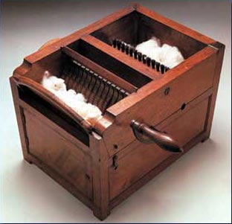
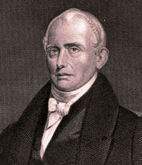
Inventions and Inventors
Samuel Slater:
  “Father of Factory System”
  Memorizes plans for machines, sneaks to US
Eli Whitney:
  Created Cotton Gin, 50 times more effective than handpicking
  Impacts of cotton gin:
    Dependence on slavery which had been dying out
    Factory system in north to create clothes

Slide 6

Inventions Continued
Due to embargos, Americans encouraged to “Buy American” and “Wear American”
Treaty of Ghent in 1815 opens up trade again, GB floods US with cheap products
  US’ response? Tariff of 1816, first protective tariff
  Who will like this? Who will hate this?
Interchangeable Parts:
  Invented by Eli Whitney, machines produce identical parts, if a part breaks, it can easily be replaced
John Deere:
  Invented steel plow that broke soil
Cyrus McCormick
  Mechanical mower-reaper

Slide 7
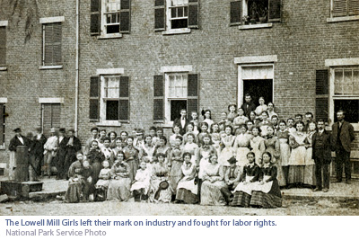
Factory Life
Factory life stunk
  Long hours, low pay, child labor, “whipping rooms”
Lowell Girls:
  Farmers’ daughters hired to work in factories
Significance of factories:
  Change in manufacturing from home to factories
1840:
  MVB establishes 10 work day for federal employees
Strikes were illegal and rare, but did happen
Commonwealth v. Hunt:
  Massachusetts Supreme Court
    Decision: Labor unions legal, so long as they were not violent or subversive
    More symbolic than immediately significant.

Slide 8
Transportation
Cheap and efficient carriers were imperative
  Why?
    Desire and need to tap resources of west
    Trade
Lancaster Turnpike
  Connected Philadelphia to Lancaster, 62 miles
  Spurs construction of other roads
    By 1832, 2,400 miles of roads connecting major cities
Robert Fulton
  Steam Engine, now boats could go in any direction

Slide 9
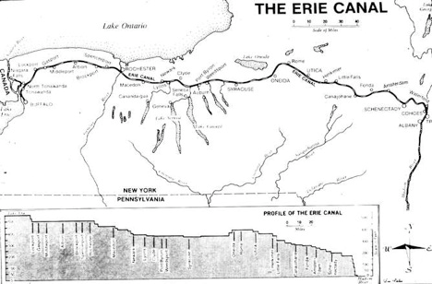
“Clinton’s Big Ditch” in NY
Erie Canal:
  363 miles from Buffalo to Albany
  Hudson River to Great Lakes
Cost to ship grain fell from $100 to $5; 20 days to six
Creation of many cities in NY, especially Lockport
Inrastate commerce

Slide 10
Effects on the Union
By Civil War, continental economy had emerged
Division of Labor applied on a national scale
  South: Agriculture
  North/East: Factories
  West: Livestock

