Slide 1
Chapter 18

Slide 2
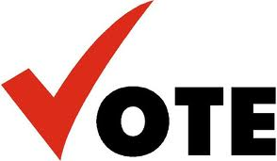
Popular Sovereignty and 1848
Election of 1848:
  Lewis Cass (Democrat) vs. Zachary Taylor (Whig)
Lewis Cass believed slavery should be decided by POPULAR SOVEREIGNTY:
  Belief that the people of a territory should decide the issue of slavery
  Why is this good for politicians? Why is this good for people living there?

Slide 3
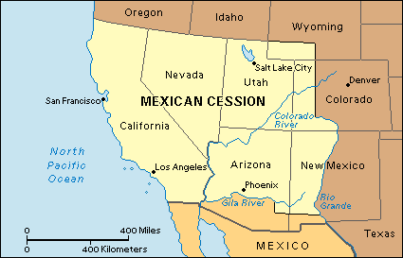
Free-Soilers
Free-Soil Party:
  Favored the Wilmot Proviso, against slavery in territories
    Hated slavery because it took away job opportunities from whites
Conscience Whigs:
  Condemned slavery on moral grounds

Slide 4
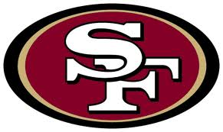


“Californy Gold”
Sutter’s Mill, CA (1848), gold is discovered
Gold paved the way for economic growth
1849:
  CA drafted a constitution that forbade slavery
  Asked Congress for admission, bypassing territory
South is upset, North is happy; potential upset to balance between free and slave states
South =
North =

Slide 5
Sectional Balance and Underground RR
South had many presidents, cabinet members, and justices
  If they were outnumbered in the House, they had equal representation in Senate
Up until CA, 15 states were free, 15 were slave
Harriet Tubman
  19 times she went to the South and rescued over 300 slaves
By 1850, Southerners demanded a new and more stringent fugitive slave-law

Slide 6
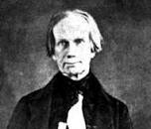
The Great Triumvirate
I’m back baby!
1849:
  “Fire-eaters” in the South threatened secession
Henry Clay is back with…… (with Stephen Douglas)
  Missouri Compromise, Nullification crisis
Favored concessions from both sides; North should yield by enacting tougher fugitive-slave law
John C. Calhoun, “The Great Nullifier”
  Wanted to leave slavery alone, return runaway slaves
Daniel Webster:
  Favored tough fugitive slave law “7th of March Speech”

Slide 7
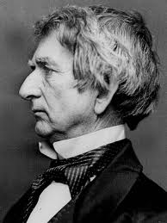
Deadlock….
William H. Seward:
  Against concessions for the South
  Slavery shouldn't be allowed in western territories due to a "higher law" than the Constitution
Taylor was against concession and threatened to veto it……

Slide 8
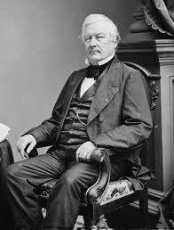
Compromise of 1850
Taylor dies in office, Millard Fillmore takes office, signs Compromise of 1850
  CA admitted as free state
  Slave trade illegal in D.C.
  Popular Sovereignty in Mexican Cession: Utah and New Mexico
  More stringent fugitive-slave law
  Texas received $10 million from federal gov’t for surrendering claim to disputed territory in New Mexico.

Slide 9
Memory Aid for Comp. of 1850
POPFACT:
  Popular Sovereignty in Mexican Cession
  Fugitive Slave Law
  Abolition of slave trade in Washington, D.C.
  California admitted as a state
  Texas given $10 million for disputed New Mexican territory.

Slide 10
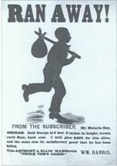
Balancing the Compromise Scales
Fugitive Slave Law of 1850 (“Bloodhound Bill”)
  ***Single most important frictional issue between the North and South in the 1850s***
  Slaves could not testify on own behalf, denied a jury trial
  Northerners who aided slaves could be fined/jailed
Effects of Slave Law:
  Moderates join abolition bandwagon
  “Personal Liberty Laws”: denied local jails to federal officials involved in catching slaves
  Ableman v. Booth, 1859 -- Supreme Court upheld the Fugitive Slave Law.

Slide 11
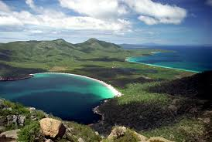
More US Expansion
Clayton-Bulwer Treaty (1850):
  Neither Britain nor America would seek control over future isthmus waterways
Ostend Manifesto:
  Urged US to buy Cuba from Spain for $120 million
  Free-soilers blocked the passage of this

Slide 12
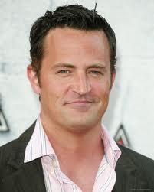
Overseas Expansion
Caleb Cushing:
  Treaty of Wanghia (1844): first diplomatic agreement between US and China, purpose was to promote commerce
    Opened up missionaries for China
1852, Everybody’s “friend” opens up Japan
Treaty of Kanagawa (1854)
  Japan and US begins trade after 200 years of Japanese isolation
  Begins Meiji Restoration

Slide 13
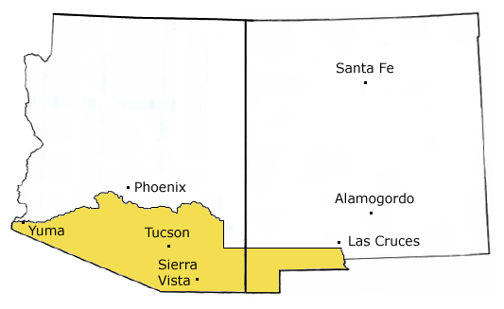
Gadsden Purchase
Desire to build RR to west coast, only one could be built: North or South?
  South wins because of favorable geography
Jefferson Davis (Secretary of War and……) appoints William Gadsen to negotiate purchase of land
Gadsen Purchase (1853)
  US pays $10 million to Santa Anna for area
Watch Jimmy Fallon’s skit

Slide 14
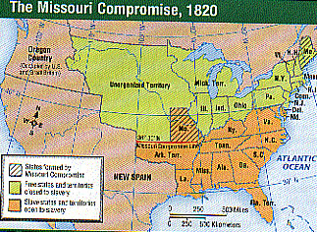

Kansas-Nebraska Scheme
Most important short-term cause of Civil War
  Response to Gadsden Purchase
  Territory of Nebraska would be split into two territories – Kansas and Nebraska
  Slavery issue would be decided by popular sovereignty
  Kansas would presumably become slave, Nebraska free
Repeal’s the Missouri Compromise of 1820 with 36˚30’ line
  North is FURIOUS
North =

