Slide 1
Chapter 19

Slide 2
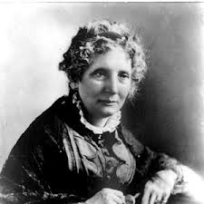
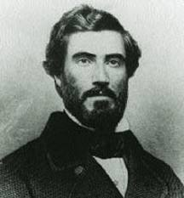
Key Books That Upset The South
I Lived in Cincinnati, OH from 1832 - 1850
Uncle Tom’s Cabin
Translated into more than 20 languages
Helped thousands of northerners join the cause
Refuse to help with fugitive slave law
Kept France and England from siding with South
The Impending Crisis of the South
Nonslave-holding whites were the ones that suffered most from slavery
Banned and burned in the South

Slide 3
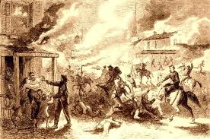
Kansas: Free or Slave?
Kansas-Nebraska Act had an “unspoken agreement” that KS would be slave, NE free
Pro and anti slavery forces come out in full force to vote
Shawnee Mission: slavery supporters “puppet government”
Lawrence: Free-soil city burned by pro-slavery raiders

Slide 4
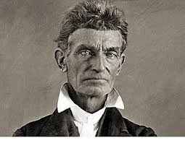
Bleeding Kansas
Pottawatomie Creek:
Led by abolitionist John Brown, five proslaveryites were hacked to pieces
Leads to massive retaliation
Lecompton Constitution:
Kansas could vote for constitution with or without slavery, Free-soilers refuse to vote, President Buchanan supports Constitution
KS does not become a state until 1861 after South seceded

Slide 5
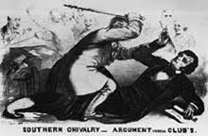
Brooks and Sumner
Charles Sumner – leading abolitionist
Upset with conflict in KS
Badmouths SC and senator, Andrew Butler
Congressman Preston S. Brooks (SC)
Resented attacks on state and cousin
Violently beat Sumner with a cane
Beating represents high tensions in Congress over slavery issue

Slide 6
Election of 1856
James Buchanan (Democrat)– nominated because he was not involved with KS-NE Act
Captain John C. Fremont (Republican) – nominated for the same reasons
Know-Nothing Party: nominated Millard Fillmore
Anti-foreign and Anti-Catholic sentiment was still strong, supported by “WASP”s
“Fire eaters” made it known if a Republican won, they would secede

Slide 7
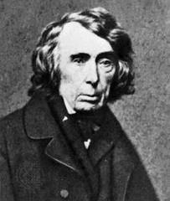
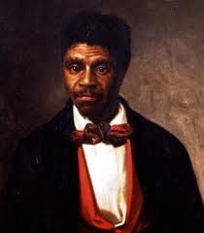
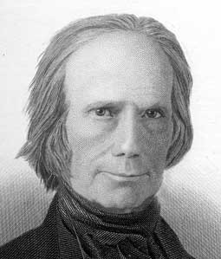
Dred Scott
Roger, why are
you ruling
my compromise
unconstitutional
bro?
Scott sued for his freedom
Roger Taney (Chief Justice) wrote majority opinion that stated:
Slaves are not citizens, cannot sue
Slaves are property, could not be taken away without due process (5th amendment)
MO compromise is unconstitutional (Congress cannot legislate slavery in territories)

Slide 8
Crash of 1857
Causes:
Gold from CA inflated currency
Land Speculation
Overproduction of grain
Results of Crash:
North was hardest hit, South not bad at all
Tariff of 1857:
Several months before the crash, tariff rates lowered to 20%, lowest since War of 1812

Slide 9
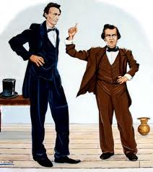
Lincoln v. Douglas
Lincoln (Republican) challenges Douglas (Democrat and KS-NE fame) to debates for Douglas’ Senate seat
Freeport Doctrine:
Lincoln asks, “Could a territory vote down slavery despite the Dred Scott decision?”
Douglas stated that territories could pass laws to limit slavery
Impact of Doctrine:
Split in Democratic party for 1860 election, Lincoln emerges on the national spotlight

Slide 10
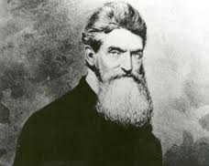
John Brown: Hero or Villain?
Harper’s Ferry:
John Brown and followers seize an arsenal, killing 7 innocent people
Hoped to encourage a massive slave rebellion
Brown is convicted of murder and treason, hanged with followers
Effects of John Brown’s raid:
Becomes a martyr in the North to abolitionists
South becomes very fearful of future attacks
Major immediate cause of disunion

Slide 11
The Disruption of the Democrats
Election of 1860, Democrats are split
Northerners favor Douglas
Southerners view him as a traitor
John C. Breckinridge:
Selected by Southern wing of Democrats
Favored extension of slavery into territories and annexation of Cuba
Constitutional Union Party:
Wanted to elect a compromise candidate

Slide 12
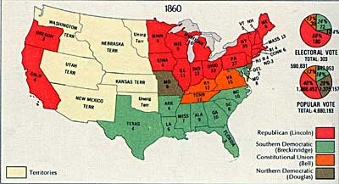
The Election of 1860
Lincoln wins, but is a “Minority” president
60% voted for someone else
Sectional president: not on ballot in 10 southern states
SC threatened to secede if Lincoln won; Charleston 1860 convention unanimously voted to secede
Shortly after, 11 states secede
February 1861: Confederate States of America
Buchanan was a “lame duck” president until March, 1861
Did not believe southern states could legally secede
Did not believe Constitution gave him authority to stop (plus Northern army not prepared)
Crittenden Amendment:
Aimed to appease the South
Slavery in territories was to be prohibited north of 36˚30’, but south of that line was to be given federal protection in all territories existing, or would exist (Cuba)
Lincoln rejects it

