Slide 1
Chapter 23 Review Video

Slide 2
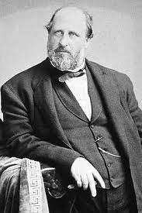
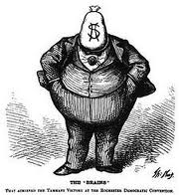
President Grant’s Administration
“Bloody Shirt”
  Using Civil War memories to receive votes
Administration Scandals:
  Credit Mobilier:
    Railroad insiders hired themselves at inflated prices
    VP of US accepted payments
  Whiskey Ring:
    Stole excise-tax revenues from Treasury department
    Grant’s private secretary was involved
Boss Tweed:
  Tammany Hall, stole over $200 million
  Thomas Nast helped contribute to his capture

Slide 3
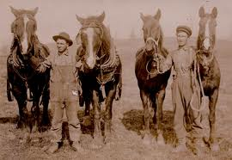

Panic of 1873
Causes:
  Overproduction of RR’s, mines, factories, etc.
  Bankers made too many risky loans
Effects:
  Debate over hard currency vs. greenbacks
  Debtors wanted greenbacks. Why?
    Paper $, inflation decreased value
  Lenders wanted hard currency. Why?
    Hard $, not affected by inflation, increased value
VS

Slide 4
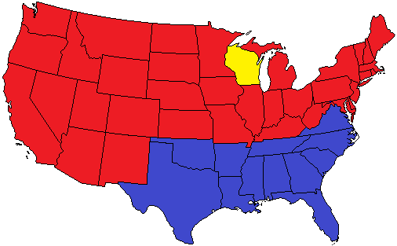
Key Terms to Know
“Solid South”:
  Democratic base in much of the South
Grand Army of Republic (GAR):
  Several 100,000 Union veterans that tended to vote Republican
Stalwarts:
  Led by Roscoe Conkling, believed in patronage
Half-Breeds:
  Led by James G. Blaine, wanted civil service reform

Slide 5
Compromise of 1877 & Civil Rights
Settled the dispute in the election of 1876 (Hayes – Republican, Tilden – Democrat)
Hayes (R) is elected, Democrats are promised :
In return for compromise:
  Reconstruction ends – Military is withdrawn
  Patronage, RR construction through Texas
Civil Rights Act of 1875:
  Guaranteed EQUAL accommodations in public places and prohibited racial discrimination in jury selection
Civil Rights Cases (1883)
  Supreme Court stated 14th amendment only prohibited government violations of civil rights, not denial by individuals
  Sets up stage for Jim Crow Laws – legal segregation

Slide 6
Railroads and Immigration
1880: 9% of CA population were Asian immigrants
  Asians tended to build RR and dig for gold
  Leads to discrimination and resentment towards immigrants
    Nativism
Chinese Exclusion Act: Limits Chinese immigration until 1943
US vs. Wong Kim Ark:
  Guarantees citizenship to ALL people born in US

Slide 7
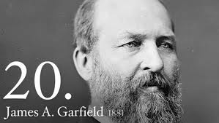
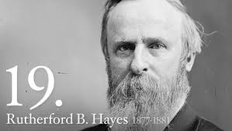
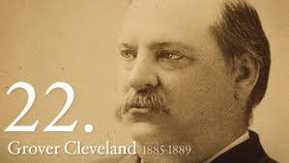
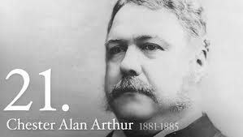
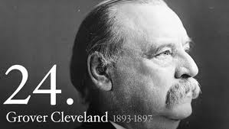
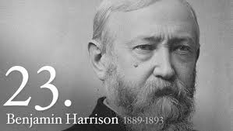
The Era of Forgotten Presidents (1877 – 1896)
Rutherford B. Hayes:
  Compromise of 1877, 1st president to send troops to break up RR strike
James A. Garfield:
  Died 6 months into office – Destiny of a Republic
  In favor of civil service reform
Chester A. Arthur:
  VP to Garfield, was a stalwart
  ***Pendleton Act of 1833 – Instituted Civil Service Reform***
Grover Cleveland:
  Laissez-faire advocate
Benjamin Harrison:
  Won electoral vote against Cleveland, lost electoral vote
Grover Cleveland:
  Still a laissez-faire advocate

Slide 8
Tariffs
1881: Treasury had annual surplus of $145 million
  Most of government revenue came from tariffs
Cleveland wanted lower tariffs – he was a Democrat
***McKinley Tariff Act of 1890***
  Highest peacetime rate ever (48.4%)
  Hated by farmers, loved by North
Remember…. Republicans want to Raise tariffs

Slide 9
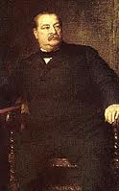
That’s it!
  Subscribe to my channel
  Help spread the word
Questions? Comments? Ideas for videos?
  Email or leave in comments
Thanks for watching………
Subscribe
Down here!

