Slide 1
Chapter 25
America Moves to the City (1865 – 1900)

Slide 2
The Growth of Cities
1st sky-scraper built in Chicago in 1885
Aspects of cities
  Electric trolleys
  Residential neighborhoods segregated by race
Industrial jobs drew people from the country
Cities gave women economic opportunity and independence
  Social workers, secretaries, stenographers, etc.

Slide 3

Rural “general stores” replaced by Sears and Montgomery Ward mail order catalogues
  What stores are replacing “mom and pop” stores today?
Issues in city life
  Waste disposal
  Criminals flourished
  Uncollected garbage
  Population explosion
  Tenement housing

Slide 4
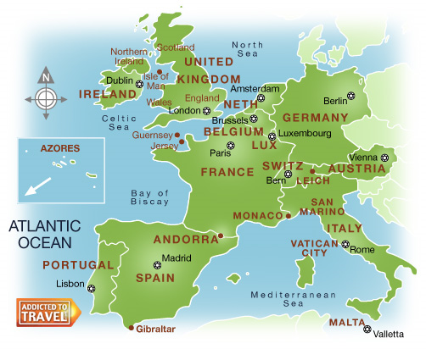
The New Immigration
Old Immigration: Before 1880
Mostly British and Western European
Usually Protestant (some German and Irish Catholics)
  High rate of literacy
  Adjusted to American life pretty easily
  New Immigration (1880-1920)
  Southern and Eastern Europe (Italy, Croatia, Greece, etc.)
  Mostly illiterate, poor, and likely to work in cities
Tensions mount between New and Old

Slide 5
Reasons for Immigration
Europe’s population increasing at drastic rates, many unemployed people
Why did they move here?
  “American letters”
  No military conscription here
  Free from institutionalized religious persecution
  “Birds of Passage”
Many Jews were forced to leave
  Tailors and shopkeepers

Slide 6
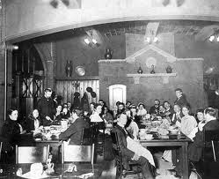
Reactions to the New Immigration
Mostly ignored, except by political bosses.
  Rewarded with jobs
  Tammany Hall
Social Crusaders attempted to improve the "shame of the cities"
Walter Rauschenbusch and Washington Gladden
  Insisted that churches tackle social issues
Jane Addams
  **Hull House** (Settlement House)
1893: Illinois passes anti-sweatshop law
  Most working women were single. Why?

Slide 7
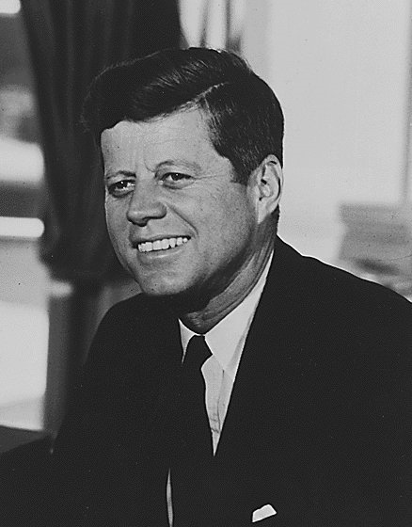
Examples of Nativism
Most New immigrants came for same reasons as Old; to escape poverty
More concerns about New immigrants:
  High birthrate
  Anglo-Saxons could be outvoted and outnumbered
  Radical ideas such as socialism, communism, anarchism, etc.
Just like Know-Nothings, anti-foreign groups emerge
  American Protective Association (APA) – urged voting against Catholics
APA, Why are you hating, bros?

Slide 8
More Immigration stuff
New immigrants were used as strikebreakers
Immigrants were hard to unionize (language)
1882: Chinese Exclusion Act (Chinese not part of New immigration)
Literacy tests were proposed for immigration, but not enacted until 1917.

Slide 9
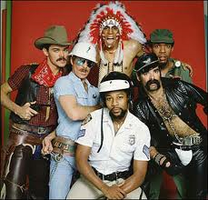
The Social Gospel
Social Gospel:
  Church movement to improve conditions affecting society
YMCA YWCA were formed by churches

Slide 10
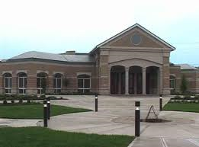
The Lust for Learning
Who helped influence and spread education?
  Horace Man
By 1900, high schools were increasing drastically
  Free textbooks supported by taxpayers
  Private Religious schools
Illiteracy rates dropped from 20% in 1870 to 10.7% in 1900

Slide 11
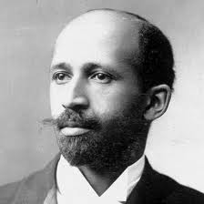
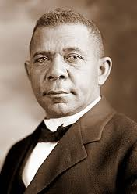
Key African Americans
Booker T.:
  Ex slave, believed Blacks should be educated in trades so they could gain self-respect and economic security
  Labeled “Accommodationist” – someone who seeks compromise
  Called “Uncle Tom” by W.E.B. Du Bois
W.E.B.:
  Ph.D. from Harvard
  Demanded immediate political equality for Blacks
  Helped found NAACP
Differences “reflected the contrasting life experiences of southern and northern Blacks”

Slide 12
Development of New Schools
Morrill Act of 1862:
  Granted public land to states for support of education
Hatch Act of 1887:
  Provided federal funds for establishment of agricultural experiment stations
New colleges and Universities develop
  Cornell
  Johns Hopkins

Slide 13
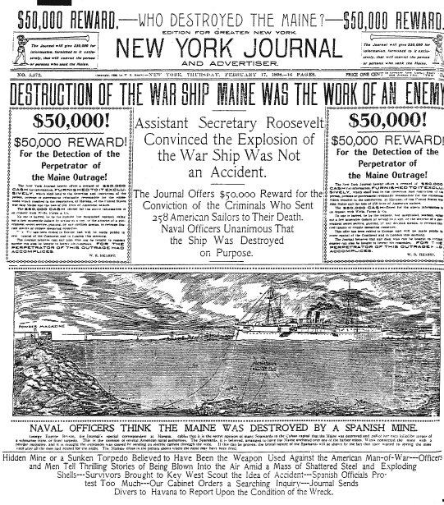

The Role of the Press
Sensationalism:
  Public interested in sex, scandal, and human interest stories
Yellow Journalism:
  Exaggerating/making up stories to sell newspapers
  Hearst and Pulitzer

Slide 14
Key Books and Authors to Know
Edward Bellamy:
  Looking Backward, government nationalized big business to serve interest of public
***Horatio Alger***
  Wrote that virtue, honesty, and industry are rewarded by success, wealth, and honor
  “Rags to Riches” stories
Frank Norris
  The Octopus, RR and corrupt politicians
Jacob A. Riis -- How the Other Half Lives (1890)
  Photo-journalist who exposed dirt, disease, vice, and misery of rat-infested New York slums

Slide 15

That’s it!
  Subscribe to my channel
  Help spread the word
Questions? Comments? Ideas for videos?
  Email or leave in comments
Subscribing to this channel equals WINNING!
Subscribe
Down here!

