Slide 1
Chapter 27 Review Video

Slide 2
Reasons for Imperialism
Markets beyond American shores: way to make more $$$$
Books: Reverend Josiah Strong’s Our Country
  Preached superiority of Anglo-Saxon civilization
The influence of Sea Power: Alfred T. Mahan
  Control of sea was the key to world dominance
Desire for a Canal connecting Atlantic and Pacific

Slide 3
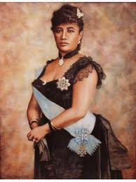
Hawaii
Why was Hawaii attractive to US?
  Sugar production
Since 1840s, US had foreign interest in HI
1887: US establishes base at Pearl Harbor
US wanted to annex HI
Queen Liliuokalani: leader of HI, believed native Hawaiians should control the islands
Queen was overthrown in 1893 after revolt by planters
Treaty to annex HI was initially rejected by Grover Cleveland

Slide 4
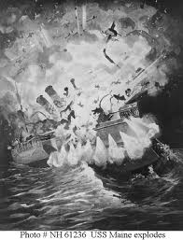
Revolt in Cuba
Tariff in 1894 taxed sugar at high rate
Cuba revolted against Spain, following a policy of scorched-earth
US very concerned. Why?
  $50 million of investments, $100 million of annual trade
Spanish General “Butcher” Weyler tried to crush rebellion
  Barbed-wire reconcentration camps
  Yellow Journalism: “You furnish the pictures and I’ll furnish the war”
Spanish Minister spoke negatively about McKinley: Called him weak!
  De Lome letter
USS Maine mysteriously blew up, killing 260 sailors

Slide 5
Revolt continued
USS Maine and subsequent pictures was a HUGE cause for US involvement in war (February 15, 1898)
April 11, 1898 McKinley sends a message to Congress urging war with Spain
Teller Amendment:
  Once US overthrew Spanish rule, Cubans would be given their freedom
The war was fought over “A Boat and a Note.”

Slide 6
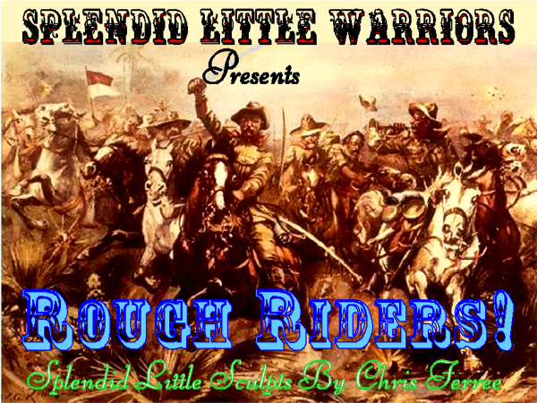
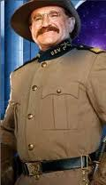
The Invasion of Cuba
“Rough Riders”
  Group of volunteers that played a role in Spanish-American War in Cuba
August 12, 1898 armistice was signed
400 Americans died during battle, 5,000 died due to disease

Slide 7
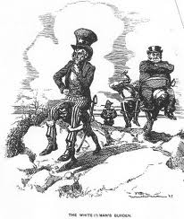
America’s Gains
What did America gain?
  Guam, Cuba, Puerto Rico
  Philippines
    Key issue of what to do. McKinley planned to “Christianize and civilize them”
Anti-Imperialist League
  Mark Twain, Presidents of Harvard and Stanford, Samuel Gompers, and Carnegie
  Didn’t Filipinos deserve “Consent of the governed?”
White Man’s Burden encouraged imperialism

Slide 8
Perplexities in Puerto Rico and Cuba
Foraker Act of 1900
  Puerto Ricans granted limited degree of popular government
  Later granted US citizenship in 1917
Key question with new land: Does Constitution follow flag? Protect these people?
Insular Cases
  Constitution does not apply to new areas. “Subjects may be subject to American rule, but they did not enjoy all American rights.”
1902, US withdraws from Cuba…. sort of
Platt Amendment (Know this!!)
  Cuba can’t have treaties with other countries that compromises independence
  US can intervene to restore order
  Guantanamo Bay given to US

Slide 9
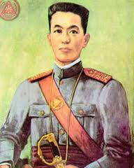
The Philippines
Philippines thought they would receive independence like Cuba, not included in peace negotiations
Emilio Aguinaldo wanted revenge
  Guerilla warfare
Aguinaldo is captured
7/4/1946 the islands are granted independence

Slide 10
Open Door in China
Europe established spheres of influence
US fearful of missing out on markets
Secretary of John Hay established Open Door Note
  Purpose was to insure US would not be locked out of China
Secret Society of the Harmonious Fists
  “Death to Foreign Devils!!!!”
  Broken up by multinational troops

Slide 11
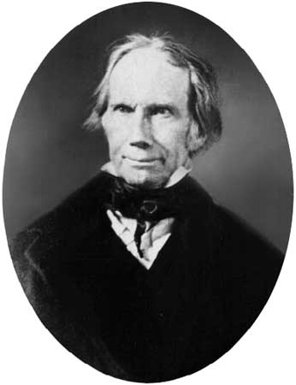
Election of 1900
McKinley easily nominated for another term
  Won a war and acquired new land
  Safeguarded gold standard
Teddy Roosevelt (former governor of NY and War hero selected as VP)
William Jennings Bryan was Democrat nominee
  Lost three different elections…… who else ran and lost several President elections?
  Charged that Lincolns freed African slaves, McKinley reestablished slavery for Filipinos
I’m Back Baby!!!!!

Slide 12
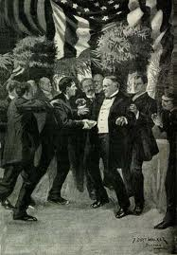
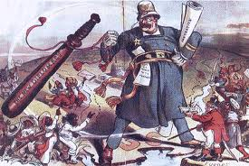
TR and The Big Stick
TR became youngest president ever
“Speak Softly and Carry a Big Stick”
  Use diplomacy often, don’t be afraid to use force if necessary
Believed president “may take any action in the general interest that is not specifically forbidden by the laws of the Constitution”
  So……. Would he be in favor of strictly or loosely interpreting the Constitution?

Slide 13
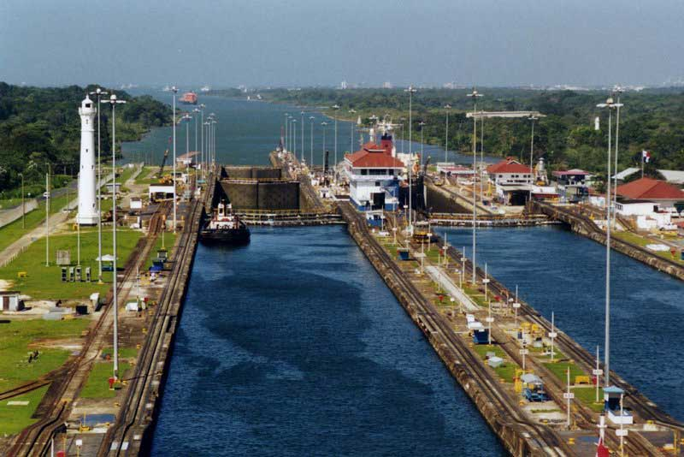
Building the Panama Canal
Canal was vital to US interests
  Cut down travel time for shipping and military
Hay-Pauncefote Treaty of 1901
  Gave US right to build canal and right to fortify it
Colombia (then controlled Panama) rejected treaty to give US right to build canal
November 3, 1901 Rebellion starts in Panama (influenced by US)
Hay-Bunau-Varilla Treaty
  Gave US right to build canal, widened to 10 miles

Slide 14
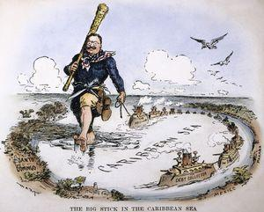
Roosevelt Corollary
Germany and Britain have a lot of $$ owed to them by LA countries
  TR feared they would become involved, violating the Monroe Doctrine. His response???
Roosevelt Corollary:
  In future financial instances, US would intervene, pay off debts.
Impact of Corollary?
  US now more involved in LA
  Resentment from many in LA

Slide 15
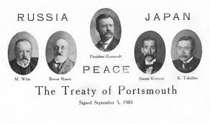
Roosevelt and the Peace Prize
Japan and Russia fight in the Russo-Japanese War (1905)
Japan humiliates Russia with a superior Navy
Japan secretly asks TR to help reach peace agreement
  Wins Nobel Peace Prize in 1906
US relations with Russia negatively affected

Slide 16
Japanese in CA
1906 San Fran school Board segregates Asian students
Tensions between the US and Japan mount
TR and Japan reach “Gentlemen’s Agreement”
  Japan would stop immigrants from coming to US by withholding passports
  Yet another example of nativism
Root-Takahira Agreement:
  US and Japan would respect each other’s territory in the Pacific, uphold Open Door Policy

Slide 17


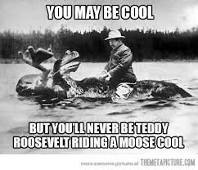
That’s it!
  Subscribe to my channel
  Help spread the word
Questions? Comments? Ideas for videos?
  Leave in comments
Subscribe
Down here!

