Slide 1
Chapter 29: Wilsonian Progressivism at Home and Abroad

Slide 2
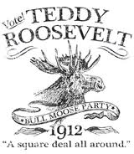
The “Bull Moose” Campaign of 1912
Wilson ran on a progressive platform, “New Freedom”
  Stronger antitrust legislation
  Banking reform (Increase supply of $)
  Tariff reductions
Roosevelt, hates Taft, runs for the Progressive or “Bull Moose” Party
  Supported by Jane Addams and many women
  Sadly, women couldn’t vote at the time
New Nationalism:
  Believed a powerful government should regulate economy and guarantee social justice
    Increase in the power of the federal government

Slide 3
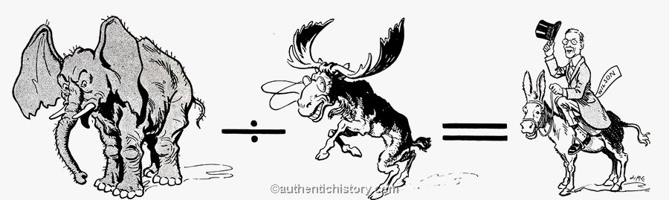
Bull Moose Continued
Two “Republicans” against each other all but guaranteed a victory for Wilson
Comparing New Nationalism and New Freedom
  Both favored more active gov’t in economic and social affairs
  Roosevelt campaigned for women’s suffrage, minimum wage, social insurance
New Freedom:
  Favored small enterprise, free functioning and unregulated and unmonopolized markets

Slide 4
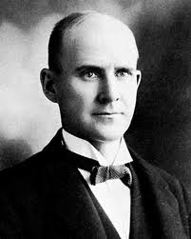
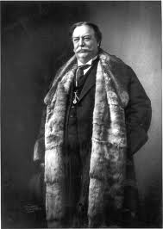
Woodrow Wilson: A Minority President
Wilson: just over 6 million popular votes
Taft and TR: over 7.5 million combined
Eugene V. Debs (1 person not Eugene versus Debs)
  Ran on a socialist ticket
  Received over 900,000 votes
  Socialism was a growing force in the US
Taft becomes Chief Justice of SC in 1921 (Yay Cincinnati!!)
That’s a large robe I’m now wearing!

Slide 5
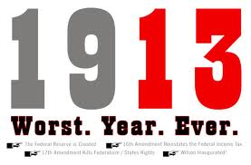
Wilson Tackles the Tariff
Assaulted the “Triple wall of privilege”
  Tariff, banks, trusts
Bully Pulpit:
  President appeals to the public to gain support for legislation and policy
  Popularized by TR, used by Woody Wilson as well
Trying to gain support for lower tariff, Wilson went before Congress and got it passed
Underwood Tariff:
  Provided for a substantial reduction of rates
  ***Beginning of government making $ from other places than tariffs***
16th Amendment:
  Populist idea
  Graduated INCOME tax

Slide 6
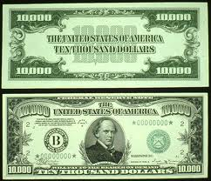
Wilson Battles the Bankers
Panic of 1907 showed inelastic (inability to increase) money supply is a problem
Louis D. Brandeis’s Other People’s Money and How the Bankers Use It exposed problems in banking system
***1913 Federal Reserve Act***
  Responsible for increasing and decreasing money supply
  Members are appointed to terms by the president

Slide 7
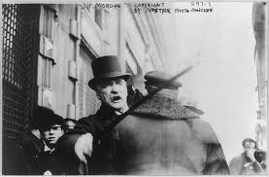
The President Tames the Trusts
Federal Trade Commission Act of 1914:
  President can appoint commission to investigate monopolies
***Clayton Anti-Trust Act of 1914***
  Essentially, gave more power to Sherman Anti-Trust Act
  Made interlocking directories illegal (same individuals serve as directors on boards of competing firms)
    JP Morgan is sad ☹
  Made labor unions and agricultural organizations exempt from antitrust prosecution
    Unlike Sherman Antitrust Act which was used AGAINST unions

Slide 8
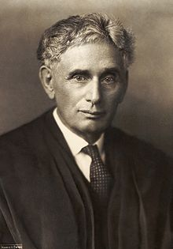
Key Acts during Wilson’s Administration
Federal Farm Loan Act of 1916
  Made credit available to farmers at low interest rates
La Follette Seamen’s Act of 1915
  Required decent treatment and a living wage on American Merchant Ships
  Unintended Consequence:
    made shipping costs increase.
Working-men’s Compensation Act of 1916:
  Provided assistance to federal civil-service employees during periods of disability
Adamson Act of 1916
  8 hour workday for workers on interstate trains, extra pay for overtime
Louis D. Brandeis: appointed justice of Supreme Court, first Jew to serve on the court – Progressive

Slide 9
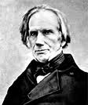
New Directions in Foreign Policy
I just won’t go away!
Wilson backed off imperialistic and aggressive foreign policy
  Hated Big Stick and Dollar Diplomacy Policies
Jones Act of 1916
  Promised independence to Philippines as soon as a “stable government” could be established
  Happened on July 4, 1946
William Jennings Bryan, perennial presidential loser becomes Secretary of State, just like what other perennial presidential loser???

Slide 10
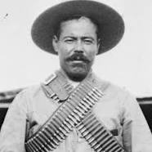
Wilson and Mexico
Americans owned 43% of property in Mexico
General Huerta (an Indian) is installed as President after revolution
Wilson hates Huerta, believes countries have “obligation to elect good men”
US weapons flowed to Huerta’s enemies (Pancho Villa and Vebustiana Carranza)
Villa was assassinated in 1923

Slide 11
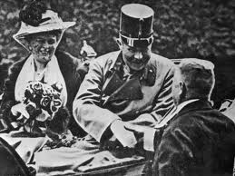
Thunder Across the Sea
WWI started in Europe when Franz Ferdinand was assassinated
MAIN causes of WWI?
US remained neutral for quite a while

Slide 12
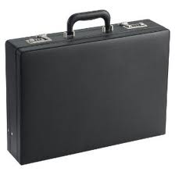
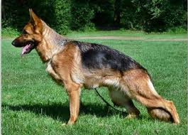
A Precarious Neutrality
Uh oh, my bad!
US naturally had more in common with Britain than Germany (language, culture, economic ties, etc.)
  Anti-German hysteria sweeps nation during WWI
11 million people in US had ties to Central Power countries
Briefcase accidently left in a NYC elevator showed Germany wanted to sabotage US factories

Slide 13
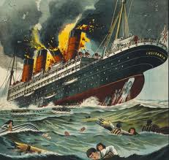
America Earns Blood $
British and French soon order war and commercial goods from US
GB would not allow the Germans to trade with US by blockading seas
  Trade between US and Germany essentially ceased
Unrestricted Submarine warfare: Germany would sink merchant ships
  Berlin said they would try NOT to sink neutral ships
Lusitania: May 7, 1915: 128 Americans died
Germany backed off slightly
"Sussex Pledge" in response. It promised that no attacks would be made on ships without warning.

Slide 14
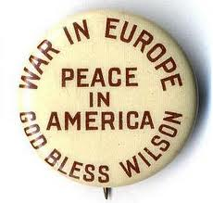
Election of 1916
Roosevelt will not run again, death knell to Progressive Party
Republicans nominate Charles Evans Hughes, supreme court justice
Wilson campaign slogan? “He kept US out of war”

Slide 15


That’s it!
  Subscribe to my channel
  Help spread the word
Questions? Comments? Ideas for videos?
  Leave in comments
Don’t make me mad, SUBSCRIBE!
Subscribe
Down here!

