Slide 1
Chapter 30
The War to End War

Slide 2
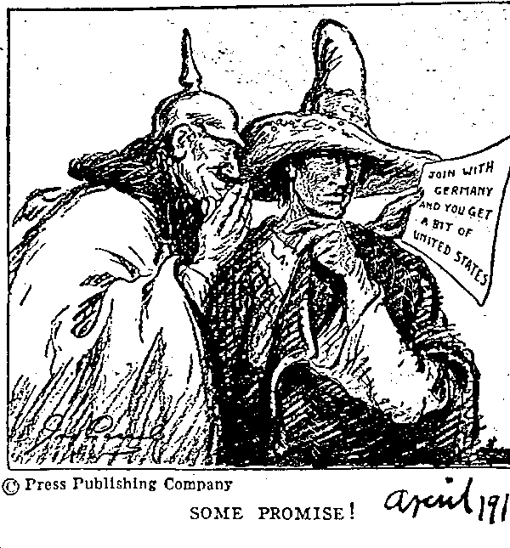
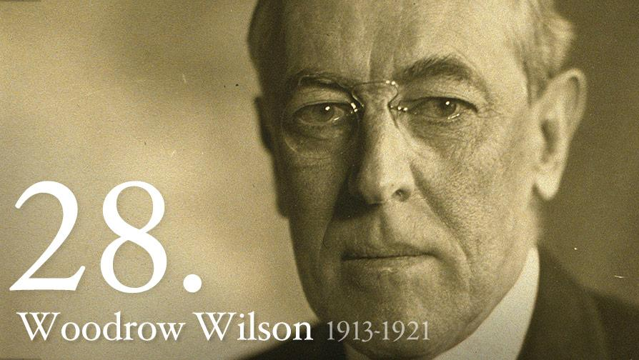
Buildup to US Entrance
Sussex Pledge
  Germany damaged a merchant ship killing 80
  Wilson told Germany if they didn’t give notice, he would break off diplomatic relations
  Germany agreed to give warning for merchant and passenger ships
Zimmermann Note:
  Germany proposed German-Mexican alliance and encouraged Mexico to attack US
March 1917, Germany sinks 4 unarmed merchant ships
April 2, 1917 Wilson asks Congress to declare war

Slide 3
14 Points: January 8, 1918
Wilson’s plan for dealing with postwar world
Major ideas:
  Abolish secret treaties
  Freedom of the seas
  Remove economic barriers
  Reduce arms
  Give up colonies
Other major idea: self-determination
  Countries should govern themselves and decide their own form of government

Slide 4
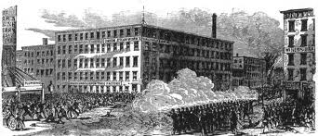
US Entrance into War
Reasons
  Zimmerman Note
  Unrestricted Submarine warfare
Goals:
  “Make the world safe for democracy”
  “A war to end wars”
Selective Service Act: (Conscription: forced military service)
  US creates a draft for soldiers (Men aged 18-45)
  First time since Civil War draft was used (Draft Riots during Civil War)

Slide 5
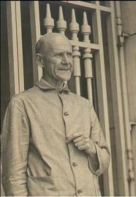
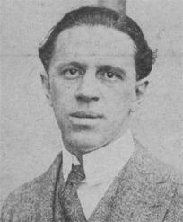
Loyalty
I LOVE spreading propaganda to help out with the war effort!
George Creel: Committee of Public Information
  Journalist hired by Wilson to sell America on the war
Espionage Act of 1917
  Prosecuted Germans and anti-war individuals
  Eugene V. Debs (again 1 person) convicted and sentenced to ten years
Sedition Act of 1918
  Restricted free speech and ability to criticize government…… sound familiar?

Slide 6
Unions During WWI
IWW (Industrial Workers of the World):
  Nicknamed “I won’t work”, sabotaged factories
AFL:
  Led by Samuel Gompers, favored the war
  Membership increases

Slide 7
Factories During WWI
At the beginning of the war, US NOT prepared
Women and African Americans help out greatly in factories (will see this again in WWII)
“Red Summer” of 1919: Race riots in many cities due to African American migrations
W.E.B. Du Bois favored war; hoped to improve standing for African Americans

Slide 8
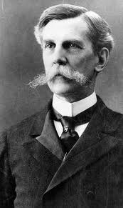
Schenck vs. US (1919)
Protestor handing out leaflets about the war
After being arrested, he sued, citing his 1st amendment right
SC said that free speech could be restricted if presents a “clear and present danger”
Lesson of case: in times of crisis and war, personal liberties decrease

Slide 9
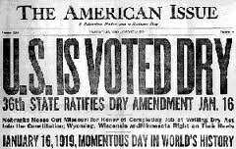
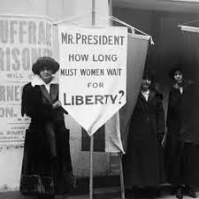
Key Amendments
18th Amendment: (1919)
  Prohibited the sale, consumption, manufacture, or transportation of alcohol
  Fueled in part by anti-German fears
19th Amendment: (1920)
  Granted women the right to vote

Slide 10
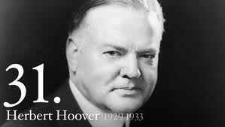
Total War
What is it?
  When all aspects of country gets involved in the war effort
Herbert Hoover:
  Encouraged people to sacrifice goods “Wheat-less Wednesdays”
Many African Americans moved North to work in factories and serve in military

Slide 11
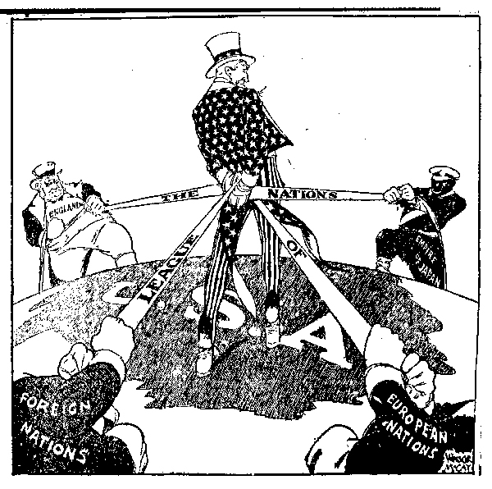
Treaty of Versailles
Some of Wilson’s 14 points are incorporated
League of Nations
  US Senate, controlled by Republicans hated this part of the treaty…. Why?
    Traditional isolationist policies
Henry Cabot Lodge:
  Republican leader in Senate, helped prevent Treaty from passing

Slide 12
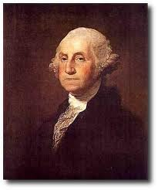
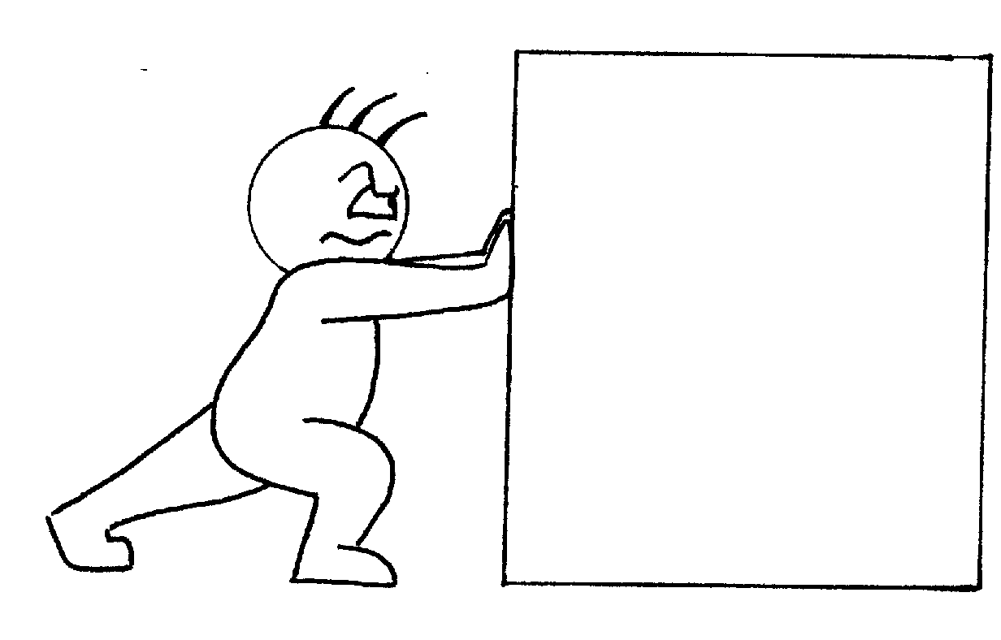
Sooooooo. Why did the Treaty fail?
I will not move Henry!
Don’t do it Woody Wilson. Bad Woodrow!
Isolationists (many were Republican) did not like the League of Nations
  Again, many people wanted the US to stay out of foreign affairs (Washington’s Neutrality Proclamation)
  The League would commit the US to foreign affairs
  Wilson refused to budge on this
  Ultimately, the treaty was defeated
Woodrow Wilson

Slide 13
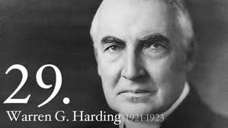
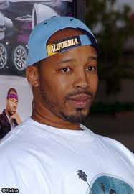
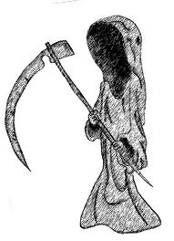
Election of 1920
Warren G………..
  Harding
  Wins presidency while campaigning on “Return to Normalcy”
Progressivism ends, push for isolation
Calvin Coolidge becomes VP, President when Warren G passes away in office

Slide 14


That’s it!
  Subscribe to my channel
  Help spread the word
Questions? Comments? Ideas for videos?
  Leave in comments
APUSH Review videos are NEVER a clear and present danger….. Unlike me
Subscribe
Down here!

