Slide 1
Chapter 31: American Life in the “Roaring Twenties”

Slide 2
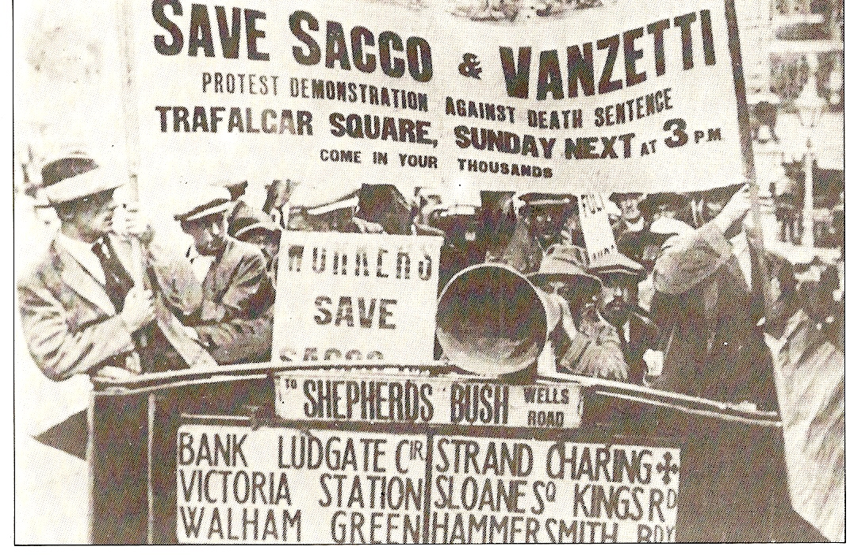
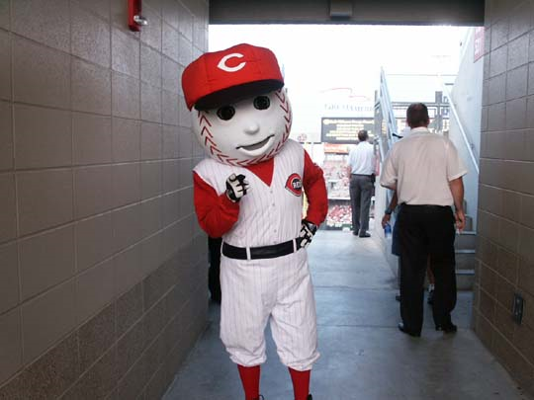
Seeing Red
As communism swept through Russia, fear that labor unions were influenced by Bolsheviks
“Red Scare” of 1919-20 (1st Red Scare)
  Crusade led by Attorney General Mitchell Palmer against suspected communists
  1,000s of Americans were arrested
  Impact of the Red Scare:
    Business people used it to help break unions
Sacco and Vanzetti
  Two Italian immigrants (anarchists, atheists, draft dodgers) charged with murder, found guilty and executed
  Showed tensions between immigrants and nativists

Slide 3
Hooded Hoodlums of the KKK
Re-emerged in the 1920s and was similar to 1860s – 70s KKK movement of anti-foreignism
By mid-1920s, 5 million Americans paid dues as members
Scandals, including embezzlement, helped lead to the decline of the clan

Slide 4
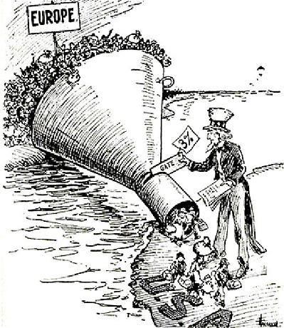
Stemming the Foreign Flood
Just like many times before, nativists fear “new” immigrants
Emergency Quota Act of 1921:
  Restricted number of immigrants from a country to 3% of total people from that country living in US in 1910
    Favored Southern and Eastern Europe
Immigration Act of 1924:
  Quotas for foreigners was cut from 3% to 2%, used 1890 census instead, hurt “New Immigrants”
  Shut out Japanese immigrants: “Hate America” rallies
  Marked an end of era of unrestricted immigration

Slide 5
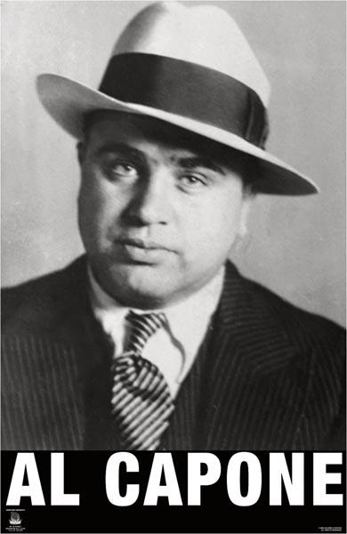
The Prohibition “Experiment”
Popular in South and West
  Southerners wanted to keep alcohol away from blacks
  Westerners hated “Saloon”
Problems with prohibition
  People liked to drink, weak enforcement, many people hostile to law
  Many government officials were bribed
  Increase in organized crime
Positives of Prohibition:
  Bank savings increased
  Absenteeism in industry decreased

Slide 6
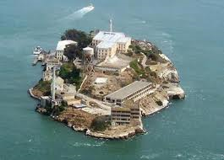
The Golden Age of Gangsterism
Huge demand for illegal alcohol.
Large cities, such as Chicago, flourished with crime
Al Capone, notorious gangster, was very popular
  St. Valentine’s Day Massacre: 7 gang members killed
  Dies of syphilis later in life
Eventually, organized crime spreads to other activities: prostitution, gambling, and narcotics

Slide 7
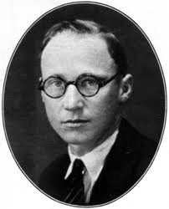
Monkey Business in Tennessee
John Dewey:
  Professor at Columbia, “learn by doing”, “education for life”
Christian Fundamentalists:
  Those that interpret the bible literally
  Detested Darwin’s theory of evolution
“Monkey Trial”
  John Scopes, biology teacher from Dayton Tennessee, violated a law by teaching evolution
  Prosecutor: William Jennings Bryan, Defense Attorney: Clarence Darrow
  Scopes found guilty, paid $100 fine
  Helped fuel religion vs. secularism for many more years

Slide 8
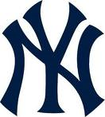

The Mass-Consumption Economy
For much of the 1920s, economy boomed
Cars, once reserved for the rich, became available to many – 30 million by 1930
What fueled Mass-Consumption?
  Advertising!
Sports became huge as well, particularly baseball
  Yes, especially the Yankees ☹
Buying on Credit:
  “Possess today and pay tomorrow”
  Problem later in the 20s and even today

Slide 9
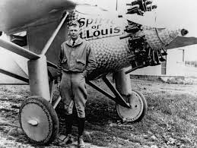
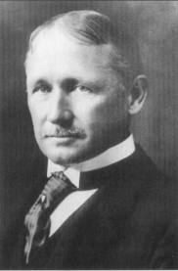
Cars and Planes
RR industry hurt by cars
  What industries did RR hurt when it came out?
Taylorism:
  Promoted efficiency in production. Workers were shown movements to eliminate wasted movement
12/17/03: 12 seconds and 120 feet that changed life forever
Charles Lindbergh:
  First solo flight w/o radio from America to Europe
  Becomes overnight sensation

Slide 10
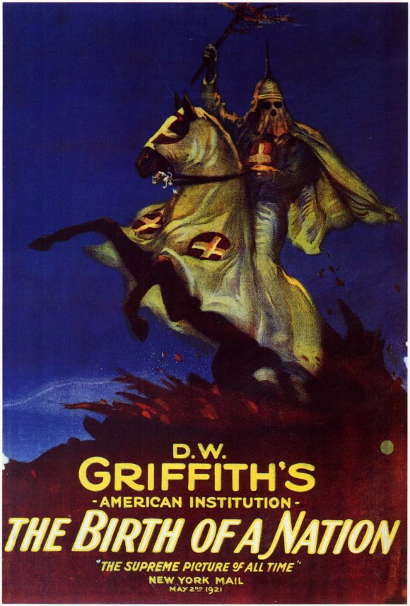
Hollywood’s Filmland Fantasies
Birth of a Nation (1915)
  Glorified the KKK, one of first full-length, popular movies
Hollywood became popular due to warm weather
  Propaganda machine during WWI
  Disney during WWII was instrumental in anti-German propaganda movies
1927, first “talkie” – The Jazz Singer

Slide 11
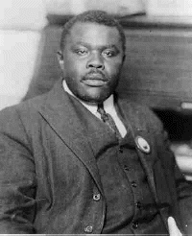
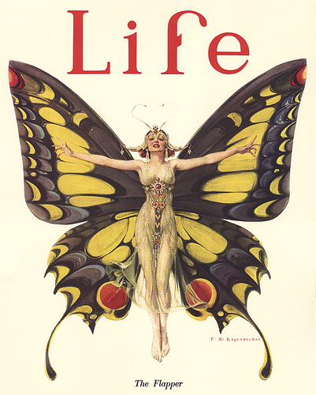
The Dynamic Decade
1920 census
  First time ever, more Americans lived in urban areas
***Margaret Sanger***
  Advocated birth control, contraceptives
  Birth control was illegal in many places
  Upset many fundamentalists
Flappers
  Short(er) dresses and short hair
  Smoked, drank, and (gasp!) danced
Marcus Garvey
  United Negro Improvement Association (UNIA)
  Promote resettlement of American blacks in their own “African homeland”

Slide 12
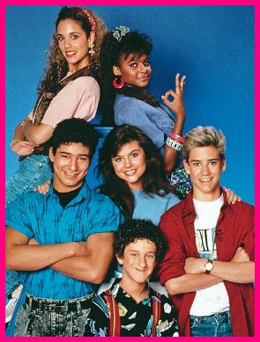
Wall Street’s Big bull Market
1920s stock market soared (Bull market)
Later crashed in 1929 (Bear market)
Bull market driven by:
  Speculation
  Buying “on margin”

Slide 13


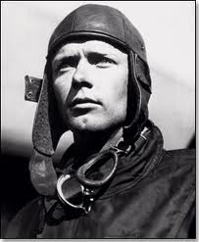
That’s it!
  Subscribe to my channel
  Help spread the word
Questions? Comments? Ideas for videos?
  Leave in comments
Visit Apushreview.com for all the chapter videos and themed videos
Subscribe
Down here!

