Slide 1
Chapter 32: The Politics of Boom and Bust
1920 - 1932
Visit www.Apushreview.com for worksheets, videos, info on key people and concepts!

Slide 2
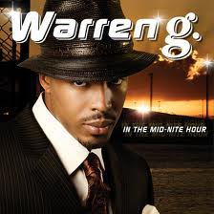
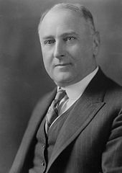
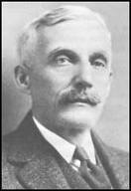
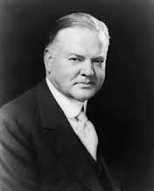
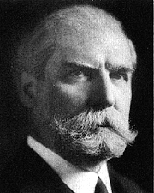
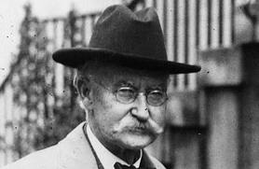
The Republican “Old Guard” Returns
The good:
  Charles Evans Hughes becomes Secretary of State
  Andrew Mellon, Secretary of Treasury
  Herbert Hoover was Secretary of Commerce
The bad:
  Albert Fall as Secretary of Interior
  Harry Daugherty was Attorney General

Slide 3
1920s Government
“Old” laissez-faire: Government does NOT regulate economy at all
“New” laissez-faire: government helps businesses make profits
1920s sees an end to Progressive legislation, including the Supreme Court
Adkins v. Children’s Hospital:
  Reversed Mueller v. Oregon, women no longer protected by special legislation
  Cited 19th Amendment

Slide 4

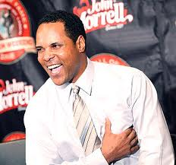
The Aftermath of War
Esch-Cummins Transportation Act of 1920:
  Encouraged private consolidation of RRs and ICC promised their profitability
Labor unions and strikers were seen as “dangerous Reds”
Union membership declines by 30% between 1920 and 1930
Veteran's Bureau:
  Operated hospital and provided benefits to disabled

Slide 5
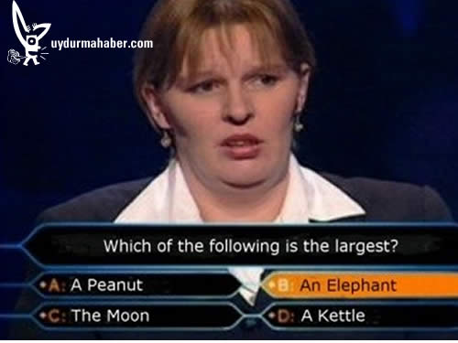
Reducing Militaries
Five Power Naval Treaty:
  US and Britain do not fortify Far East possessions
  No restrictions on small warships
Kellogg-Briand Pact: (Pact of Paris)
  Made wars illegal, except for defensive wars; not enforceable

Slide 6
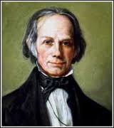
Hiking the Tariff Higher
I like high tariffs! Remember my American System???
What political party generally favors high tariffs? What political party is Warren G….?
Tariffs were raised to high prices to keep American products selling
Fordney-McCumber Tariff Law:
  Raised rates to 38.5%
  Harding and Coolidge both favored high tariffs to help businesses (Both are Republicans)
High tariffs in US encouraged high tariffs in Europe, a problem in years to come

Slide 7
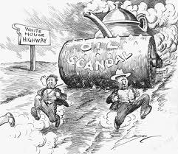
The Stench of Scandal
Colonel Charles Forbes stole $200 million from government, sentenced to two years in jail
***Teapot Dome Scandal***:
  Secretary of Interior Fall transferred land to his department, leased land to oil companies, and took $100,000s in bribes
Just like President Grant, Harding was associated with Corruption and Scandal

Slide 8
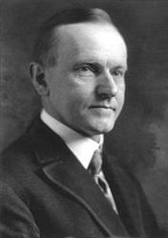
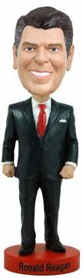
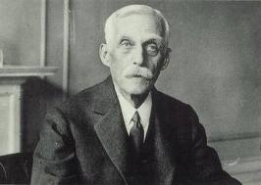
“Silent Cal” Coolidge
Took a large “hands off” approach; desired lower taxes and debts
  “Trickle-down economics”
    Secretary of Treasury Mellon

Slide 9
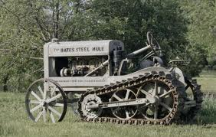
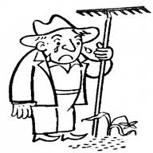
Frustrated Farmers
Farmers lose $
  US government and foreign nations purchasing less goods
  After the war, demand went down
Steel Mule allowed for massive amounts of cultivation in less time -> faster turnover of crops
  Increases production
  More production = higher supply
  Higher supply = lower prices
  Lower prices = sad farmers
Capper-Volstead Act
  Exempted farmers’ marketing cooperatives from antitrust prosecution
  The Clayton anti-trust act exempted who from antitrust prosecution?????

Slide 10
A Three-Way Race …. In 1924
Republicans: Silent Cal
  “Keep cool and keep Coolidge”
Democrats: John Davis
  Corporate lawyer
La Fallette’s new Progressive platform called for government ownership of RR’s and relief for farmers
Coolidge wins in a landslide

Slide 11
Foreign-Policy
US reverts to isolationism in the world, except in Latin America
  Intervened in Caribbean and Central America
America goes from being debtor prior to and during WWI to leading creditor
  Loaned $10 billion to European countries in 1920s

Slide 12

Unraveling the Debt Knot
Hyperinflation in Germany: loaf of bread costs $480 million
***Dawes Plan of 1924***
  Not to be confused with Dawes Severalty Act
  Rescheduled German reparation loans
  US banks loaned $ to Germany -> pays Britain and France -> pays loans back to US Treasury
  Simply a circle of $ - ends with stock market crash of 1929

Slide 13
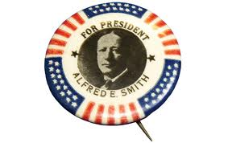
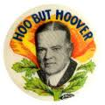
The Triumph of HH, 1928
Republicans: “Hoo but Hoover?” – Coolidge does not run again
Democrats: Alfred Smith -> Roman Catholic
Hoover preached “Rugged individualism”
  Belief that individuals can succeed on hard work and dedication
  Self-made millionaire
“A vote for Al Smith is a vote for the Pope”

Slide 14
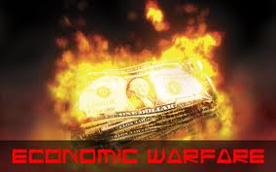
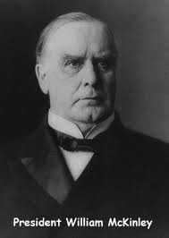
President Hoover’s First Move
Federal Farm Board
  Helped farmers buy, sell, and store agricultural supplies
***Hawley-Smoot Tariff of 1930***
  Designed to assist farmers
  Becomes the highest protective tariff in nation’s peacetime history
    Previous highest peace-time tariff????
  “Economic warfare” on other nations
Other nations, in turn, create high tariffs on US products

Slide 15
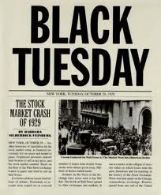
The Great Crash Ends……
Speculative bubble got too big
“Black Tuesday” October 29, 1929
  By end of 1929, $40 billion was lost
By end of 1930, 4 million were jobless, by 1932, 12 million
The economic system was broken, not necessarily individual initiative

Slide 16
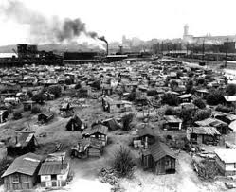
Hooked on the Horn of Plenty
Causes of Depression:
  Overproduction by farmers and factories
  Consumption of goods decreased
  Uneven distribution of wealth: not enough money going into wages and salaries of workers
  Overexpansion of credit
Hawley-Smoot tariff discouraged trade, which made depression worse
Unusual drought in Mississippi Valley
“Ragged individualists” sleep under “Hoover Blankets” in “Hoovervilles”

Slide 17

Hoover Battles the Great Depression
Reconstruction Finance Corporation
  Government lending bank
  Assisted insurance companies, banks, RR’s, etc.
Norris – La Guardia Act
  Outlawed “yellow dog” contracts and forbade federal courts from interfering with strikes, boycotts, etc.

Slide 18
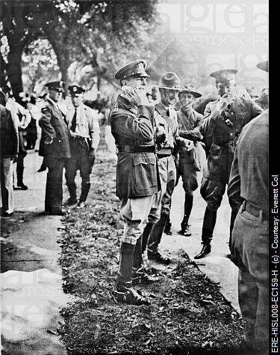
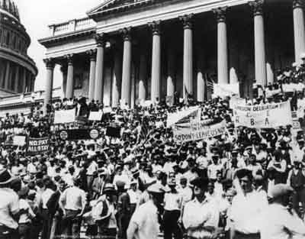
Routing The Bonus Army in Washington
WWI Veterans were hit hard during Depression
“Bonus Expeditionary Force” (BEF)
  Descends upon D.C. in hopes of receiving their bonuses
  Set up “Hoovervilles”
Hoover ordered army (led by MacArthur) to break up “Bonus Army”
Bonus Army eventually leaves, taints Hoover even more

Slide 19
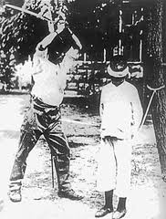
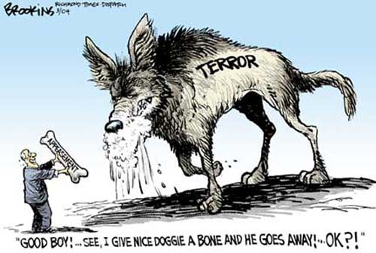
Japanese Militarists Attack China
Japan, in need of natural resources (oil and rubber) invade China, and do so brutally (Rape of Nanjing)
  What Pact did this violate that many countries agreed to only a few years before?
Stimson Doctrine (1932)
  US would not recognize any territory gained by force
US and other countries do not stand up to Japan
Foreshadow of things to come with Hitler
  APPEASEMENT!

Slide 20


That’s it!
  Subscribe to my channel
  Help spread the word
Questions? Comments? Ideas for videos?
  Leave in comments
If only I visited www.apushreview.com
Subscribe
Down here!

