Slide 1
Chapter 33
The Great depression and the New Deal

Slide 2
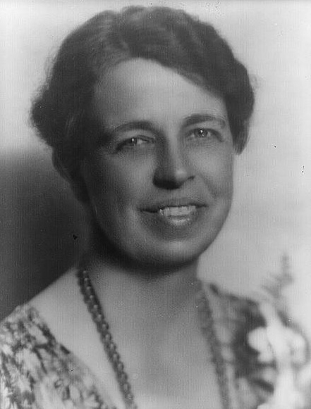
FDR: Politician in a Wheelchair
Disabled from polio at a younger age
  Taught him patience, tolerance, compassion and strength of will
Eleanor:
  Distant cousin of FDR and niece of TR
“Eyes and ears” for Franklin
Redefined the role of the First Lady
As governor of NY, Franklin helped out during the depression by heavy state spending

Slide 3
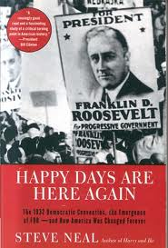
Presidential Hopefuls of 1932
“Brains Trust” created many speeches
  FDR’s “kitchen cabinet”
Campaigned with slogans such as:
  “Happy days are here again”
  “The Worst is Past”
  “Prosperity is just around the corner”

Slide 4
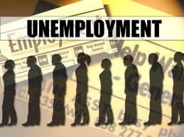
Hoover’s Humiliation in 1932
Blacks shifted their allegiance to the Democratic party
Voters voted as much against Hoover as they did for FDR
High unemployment (1/4) caused voters to want a new president

Slide 5
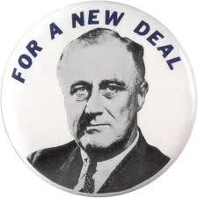
FDR and the Three R’s
March 4, 1933: FDR inaugurated
  “The only thing we have to fear is fear itself”
March 6 -10: Banking holiday
100 days, Congress passed large number of legislation
Relief: provide relief for individuals
Reform: new laws such as child labor
Recovery: Get the country in the right direction

Slide 6

Roosevelt Manages the $
Emergency Banking Relief Act of 1933:
  President could regulate banking transactions
“Fireside Chats”
  FDR assured Americans banks were safe
Glass-Steagall Act:
  Set up FDIC, guaranteed individual banking deposits
Price of gold in 1933: $35 an ounce
Price of gold in 2013?
  $1,600!

Slide 7
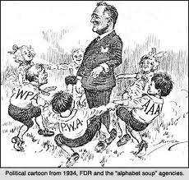
Creating Jobs for the Jobless
Civilian Conservation Corps (CCC)
  Government camps for young men, reforestation, firefighting, etc.
Federal Emergency Relief Act:
  $3 billion to states for work projects and payments
Agricultural Adjustment Act (AAA)
  Helped farmers pay loans
Civil Works Administration (CWA)
  Provided temporary jobs during harsh winter

Slide 8
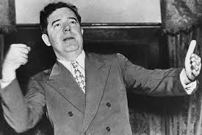
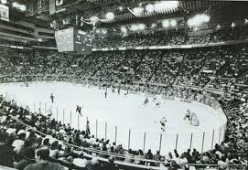
A day for Every Demagogue
Demagogue: someone who appeals to people based on popular desires and wants, rather than using rational argument
Huey Long:
  Senator from LA, promoted “sharing the wealth”
Dr. Francis Townsend:
  Appealed to senior citizens
Works Project Administration (WPA):
  Spent $11 billion on buildings, bridges, roads, etc.
  9 million people were given jobs

Slide 9
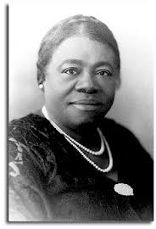
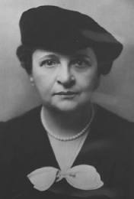
New Visibility for Women
Under FDR, women played a large role in government, more than ever before
Frances Perkins:
  Secretary of Labor: America’s first women secretary
Mary McLeod Bethune
  Director of Office of Minority Affairs
  Highest African American in FDR administration

Slide 10

Helping Industry and Labor
***National Recovery Act (NRA)***
  Designed to assist industry, labor, and unemployed
  Encouraged employers to hire more workers
  Established minimum wage laws
  Gave rights to labor unions
  Outlawed “Yellow Dog Contracts”
Schechter vs. US:
  Declared some of New Deal policies unconstitutional
  Legislative powers could not be delegated to president

Slide 11
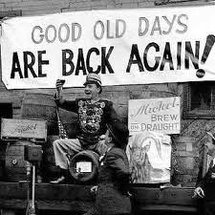
Helping Labor Continued
Public Works Administration (PWA)
  Provided industrial recovery and unemployment relief
  Built Grand Coulee Dam
    Provided for irrigation of millions of acres of new farmland
21st amendment:
  Repealed prohibition; served as a tax revenue for the government

Slide 12
Paying Farmers Not to Farm
AAA:
  Eliminate surpluses by paying farmers not to grow
  Inadvertently helped create unemployment
  Supreme Court struck it down in 1936
2nd AAA of 1938:
  If acreage restrictions were reserved on cotton and wheat, would provide “parity payments”

Slide 13
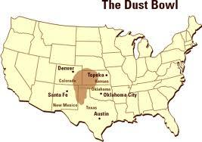
Dust Bowls and Black Blizzards
Dust Bowl:
  Area of land from eastern Colorado to western Missouri
Causes:
  Drought and wind
  Human cultivation
The Grapes of Wrath: story about Dust Bowl
Resettlement Administration:
  Moved poor farmers to new land; planted trees from CCC
Indian Reorganization Act of 1934:
  Reversed Dawes Severalty Act, Natives encouraged to preserve traditions and establish self-government

Slide 14
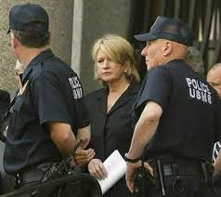
Battling Bankers and Big Business
“Truth in Securities Act”
  Could not lie about “soundness of stocks”
Securities and Exchange Commission (SEC)
  Regulated the stock market
  Watchdog of NYSE

Slide 15
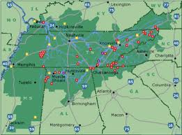
The TVA Harnesses the Tennessee
Hydroelectric Power could be huge source of energy
  TVA helped reform monopolies and provide jobs
TVA was most revolutionary of all New Deal Acts
Encouraged hydro-electric development of other areas as well

Slide 16


Housing and Social Security
Federal Housing Administration (FHA)
  Provided loans and mortgages to individuals for improving homes and buying new ones
  Still around today
***Social Security Act of 1935***
  Provided federal-state unemployment insurance
  Provided $ for senior citizens, disabled, etc.
  Collected by creating a new payroll tax

Slide 17
A New Deal for Labor
National Labor Relations (AKA Wagner Act) KNOW THIS AT ALL COSTS. THE REGENTS AND AP EXAMS LOVE TO ASK ABOUT THIS. IT IS VERY IMPORTANT TO KNOW. THANK YOU ☺
  Huge boost to labor movement
  Reassured right to collectively bargain
John C. Lewis:
  Formed Committee for Industrial Organization (CIO)
  Introduced sit-in strike which did not allow strike breakers to work
Fair Labor Standards Act
  Established 40 hour work week and minimum wage

Slide 18
Landon Challenges “the Champ”
1936 election, Republicans nominate Kansas governor Alfred M. Landon
  Chastised FDR for his deficit spending
FDR wins in a landslide: 523 - 8
CIO and other labor groups contributed large amounts of $ to FDR’s campaign chest

Slide 19
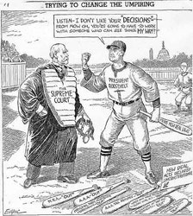
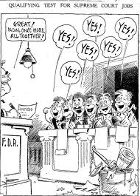
***Nine Old Men on the Bench***
KNOW THIS SLIDE!!!
20th Amendment:
  Changes inauguration to January 20, instead of March 4
In 9 New Deal cases, S.C. overturned 7
FDR wants a court in favor of his programs
  His proposal? 1 new judge for every judge over 70
  Congress, his party, and the American public do NOT support this. Fear of “dictator”

Slide 20
The Court Changes Course
Court begins to come around to his programs
Retirements and deaths allow FDR to appoint 9 new judges

Slide 21
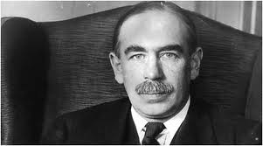
Twilight of the New Deal
1937, economy goes south: “Roosevelt Recession” due to Social Security Taxes
Roosevelt’s solution?
  Spend even more money, go into a deficit.
  Huge change in government economic decisions
  Keynesian Economics: purposely deficit-spend
Hatch Act of 1939:
  Due to FDR having large campaign $, this act barred many from active political campaigning and soliciting

Slide 22
New Deal or Raw Deal?
Impact of New Deal:
  Federal government becomes largest employer
  Issues with this?
Republicans claimed way out of Depression was less government restrictions
Did not fix the depression, farm surpluses still existed

Slide 23


Thanks for watching!
  Subscribe to my channel
  Help spread the word
Questions? Comments? Ideas for videos?
  Leave in comments
Visit www.apushreview.com for many videos and resources
Subscribe
Down here!

