Slide 1
Chapter 34
Franklin Roosevelt and the Shadow of War (1933 – 1941)

Slide 2
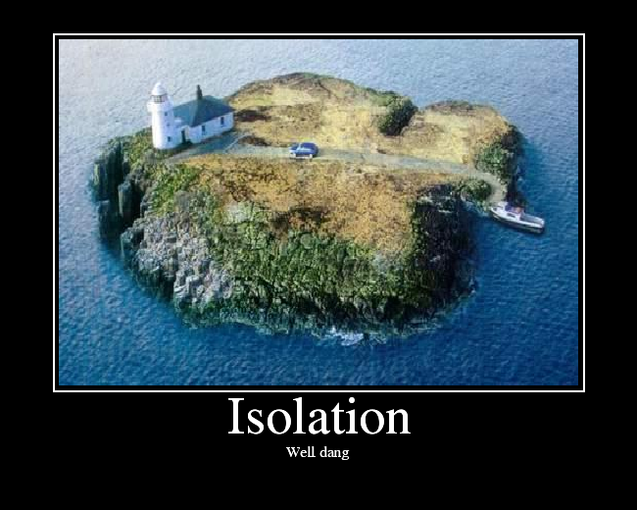
The London Conference
Purpose of the conference?
  “Organize a coordinated international attack on the global depression.”
Roosevelt withdrew from conference for fear of sacrificing US economy for world economy
Reflected US isolation

Slide 3
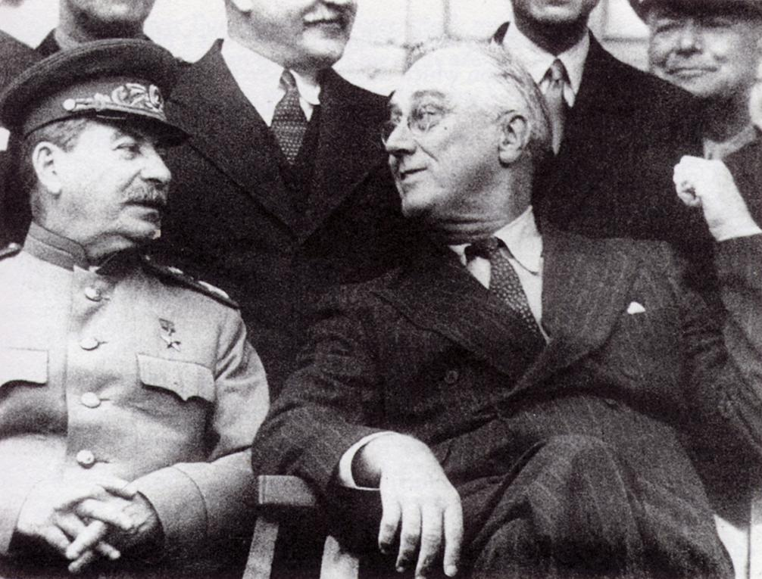
Freedom for the Filipinos….
Tydings-McDuffie Act
  Promised Philippines freedom (happens in 1946)
In 1933, US formally recognized the Soviet Union
  Hope for trade
  Counteract Germany and Japan

Slide 4

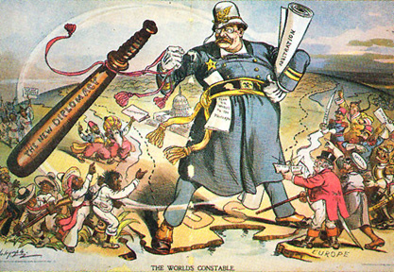
Becoming a Good Neighbor
Good Neighbor Policy
  Improving relations with Latin America
  Renounced armed intervention
  Overturned the Roosevelt Corollary
Improved relations would help defend the Western Hemisphere

Slide 5
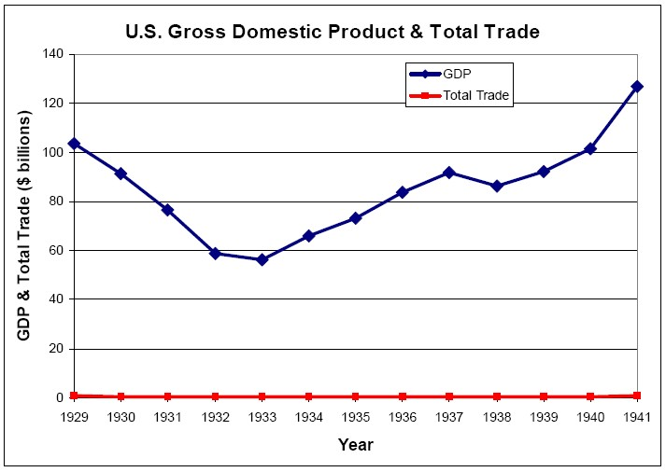
Secretary Hull’s Reciprocal Trade Agreements
Reciprocal Trade Agreements Act:
  Gave power to Roosevelt to lower tariff rates on specific countries if they did the same
  Passed in response to previous high tariffs (Hawley-Smoot)
Foreign trade increased

Slide 6
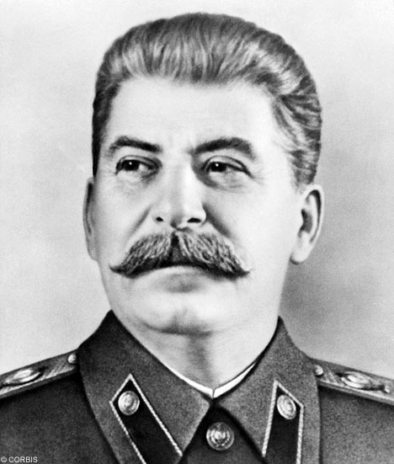
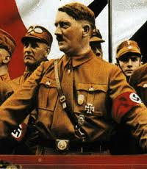
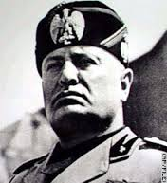
Storm-Cellar Isolationism
Growth of Totalitarianism in the 1930s
  Stalin, Hitler, Mussolini
Japan and Germany sought to expand their borders
  Japan began building battleships
Isolationism increases

Slide 7
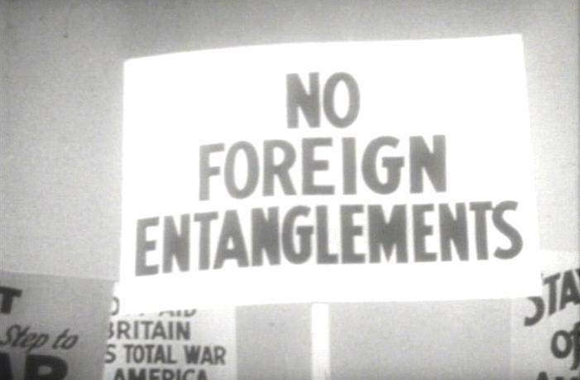
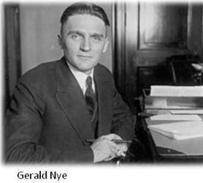
Congress Legislates Neutrality
Nye Committee:
  Investigated allegations US became involved in WWI to make $ for munitions companies
Neutrality Acts of 1935, 1936, and 1937
  If there’s a war, restrictions automatically take effect
    America could not sail on that country’s ships, sell weapons, or lend money
  “No distinction between brutal aggressors and innocent victims.”

Slide 8
America Dooms Loyalist Spain
War in Spain between Fascists and left-leaning government (supported by USSR)
Due to Neutrality Acts, US could NOT help in the fight against the Fascists

Slide 9

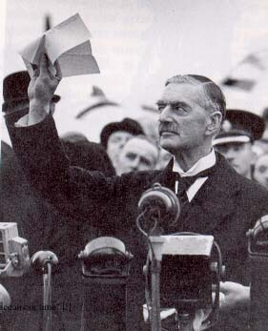
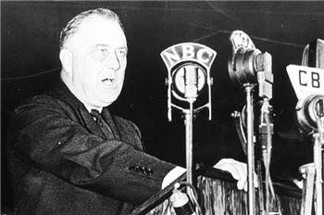
**Appeasing Japan and Germany**
“Quarantine Speech”
  In response to Italy and Japan
  Felt countries should “quarantine” aggressive nations (embargoes)
Isolationists feared this could lead to war
Panay
  American gunboat sunk by the Japanese
Germany violated Treaty of Versailles
  Marched into Rhineland, built up military, annexed Austria, Sudetenland
Munich Conference
  Gave Germany the Sudetenland, Hitler “promised” not to take over more land
  Appeasement

Slide 10
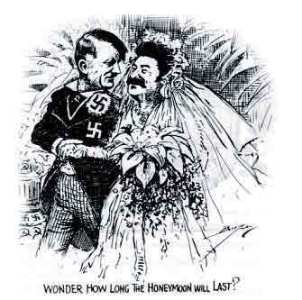
Hitler’s Belligerency and US Neutrality
August 23, 1939 – Germany-Soviet Non-aggression Pact
September 1, 1939 – invasion of Poland
Britain and France need weapons…
Neutrality Act of 1939
  European democracies could buy weapons on a “cash-and-carry” basis
  US is no longer truly “neutral”

Slide 11
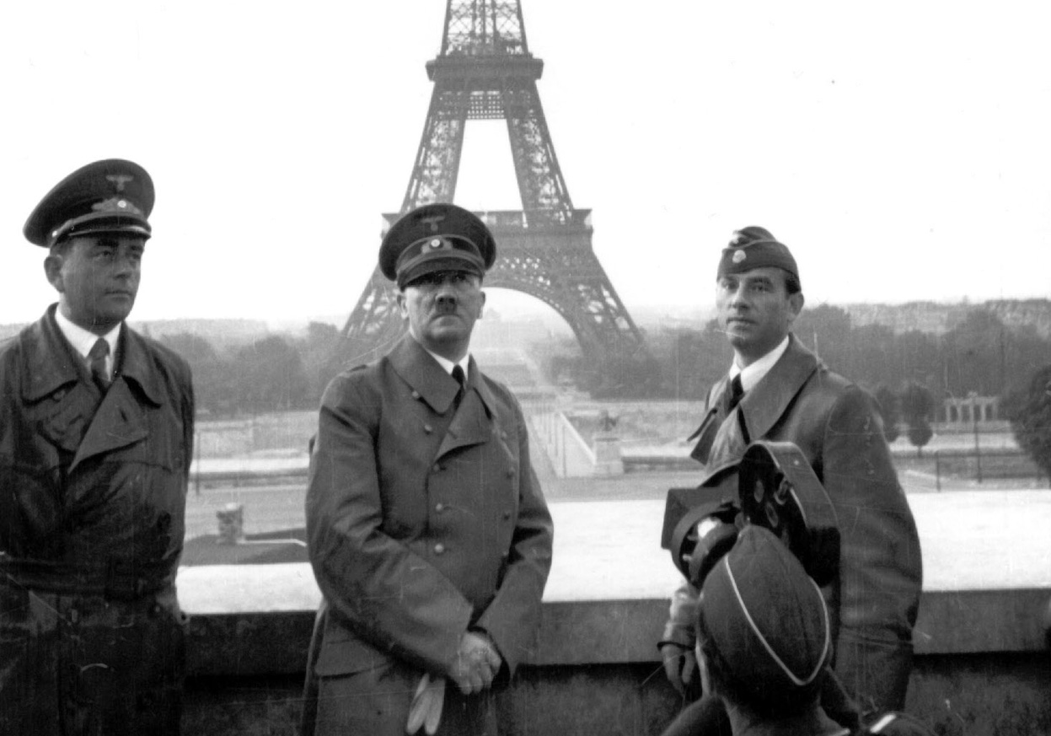
The Fall of France
June 1940, France falls to Hitler
England stood alone
US began building its military
September 6, 1940: first peace-time conscription law
Havana Conference (1940):
  US and L.A. would uphold Monroe Doctrine

Slide 12
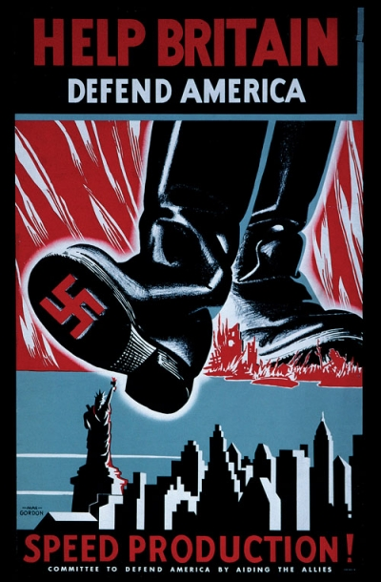
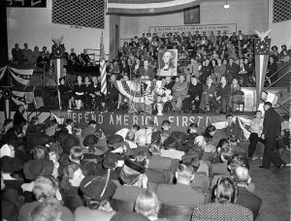
Bolstering Britain with the Destroyer Deal (1940)
Germany bombed England in preparation of invasion
“Fortress of America” or help to Britain?
Committee to Defend America:
  Favored aiding allies
America First Committee:
  Against American involvement
September 1940, Roosevelt gave Britain ships from WWI in return for bases
Most Americans favored “all aid short of war”

Slide 13
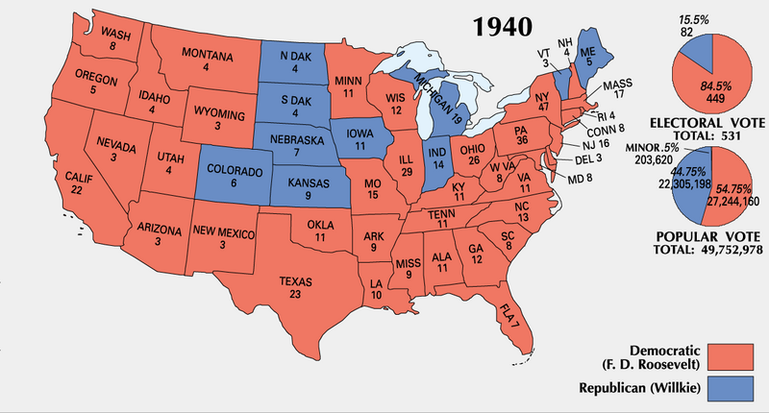
FDR Shatters the Two-Term Tradition
Wendell Willkie v. FDR
  Condemned the New Deal and FDR “Dictatorship”
FDR won 449 - 82

Slide 14
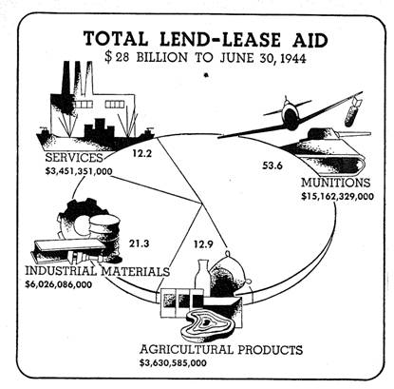
Congress Passes the Lend-Lease Law
What was it?
  March 1941
  Send supplies to victims of aggression
  “Billions not bodies”
Seen as a economic declaration of war
Officially marked the end of neutrality
  Germany began sinking American ships

Slide 15
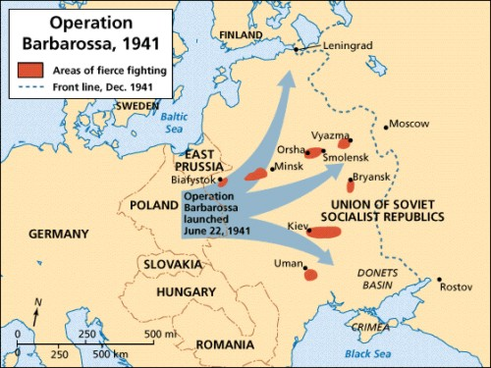
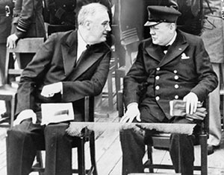
Hitler’s Assault on the Soviet Union….
June 22, 1941: Operation Barbarossa
Atlantic Conference:
  Roosevelt and Churchill meet
  Outlined goals for postwar world
    No territorial exchanges
    New League of Nations

Slide 16
US Destroyers and Hitler’s U-boats Clash
July 1941, Roosevelt decided US ships would escort lend-lease supplies to Iceland
  Roosevelt orders a “shoot on sight” policy
November 1941:
  Merchant ships could be legally armed

Slide 17
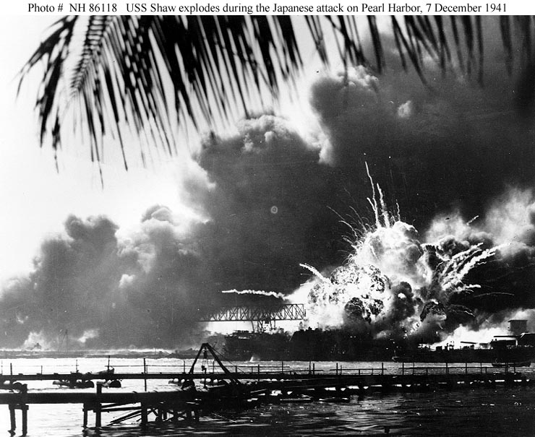
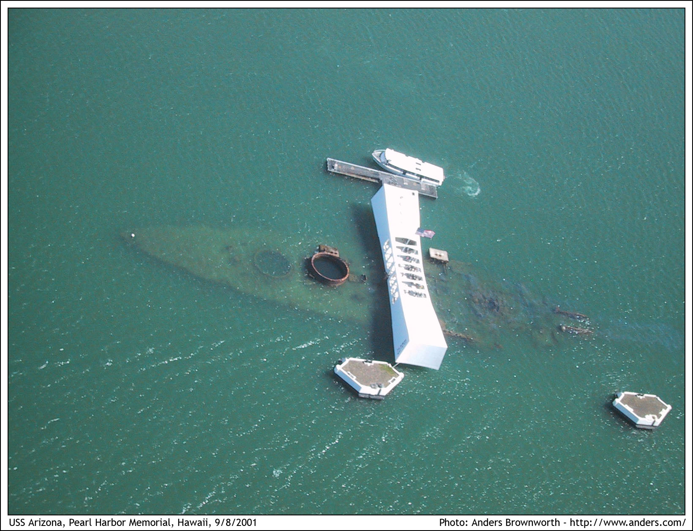
Surprise Assault on Pearl Harbor
Late 1940 – 1941:
  US enacts embargoes on Japan and freezes assets in the US
December 7, 1941:
  A day “that will live in infamy”
  3,000 casualties

Slide 18


Thanks for watching!
  Subscribe to my channel
  Help spread the word
Questions? Comments? Ideas for videos?
  Leave in comments
Subscribe
Down here!

