Slide 1
Chapter 35: World War II

Slide 2
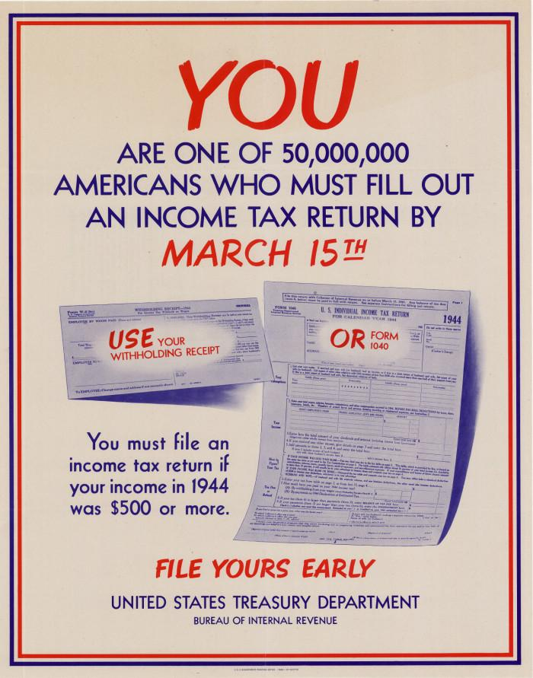
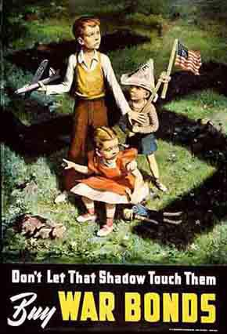
The Home Front
Selective Service Act:
Men ages 18 – 65 had to register
War Productions Board:
½ of factory production went to war effort
Funding of World War II
Increased taxes
War Bonds

Slide 3
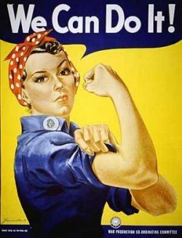
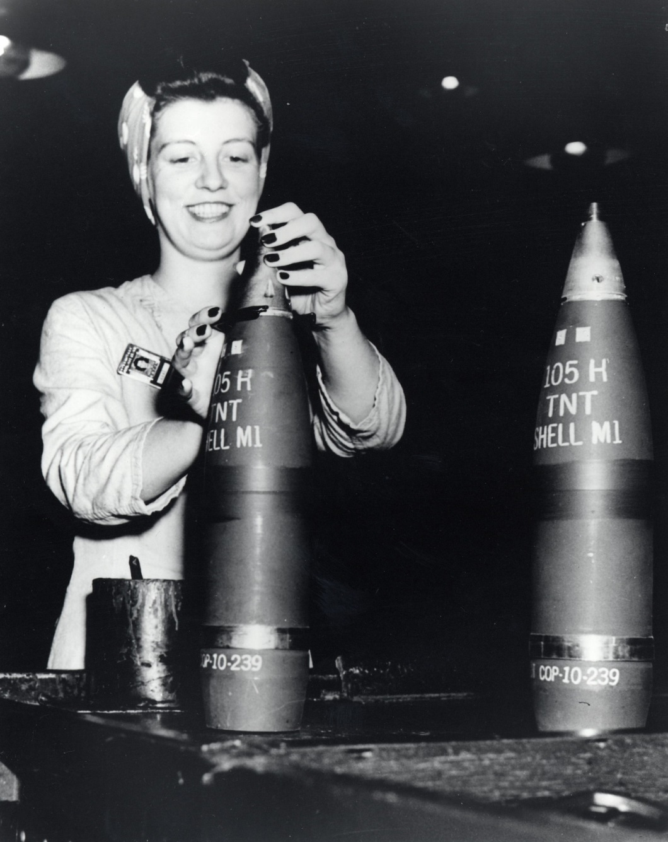
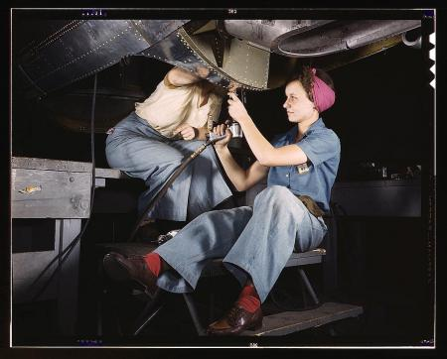
World War II and Women
Women in the military:
WACs (Women’s Army Corps)
WAVES (Women Appointed for voluntary Emergency Service)
“Rosie the Riveter”:
Some women moved to new communities to work in aircraft, munitions, and automobile industries.
Propaganda urged women to work in industry
Films characterized “Rosie” as a heroine

Slide 4
World War II and African Americans
Nearly one million African Americans served in segregated units
Tuskegee Airmen: first African American aviators in the U.S. Army
Double V Campaign:
Victory abroad and victory at home (civil rights)

Slide 5
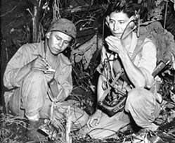
World War II and Native Americans
Navajo volunteers were used as “code talkers”
Japan unable to crack their language used for military communication

Slide 6
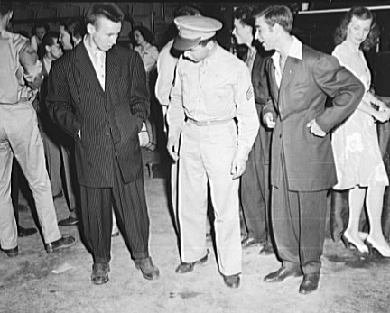
World War II and Mexican-Americans
Bracero Program
1942, need for farm labor led to U.S. gov’t issuing short-term work permits to Mexican workers
About 150,000 Braceros worked in agriculture and the railroads.
Zoot Suit Riots (L.A.), 1943
Young Mexican-Americans became the object of frequent violent attacks by white sailors and marines.
In June, riots broke out in East L.A.
150 were injured; 500 Mexican Americas arrested

Slide 7
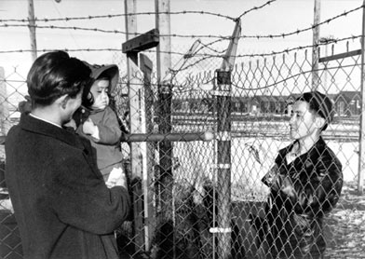
The Home Front: Japanese - Americans
Executive Order 9006
Relocation of Japanese Americans on West Coast to internment camps
Korematsu v. US (1944)
Supreme Court upheld internment camps for Japanese Americans
Significance?
During times of war, individual rights go DOWN!

Slide 8
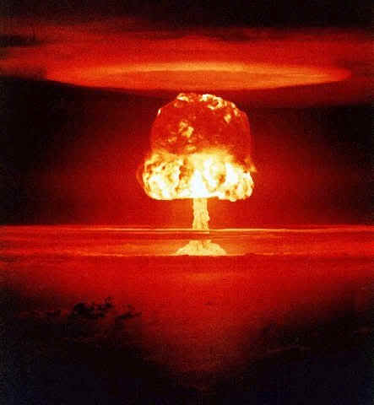
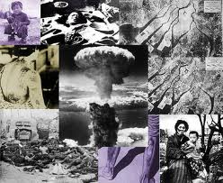
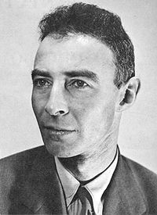
The Atomic Bomb
Manhattan Project:
Headed by J. Robert Oppenheimer
Trinity Test:
July 16, 1945
Hiroshima and Nagasaki:
August 6 and 9, 1945
Why did the US use the bombs on Japan?
To save American lives
To demonstrate power to the Soviet Union
Revenge for Pearl Harbor
Belief that Japanese would fight to the last man

Slide 9
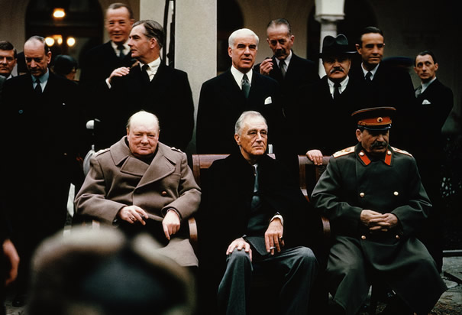
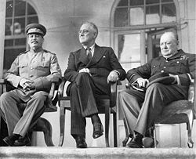
Key Conferences During the War
Tehran Conference (1943)
First meeting of Roosevelt, Churchill, and Stalin
Stalin wanted control of Eastern Europe and a divided Germany
Churchill wanted a free Eastern Europe
Yalta Conference (1945)
Big Three meet again
Discuss plans for postwar Europe
Stalin agreed to free elections
Division of Germany into 4 zones
Potsdam Conference (1945)
Demanded unconditional surrender of Japan

Slide 10
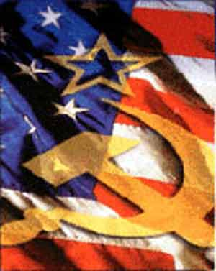
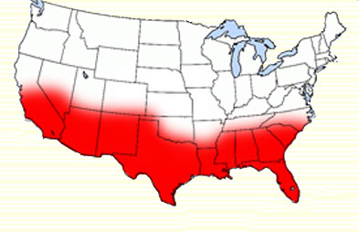
Impact of the War
End to the Great Depression
Post-war economic boom (1950s)
Demographic shifts
“Baby boom”
Growth of the “sunbelt”
African Americans move north
End of Isolation
Beginning of the Cold War

Slide 11
Thanks for watching!
Subscribe to my channel
Help spread the word
Questions? Comments?
Leave in comments
We all agree on subscribing!
Subscribe
Down here!

