Slide 1
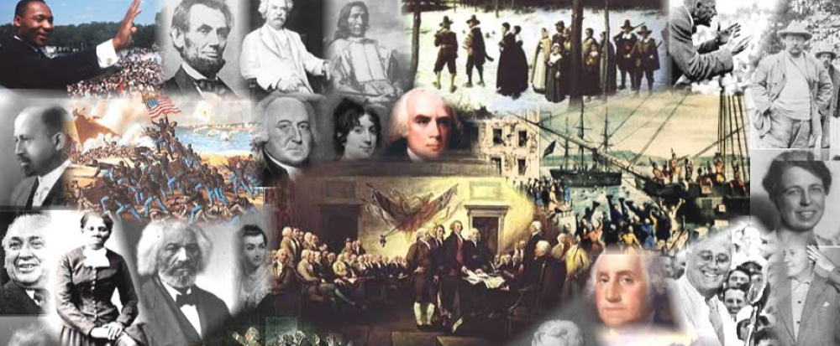
www.Apushreview.com

Slide 2
Chapter 37
The Eisenhower Era “I Like Ike!”

Slide 3
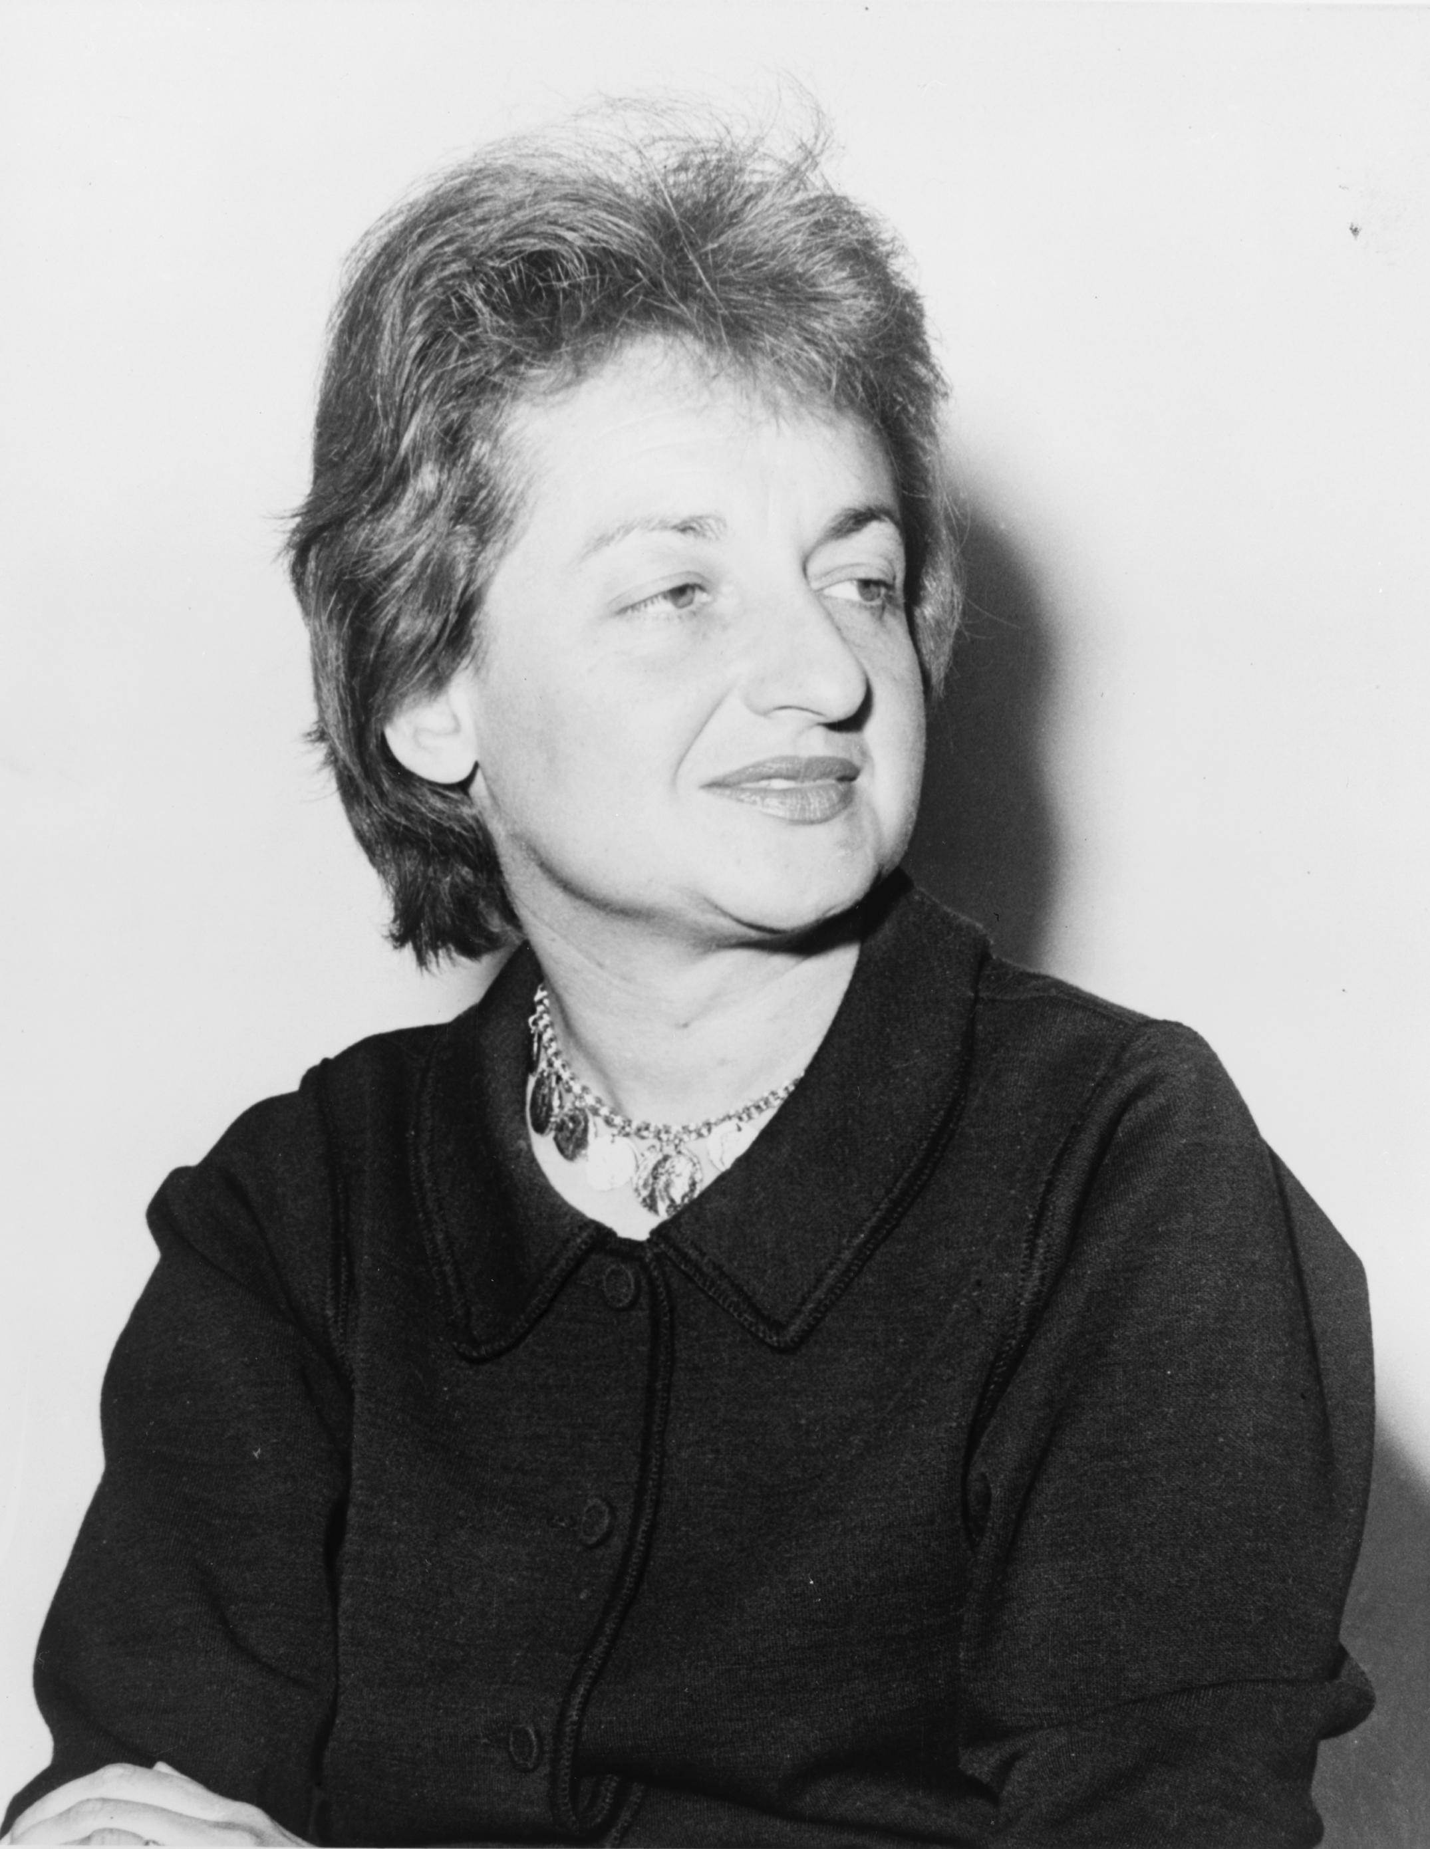
Affluence and Its Anxieties
Many people buying homes -> suburbs - > FHA
Union membership peaks at 35% in 1954
“Cult of domesticity”
  Women were expected to stay home, raise a family
  “Leave it to Beaver”
    2 children, suburban house, stay at home mom
***Betty Friedan***
  Author, The Feminine Mystique, bestselling book that launched modern women’s movement

Slide 4
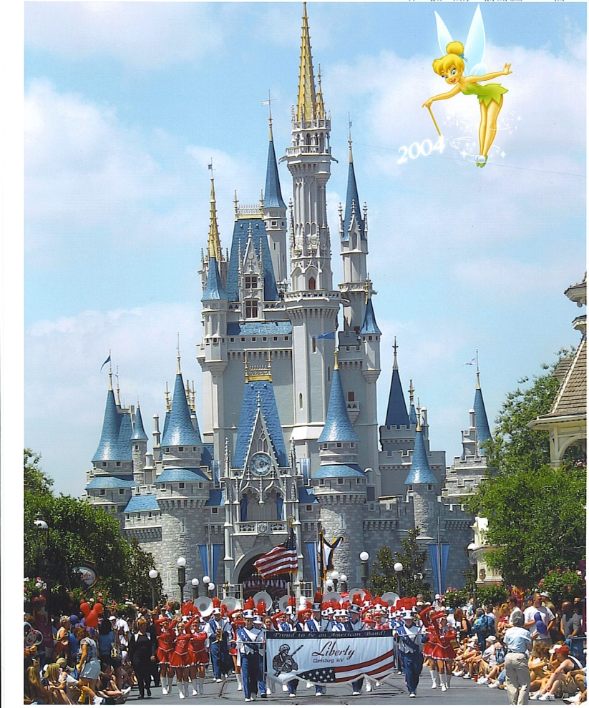
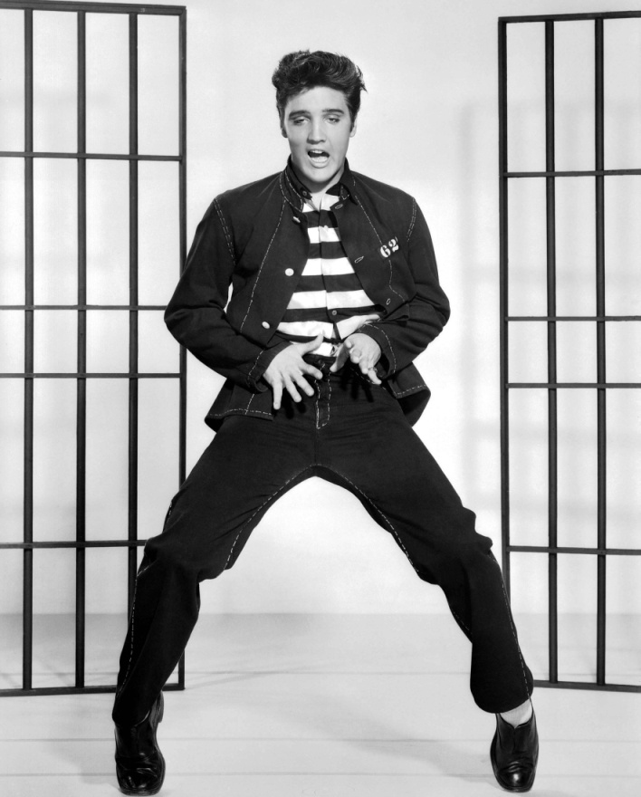
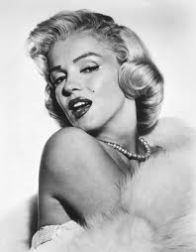
Consumer Culture in the 50s
Birth of McDonalds, Disney Land, Credit Cards
TV:
  Virtually all houses had a tv
  “degrading the public’s aesthetic, social, moral, political, and educational standards” Sound familiar?
Presley and Monroe:
  Thrust sexuality to the forefront

Slide 5
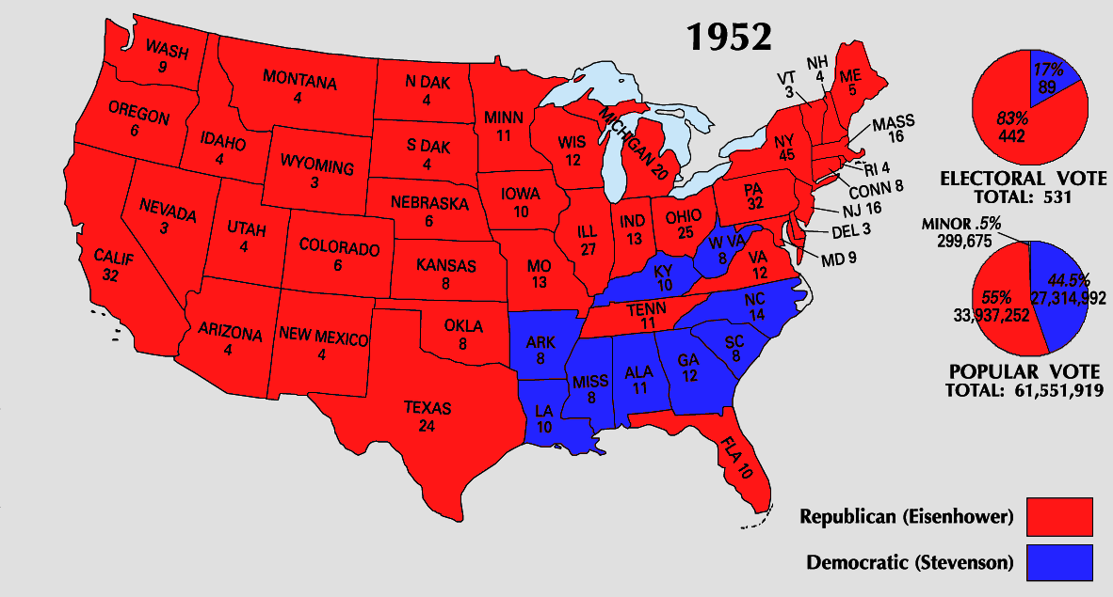
The Advent of Eisenhower
Republican President, red-chasing Nixon as VP
  Broke into “Solid South” that traditionally voted Democrat
Ended Korean War in July 1953 at cost of 54,000 American lives, 1,000,000 Korean and Chinese lives, tens of billions of dollars
“Grandfather” figure

Slide 6
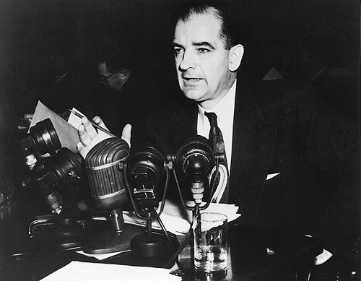
The Rise and Fall of McCarthy
Note: McCarthy was not a part of HUAC (Nixon was)
McCarthy targeted Communist “sympathizers” and those that took over the State department
  Nothing more than a witch hunt, often against the opposing party

Slide 7
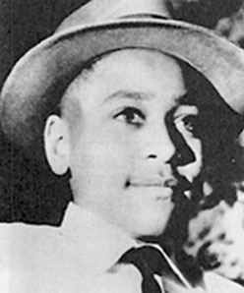
Desegregating American Society
Jim Crow laws were still in effect in the South
Emmett Till
Thurgood Marshall, NAACP lawyer, future justice argued for desegregation
Bus Boycott:
  Rosa Parks
  27 year old preacher MLK -> Gandhi and Thoreau

Slide 8
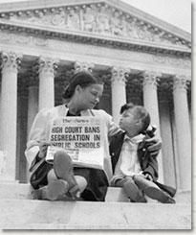
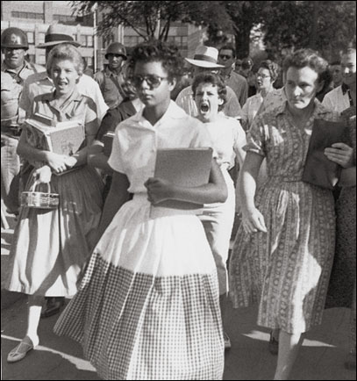
Seeds of the Civil Rights Revolution
1948: Truman desegregated military, federal jobs
***Brown v. Board (1954)***
  Ended “Separate but Equal” established by Plessy
  Schools must be desegregated with “All deliberate speed”
AK: Eisenhower sent troops to escort “Little Rock 9” to school

Slide 9
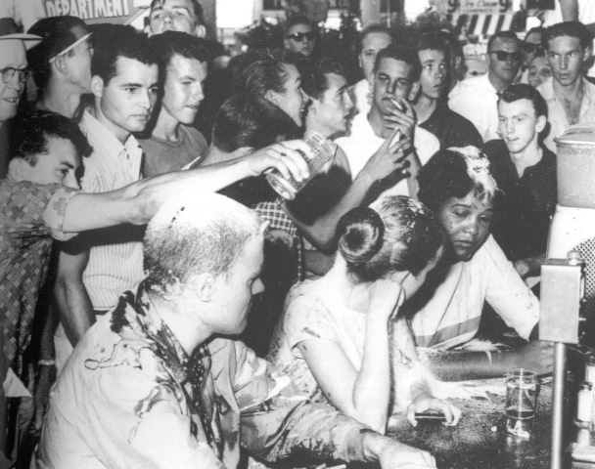
Continued (Please know EVERYTHING on this slide!)
MLK forms Southern Christian Leadership Conference (SCLC)
  Black churches become involved in civil rights movement
“Sit-in”:
  Started in NC, black students sat at an all-white counter, refused to leave
Student Nonviolent Coordinating Committee (SNCC, or “Snick”)
  Promoted sit-ins and freedom rides

Slide 10
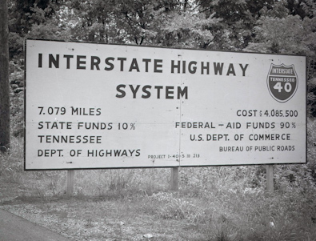
Eisenhower Republicanism at Home
Sought to limit military spending, balance the budget
Reversed Native American policies back to the Dawes Act goals of assimilation
Accepted many New Deal programs
**Interstate Highway Act of 1956**:
  42,000 miles of motorways
  Provided jobs, expansion, growth of car industry
  How would Henry Clay feel? Why?
  Hurt certain industries
  Led to “White Flight”

Slide 11
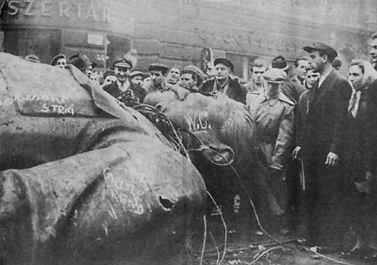
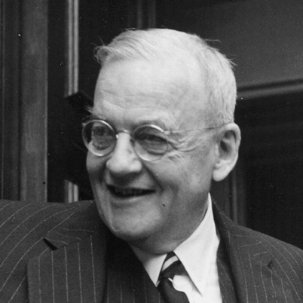
A “New Look” in Foreign Policy
Secretary of State John Foster Dulles
  Hoped to “roll back” the red tide
  Goes against containment
Strategic Air Command:
  Airfleet of superbombers
1956 Hungarian Revolution
  Hungary revolts against the Soviet Union, USSR crushes them
  US does not get involved, fear of possible “massive retaliation”

Slide 12
The Vietnam Nightmare
France was in control of Vietnam (French Indochina)
US provided $billions in aid
Dien Bien Phu falls (rock around the clock, Einstein, James Dean, Brooklyn’s got a winning team….. sorry) in 1954, France eventually leaves
  Who will take their place?
  With North Korea and China Communist, possible fear of Vietnam becoming Communist
Vietnam divided at 17th parallel

Slide 13
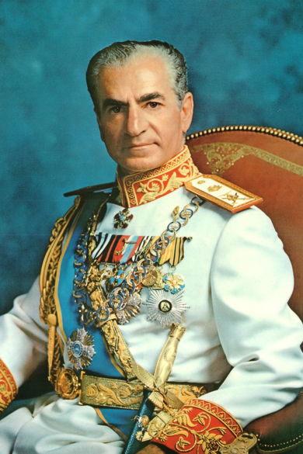
Cold War Crises in Europe and M.E.
Warsaw Pact:
  Soviet Union’s response to NATO
Fear of Soviet Union in M.E. increase Western concern
CIA overthrows Iranian government, instills Shah of Iran – brutal dictator
Nasser, president of Egypt, nationalizes (takes control) of canal (owned by France and England)
Eisenhower Doctrine:
  Pledged US military and economic aid to M.E. nations threatened by Communist aggression

Slide 14
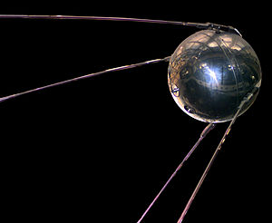
Round 2 for Ike
Eisenhower wins in a landslide, 457 – 73
Sputnik launched by USSR, starts Space Race
  NASA established (bases in Sunbelt – FL and TX, “Houston we have a problem”)
  Huge increase in spending in education and science

Slide 15
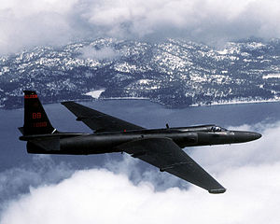
The Continuing Cold War
1960 “U2” (Syngman Rhee, payola and Kennedy, Chubby Checker, Psycho, Belgians in the Congo) Sorry, last time that will happen
  Soviet Union Shot down US spy plane
  Leads to increase tensions…….

Slide 16
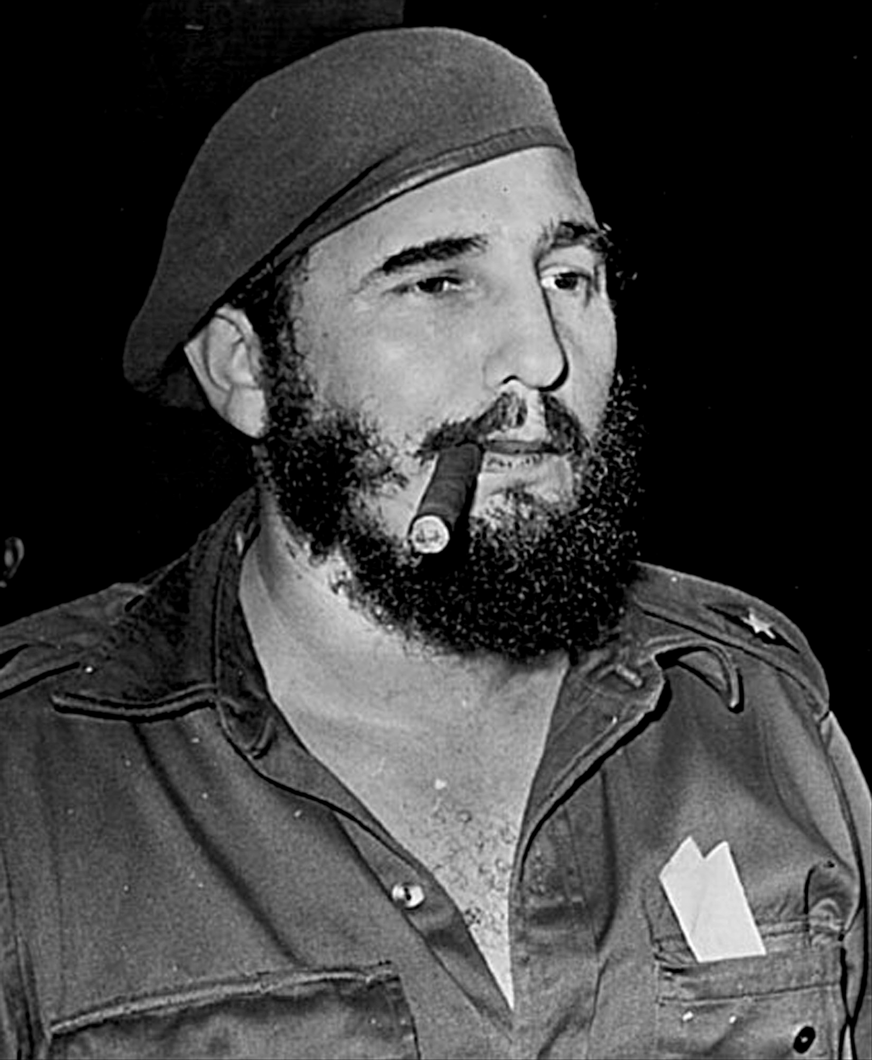
Cuba’s Castroism Spells Communism
1959, Castro ousts dictator Batista, confiscated foreign owned land
  Becomes “satellite” to Soviet Union
1961, US places embargo on Cuba

Slide 17
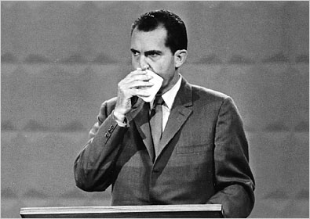
Kennedy Challenges Nixon
Election of 1960: Former VP Nixon (R) v. Senator Kennedy (D)
  Fear of Kennedy’s Catholicism
Role of TV in election
  JFK “wins” on TV, Nixon “wins” on radio
Kennedy wins 303-219, but popular vote was extremely close

Slide 18
An Old General Fades Away
Eisenhower overwhelming admired by Americans
Alaska and Hawaii join the Union
Farewell Speech:
  Warned of too much money being spent on military, “Military Industrial Complex”

Slide 19

That’s it!
  Subscribe to my channel
  Help spread the word
Questions? Comments? Ideas for videos?
  Leave in comments
Subscribe
Down here!

