Slide 1
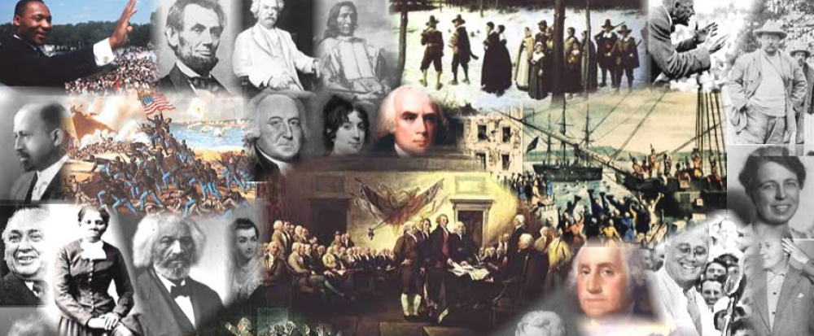
www.Apushreview.com

Slide 2
Chapter 38
The Stormy Sixties: 1960 – 1968

Slide 3

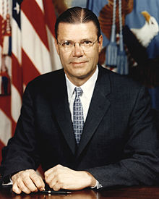
Kennedy’s “New Frontier” Spirit
    New Frontier – urban renewal, civil rights, health care Cabinet:
  Attorney General:
    Brother Bobby
  Defense:
    Robert McNamara
Peace Corps:
  Young Americans would bring “American skills to underdeveloped countries.”

Slide 4

The New Frontier at Home
Economy:
  Tax cuts to help stimulate the economy
Space Program:
  Billions of dollars spent to get a man on the moon

Slide 5
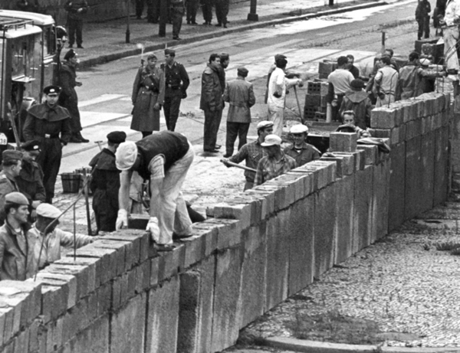
Rumblings in Europe
August, 1961:
  Construction of the Berlin Wall
Trade Expansion Act (1962):
  Tariff cuts to help increase trade with “Common Market Countries”
  Sounds like?????

Slide 6
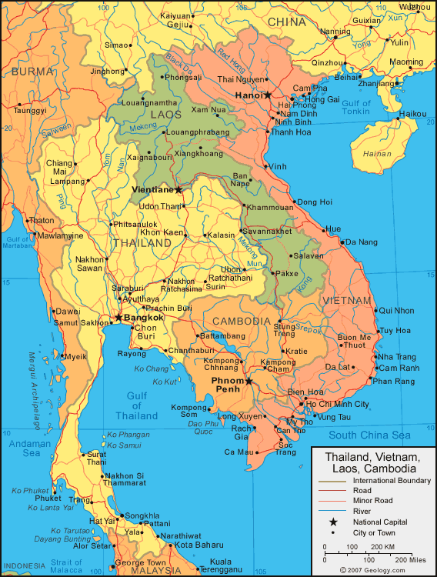
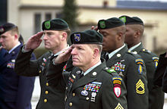
Foreign Flare-ups and “Flexible Response”
Civil War in Laos
  Fear of communism spreading
“Massive Retaliation”
  Secretary Dulles
“Flexible Response”
  Robert McNamara
  Variety of options to use in a crisis

Slide 7
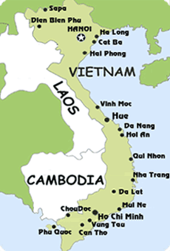
Stepping into the Vietnam Quagmire
1954: Fall of Dien Bien Phu
  France leaves Vietnam, US increases presence
Diem: Leader of South Vietnam
1961, JFK increases troops in Vietnam

Slide 8
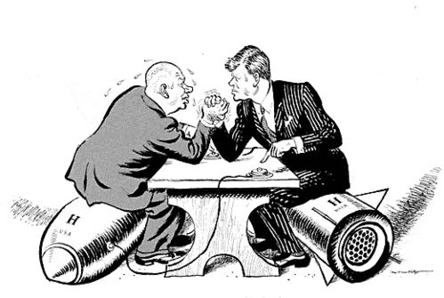
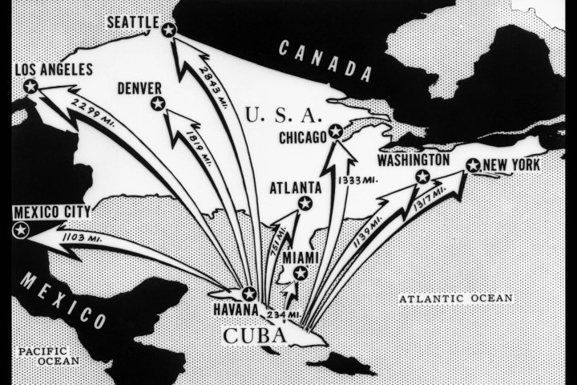
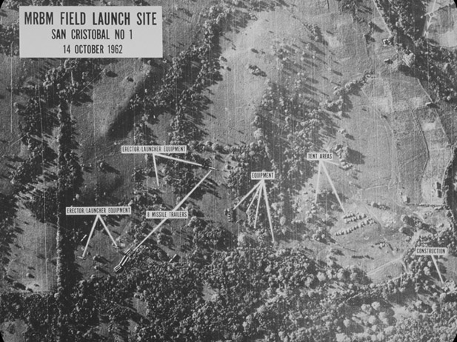
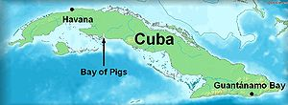
Cuban Confrontations
Alliance for Progress:
  “Marshall Plan for Latin America”
Bay of Pigs
  CIA-backed plan from Ike’s administration
  Cuban rebels attempted to overthrow Cuban government, US didn’t provide aid
Cuban Missile Crisis
  October 1962
  Soviet Union installed nukes in Cuba
  JFK instilled a quarantine
Crisis ended when:
  US ended quarantine, promised not to invade Cuba
  US removed missiles from Turkey
Impact?
  Closest two sides ever came to war
  “Hot-line” established
  Beginning of détente

Slide 9
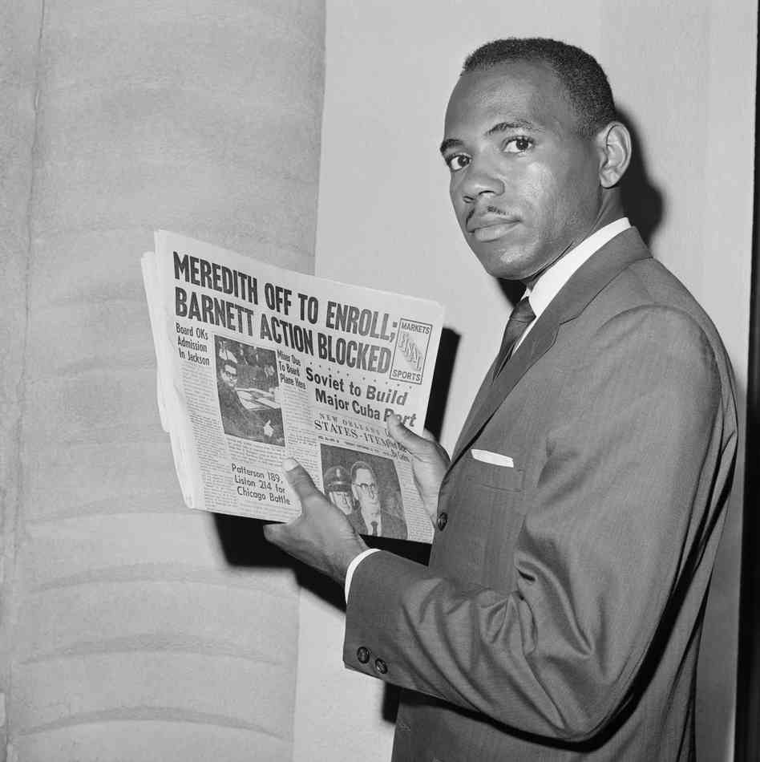
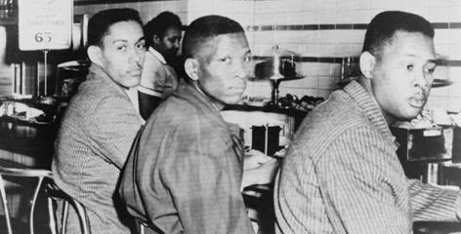
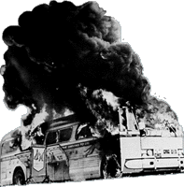
The Struggle for Civil Rights
Sit-ins
Freedom Rides:
  Federal government provides protection
FBI wiretapped MLK Jr.
“Ole Miss”
  Kennedy sent 400 troops to register James Meredith

Slide 10
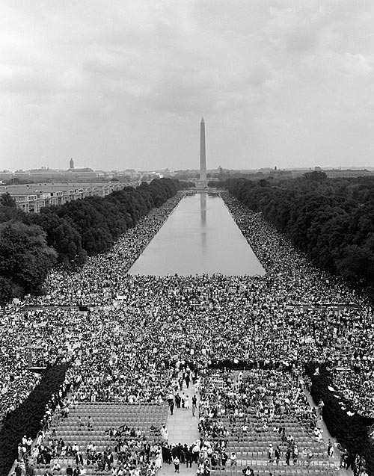
Struggle Continued
Birmingham, AL
  ½ of population was black, but made up 15% of voters
March on Washington
  200,000
  “I have a dream”

Slide 11
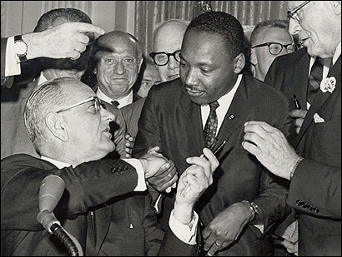
The LBJ Brand on the Presidency
Civil Rights Act of 1964:
  Banned racial discrimination in private facilities
  Empowered federal government to end segregation in schools
  Equal Employment Opportunity Commission:
    Purpose was to eliminate discrimination in hiring
“War on Poverty”

Slide 12

LBJ Continued
Great Society:
  New Deal + Civil Rights
The Other America
  20% of population and 40% of blacks lived in poverty

Slide 13
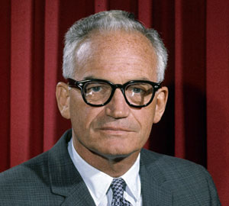
Johnson Battles Goldwater in 1964
Goldwater: Conservative senator from Arizona
  Platform:
    Attacking the federal income tax, Social Security, and TVA
    Essentially, anti-New Deal and Great Society
“In your heart, you know he’s right”

Slide 14
The Great Society Congress
Big Four Legislative achievements:
  Aid to education
  Medical care for the elderly
  Immigration reform
  New voting rights bill
Immigration and Nationality Act of 1965:
  Eliminated quotas from 1920s

Slide 15
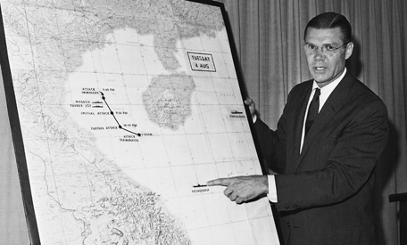
Johnson Continued
***Gulf of Tonkin Resolution***
  American ships were supposedly attacked
  Provided a “blank check” to Johnson in Vietnam
  Increase in presidential powers during war

Slide 16
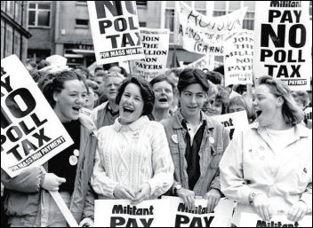
Battling for black rights
Poll taxes and literacy tests discouraged black voting
24th Amendment:
  Eliminated poll taxes
“Freedom Summer:”
  Voter-registration campaign
Voting Rights Act of 1965:
  Eliminated literacy tests
  Use of voter registrars

Slide 17
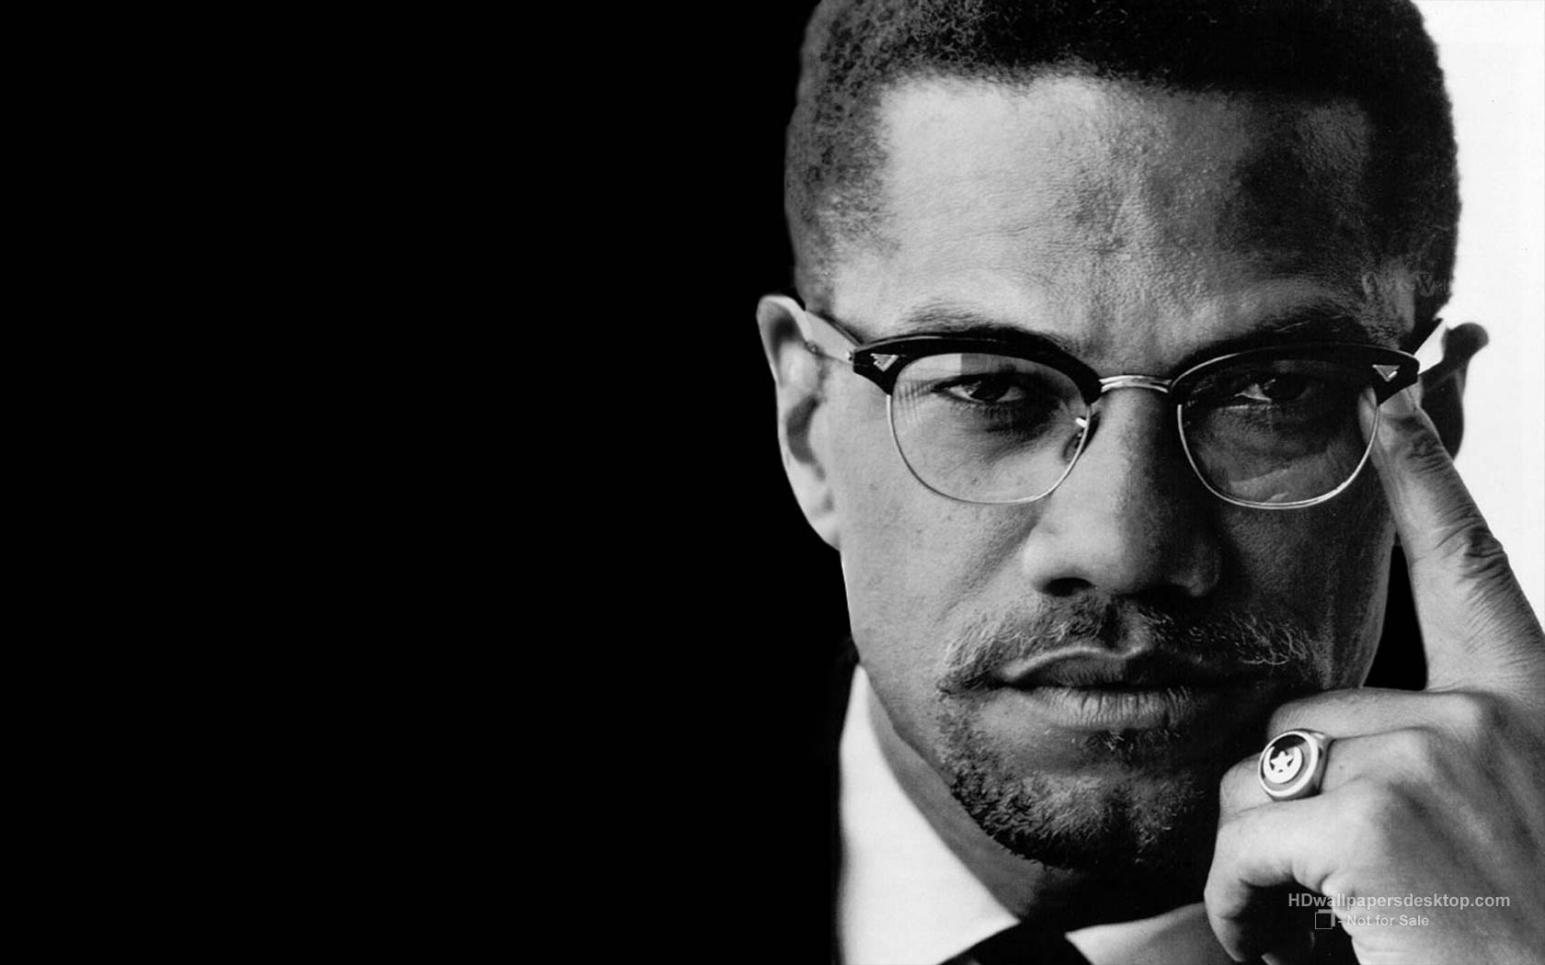
Black Power
Watts Riots (1965):
  Changed the black struggle
    Separatism
    Militant
Malcolm X:
  Nation of Islam
  Assassinated in 1965
Stokely Carmichael:
  Leader of “snick,” Student Nonviolent Coordinating Committee
  Promoted Black Power
As the 60s went on, more of a focus was on economic equality

Slide 18
Vietnam Vexations
Protests on college campuses
Draft “dragged more and more young men off to the Southeast Asian slaughter pen”
“Doves”
  Those that were against the war
“Hawks”
  Those that supported the war

Slide 19
Vietnam Topples Johnson
Tet Offensive:
  Attack by North Vietnam during the Vietnamese New Year
  Led to an increase of opposition to the US in the war
Johnson declares he won’t run for re-election in 1968:
  Bobby Kennedy vied for the Democratic nomination

Slide 20
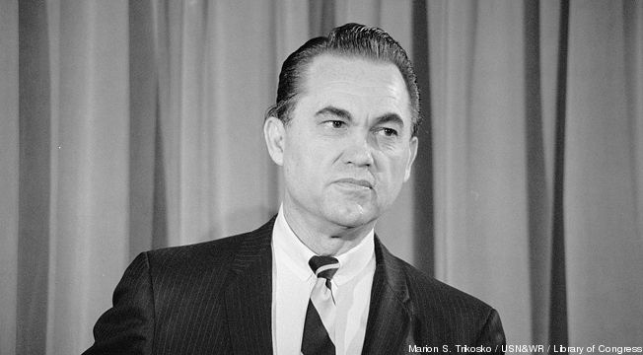
The Presidential Sweepstakes of 1968
June 5, 1968:
  RFK was assassinated by Sirhan Sirhan
Democratic Convention (Chicago):
  Riots
Republicans nominate Nixon and Agnew
American Independent Party:
  George Wallace, former governor of AL
  Segregationist
  Favored escalating the Vietnam War
  Detested war protests

Slide 21
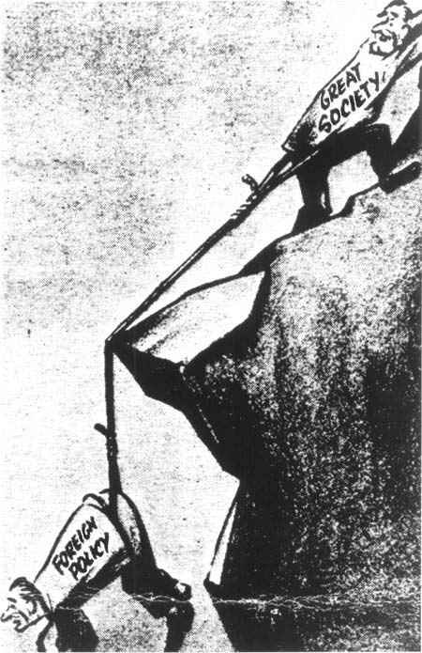
The Obituary of Lyndon Johnson
The Vietnam War came at the expense of Great Society programs
  Money needed for Great Society was used on the war

Slide 22
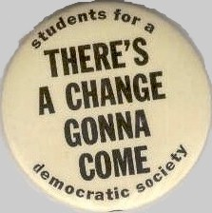
The Cultural Upheaval of the 1960s
Clash of cultures
  Distrust of government, religions, superiors, etc.
UC Berkeley:
  Free Speech Movement
  Objected to not being allowed to use school grounds for political debate
Students for a Democratic Society (SDS):
  Antiwar activists that used terrorism by the end of the 60s

Slide 23

Thanks For Watching!
  Subscribe to my channel
  Help spread the word
Questions? Comments? Ideas for videos?
  Leave in comments
Subscribe
Down here!

