Slide 1
Chapter 9 Review

Slide 2
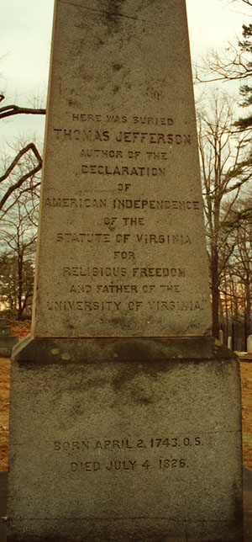
Ideas after American Revolution
Republican Motherhood:
  Women were to raise children to be good citizens of the United States
Virginia Statute of Religious Freedom:
  Created by Jefferson, religious freedom, influences the Bill of Rights
Popular Sovereignty:
  Idea that people are the source of power and have a say in government

Slide 3
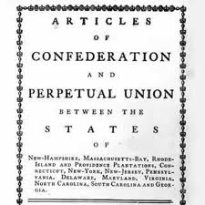
Articles of Confederation
First governing document of the United States
***NO STRONG CENTRAL GOVERNMENT***
To amend the Articles, all 13 states’ approval was necessary

Slide 4
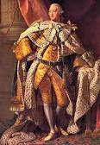
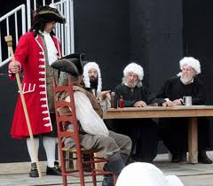
Negatives of Articles
No executive branch
Weak judicial branch
Each state has single, equally powerful vote
  Conflict between large and small states
Congress could not enforce tax collection
  Why?

Slide 5
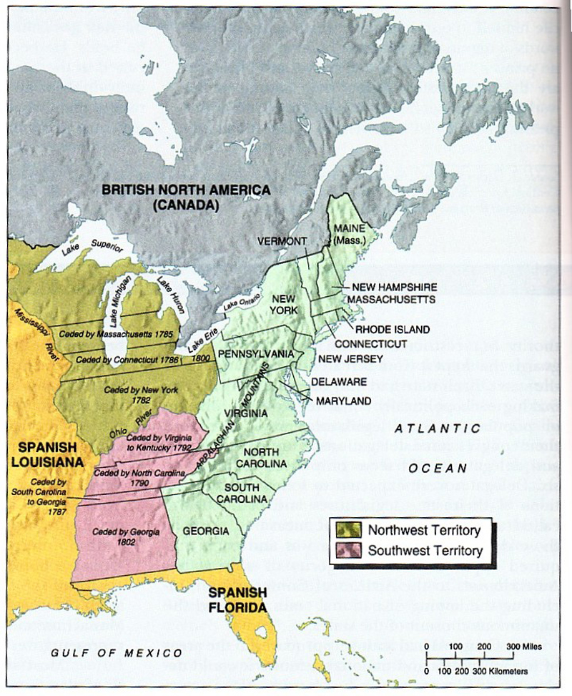
Positives of Articles
Clearly defined powers:
  Create post offices
Land Ordinance of 1785:
  Divided up land in Northwest, sold it to raise money
Northwest Land Ordinance of 1789:
  Process of admitting territories into union
  Prohibited slavery in old northwest
    CONFLICT BETWEEN NORTH AND SOUTH!!

Slide 6

International Challenges
Britain: closed West Indies trade, encouraged Natives to raid colonist towns
Spain: Closed Mississippi River, also sided with Natives
Mediterranean: Pirates (Barbary) were attacking American ships
France: Demanded repayment of loans, restricted West Indies trade

Slide 7

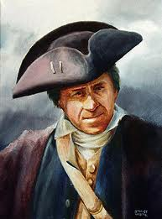
Shays’ Rebellion
Former military man, Daniel Shay leads a rebellion made up of poor farmers. Sound familiar?
  Wanted lower taxes
  Wanted banks to stop foreclosing on homes
Rebellion was eventually crushed, but showed that America needed a STRONG CENTRAL GOVERNMENT THAT WAS NOT PROVIDED BY THE ARTICLES OF CONFEDERATION!!!

Slide 8
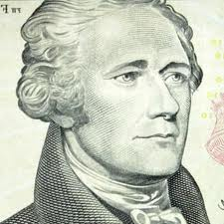
Conventions
Annapolis Convention: Led by A. Hamilton, only 5 states show up, promise to meet next year to revise A of C
Philadelphia Convention: purpose to revise A of C, end up creating a brand new governing document called…………
THE CONSTITUTION

Slide 9
Compromises
Virginia Plan (Large State)
  Representation in Congress should be based on population
New Jersey Plan (Small State)
  Representation in Congress should be equal
Great Compromise: (Connecticut Compromise) Roger Sherman
  2 house (bicameral) legislature: 1 based on population (House of Representatives), 1 equal per state (Senate)

Slide 10
More Constitution stuff
South wanted slaves to count as population, north didn’t
3/5 Compromise:
  60% of slaves will count towards population in the house
Slave Trade Compromise: slave trade can continue until end of 1807
  How does the end of the slave trade affect slaves?

Slide 11
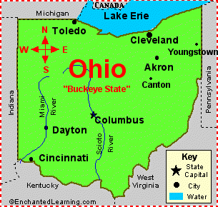
Still more stuff…………
Electoral College:
  Used to elect the President rather than popular vote
  Popular vote winner in each states wins electoral votes
The Elastic Clause (Necessary and Proper):
  Congress shall have the power to… make all Laws which shall be necessary and proper for carrying into Execution the foregoing Powers…"
18

Slide 12
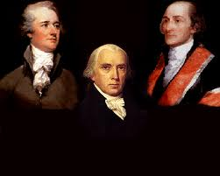
Federalists vs. Anti-federalists
Federalists: In favor of a strong central government (Madison, Hamilton, Washington, Jay, etc.)
Anti-Federalists: In favor of a weaker central government with states having more power (Patrick Henry)
Why did Anti-Federalists adopt the Constitution?
  Federalists promised to add a Bill of Rights!!!!
Federalists Papers: pamphlet to gather support for the Constitution

