Slide 1
Chapters 1-2 Review

Slide 2
Chapter #1
Exploration

Slide 3
Reasons for Exploration of New World
European demand for more and cheaper products
Search for New Routes to the East- Ottomans had a monopoly on trade routes
The 3 G’s- “Gold, Glory, Gospel” (Explorers wanted Gold and Glory/ missionaries wanted to convert Natives

Slide 4
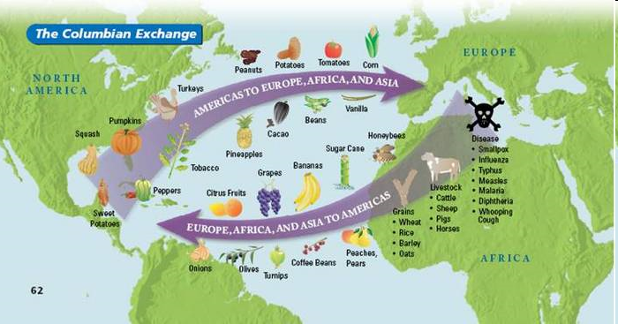
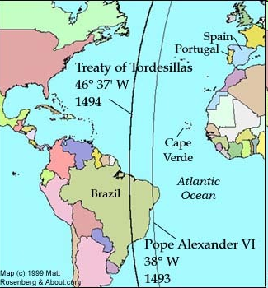
Effects of Exploration
Slave Trade needed for sugar plantations in the West Indies
Spread of disease- Again, “Guns, Germs, and Steel” killed 90% of population
Conflicting Claims- many European nations claimed the same area based on similar explorations
  Papal Line of Demarcation (1493)- Pope Alexander VI divided the “new world” between Spain and Portugal
  Treaty of Tordesilla (1494), which gave most of the “new world” in the Americas except Brazil to Spain.
The Colombian Exchange:
  Dramatically widespread exchange of animal, plants, culture (including slaves), diseases, and ideas between the Eastern and Western hemispheres.
  Effects: Cultural Diffusion, changes two worlds forever

Slide 5
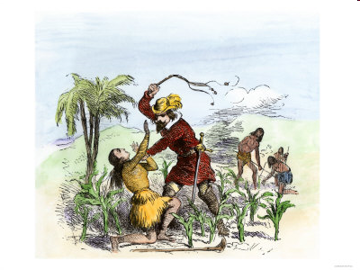
Spain Builds an Empire
Encomienda System - allowed the government to “commend”, or give, Indians and land to certain colonists in return for the promise to try to Christianize them
  It really was slavery.
“Black Legend”- false concept held that the conquerors merely tortured and killed the Indians, stole their gold, infected them with smallpox, and left little but misery behind.
  Somewhat true
  They grafted their culture, laws, religion, and language into the native societies. This laid the foundation for the modern- day Spanish speaking nations.
The Spanish also incorporated indigenous culture with their own, rather than isolating and shunning the Indians as the English did
  Intermarriage

Slide 6
Chapter 2
Planting of English America

Slide 7
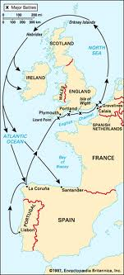
England Emerges
Spanish Armada is defeated by England; England emerges as a naval power
  Also brings a Protestant nation to the forefront (Spain was Catholic)

Slide 8
Characteristics of English Empire
Types of Colonies:
    Charter-
      chartered trading companies made up of stock- holders who shared both the profits and the losses of the colonies (Virginia).
    Proprietorships-
      Royal grant of land to Royal favorites (Maryland- Lord Baltimore)
    Royal-
      ruled by the Crown of England (Georgia)

Slide 9
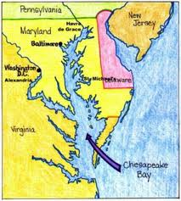
Chesapeake Bay
Made up of Virginia and Maryland
  Indentured servants were early labor source until Bacon’s Rebellion
John Rolfe (Jamestown) introduces tobacco and saves colony
Representative self- government- 1619- House of Burgesses (Early form of self-government)
Powhattan Confederacy: Neighboring Native American Tribe, fell victim to 3 D’s. Disease, Disorganization, Disposability

Slide 10
MD and VA key terms
MD (Lord Baltimore) Proprietorship
Acts of Toleration – guarantees religious toleration to all Christians ONLY
  Not to Jews
Indentured Servants: Worked a period of 5-7 years in exchange for passage to America

Slide 11
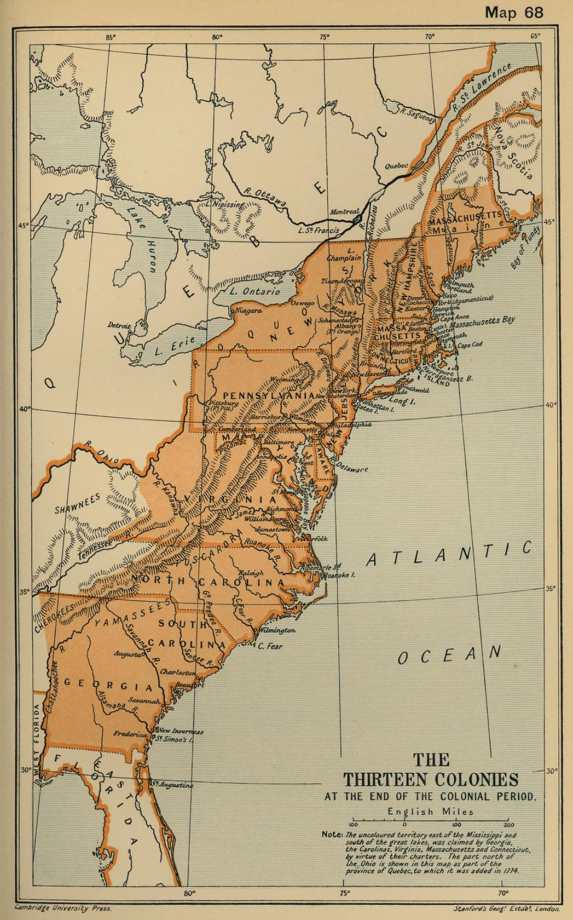
Georgia: The Buffer Colony
Georgia
Last of the original 13 colonies formed in 1733 originally as a buffer between aristocratic South Carolina and Spanish Florida and French Louisiana.
Also a penal colony for debtors
James Oglethorpe became the leading statesman in Georgia, repelled Spanish attacks
Later, in 1750, Georgia adopts the plantation system modeled after SC

Slide 12

That’s it!
  Subscribe to my channel
  Help spread the word
Questions? Comments? Ideas for videos?
  Email or leave in comments
Subscribe for APUSH nuggets of wisdom!
Subscribe
Down here!

