Slide 1
Key Compromises in US History

Slide 2
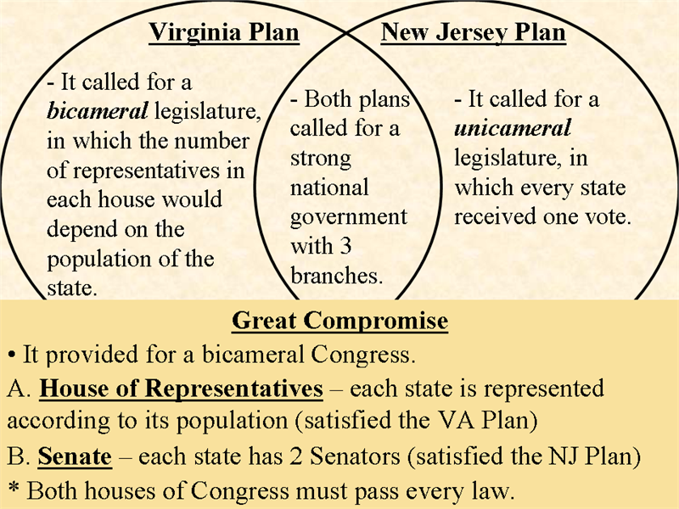

The Great Compromise (1787)
The issue:
  How would representation in Congress be determined?
The views:
  Small State (NJ)
    Favored 1 house legislature, based on equal representation
  Large State (VA)
    Favored bicameral legislature, representation would be based on population
The result:
  Bicameral (2-house) legislature
  One house would be based on population (House of Reps)
  One house would be equal representation (Senate)

Slide 3
The 3/5 Compromise (1787)
The issue:
  How would slaves be counted towards representation in Congress?
The views:
  North: Slaves should not count since they are not citizens
  South: Slaves should count since they are a large portion of population
The result:
  3/5 slaves (60%) will count towards representation in the House

Slide 4
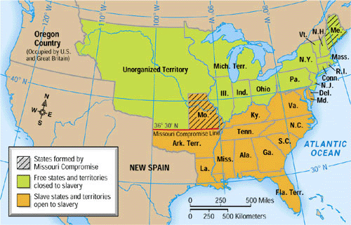
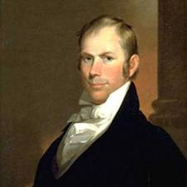
Compromise of 1820
The issue:
  MO wanted enter union as a slave state
  Would upset the balance of free and slave
Three aspects:
  Missouri would enter as a slave state
  Maine would enter as a free state (carved from MA)
  3630 – every future state above would be free, every state below would be slave The result:
  Increase sectional tensions between North and South
  Eventually overturned by Kansas-Nebraska Act

Slide 5
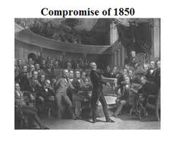
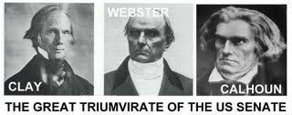
Compromise of 1850
The issue:
  What would happen to land gained from Mexican Cession? Would it be free or slave?
Five Parts:
  Popular Sovereignty in Mexican Cession
  Fugitive Slave Law (more harsh)
  Abolition of slave trade in D.C.
  California is admitted as a free state
  Texas paid $10 for boundary dispute
Significance:
  Avoided Civil War for 10 years
  Last hurrah for Great Triumvirate (Clay, Webster, Calhoun)

Slide 6
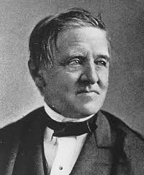
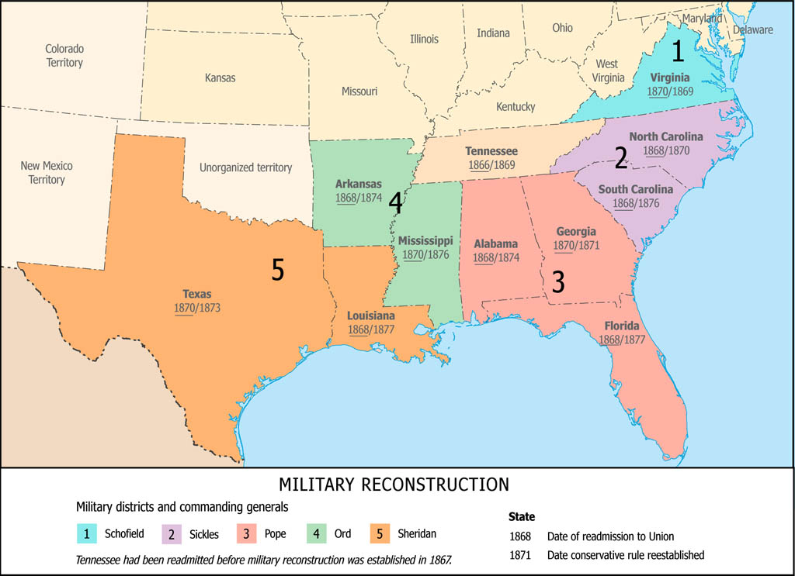
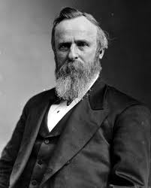
Compromise of 1877
VS
The issue:
  Who won the presidential election of 1876
    Tilden (Democrat)
    Hayes (Republican)
  Three states had conflicting electoral results (20 votes)
  Tilden needed only 1
The result:
  Hayes is declared the winner in return for:
  Removal of troops from the South (Reconstruction IS OVER!)
  Southerner must be named to Hayes’ cabinet
  $ to South

Slide 7


Thanks for watching!
  Subscribe to my channel
  Help spread the word
Questions? Comments? Ideas for videos?
  Leave in comments
Visit www.apushreview.com for many videos and resources
Subscribe
Down here!

