Slide 1
Presidential Doctrines Review
From Monroe to Reagan

Slide 2
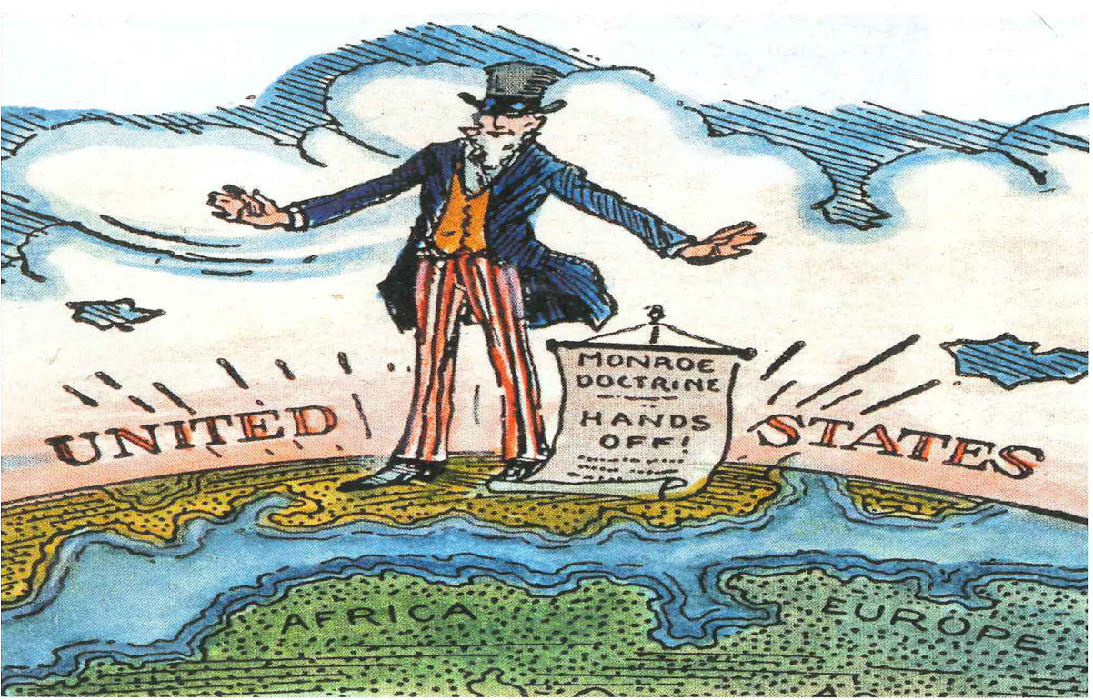
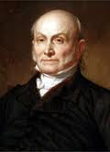
The Monroe Doctrine
What was it?
  Issued by James Madison (1823)
  Written by Secretary of State, JQA
Why was it issued?
  Fear that Europe would recolonize newly created nations
What were the provisions?
  Europe stays out of Western Hemisphere
  US stays out of European affairs

Slide 3
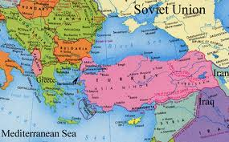

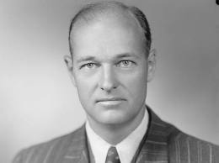
The Truman Doctrine
What was it?
  Issued in 1947 as part of the Containment strategy (George Kennan)
Why was it issued?
  US was fearful of Turkey and Greece becoming susceptible to communism and/or Soviet influence
What were the provisions?
  $400 million in aid to countries (Greece and Turkey) that were resisting communism
Impact?
  Helped set the stage for US foreign policy during the Cold War

Slide 4
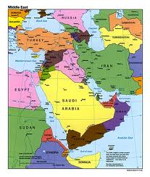
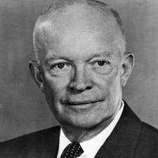
The Eisenhower Doctrine
What was it?
  Issued by Eisenhower in 1957 to stop communism in the Middle East
Why was it issued?
  Fear that Communism could progress to Middle East countries (oil)
What were the provisions?
  President could provide military and economic aid to nations resisting communism

Slide 5
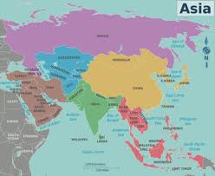

The Nixon Doctrine
What was it?
  Issued by Nixon in 1969 based on US’ experience in Vietnam
  Focused on containment in Asia
Why was it issued?
  To introduce a new twist on Containment
What were the provisions?
  US would aid allies in resisting communism
  Increase in economic and diplomatic ways of containing, rather than troops

Slide 6
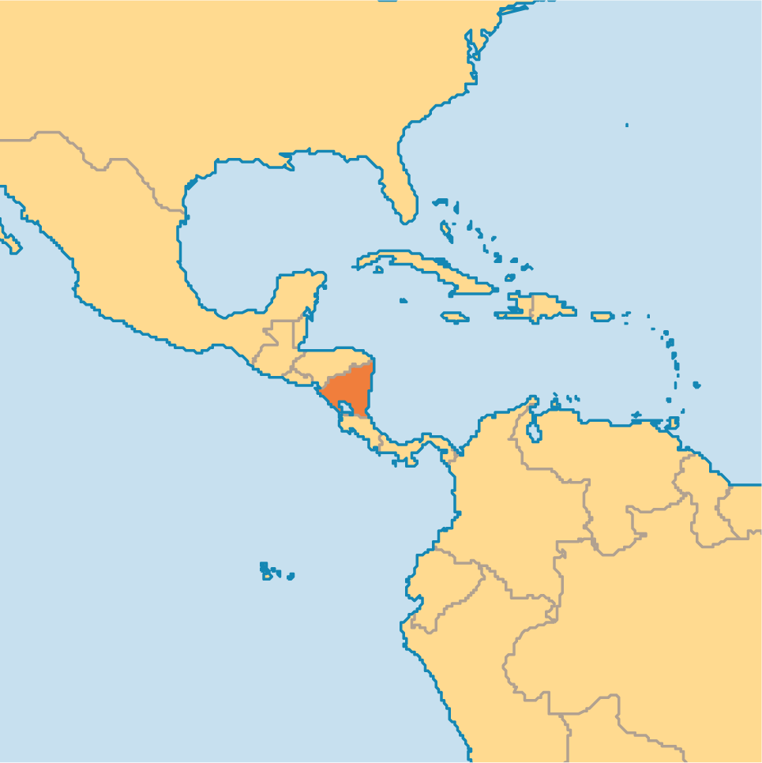


The Reagan Doctrine
What was it?
  Issued by Reagan in the early 1980s to “roll back” communism in the world (Latin America)
Why was it issued?
  As with previous doctrines, to limit expansion of communism
What were the provisions?
  US would provide direct and covert aid to anti-communist forces
  Example: Nicaragua

Slide 7
Quick Recap
All had specific areas of the world they were concerned with:
  Monroe: Latin America
  Truman: Europe (Turkey and Greece)
  Eisenhower: Middle East
  Nixon: Asia
  Reagan: Latin America
All doctrines, except Monroe, dealt with containing communism

Slide 8


That’s it!
  Subscribe to my channel
  Help spread the word
Questions? Comments? Ideas for videos?
  Leave in comments
Visit www.apushreview.com for many videos and resources
Subscribe
Down here!

