Slide 1
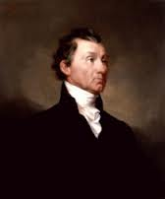
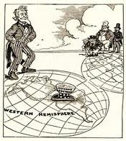
US Foreign Policy
Brought to you by www.APUSHREVIEW.COM
Latin America Edition!

Slide 2
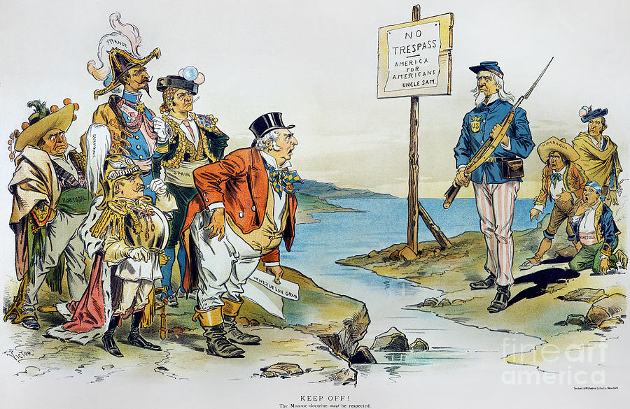
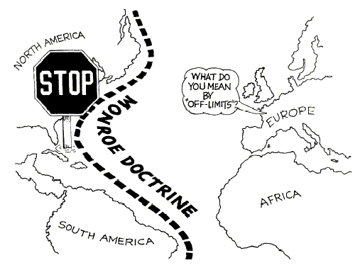
The Monroe Doctrine
What was it?
  Written in 1823 under Monroe’s administration
  Authored by John Quincy Adams (Secretary of State)
What was the message?
  Europe and America were different politically
  Europe must stay out of Latin American affairs
    Any attempt to interfere will be seen as hostile
  In return, the US will stay out of European affairs
What was the impact?
  Initially, it was simply symbolic
  Over time, it became a cornerstone of US foreign policy in Latin America

Slide 3
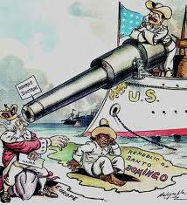
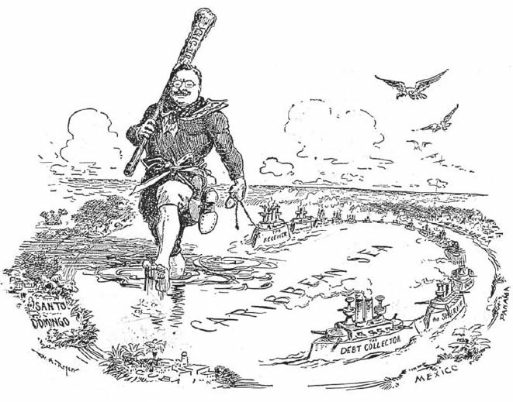
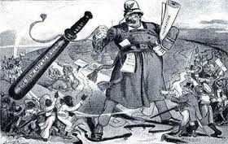
The Roosevelt Corollary
What was it?
  President Theodore Roosevelt’s addition to the Monroe Doctrine
Why was it issued?
  Venezuela and Dominican Republic were in debt to European Countries
  Roosevelt feared Europe would become involved in Latin America
What was the message?
  America reserved the right to intervene in LA
  In future debt crises, US would pay off debt and keep Europe out
  Used to justify intervention in LA
What was the impact?
  America becomes a police power
  Increased tensions with LA countries

Slide 4
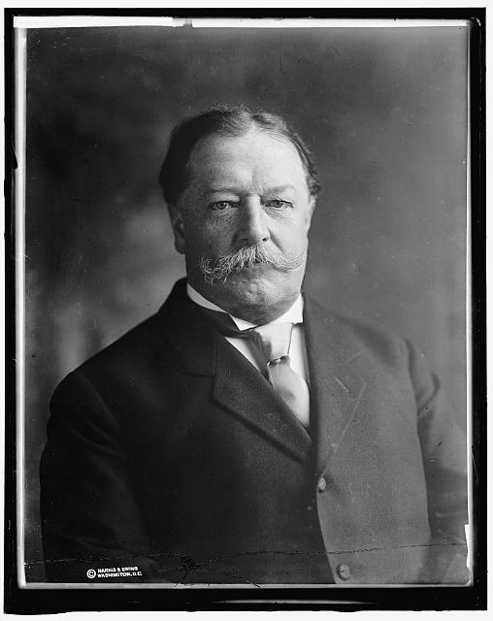
Dollar Diplomacy
What was it?
  President Taft’s plan to increase investment in Latin America
Why was it issued?
  US businesses could increase their markets by investing in other countries
  The US government did NOT invest, it was American businesses
What was the impact?
  US involvement in Latin America increases
  US is concerned about protecting its interests

Slide 5
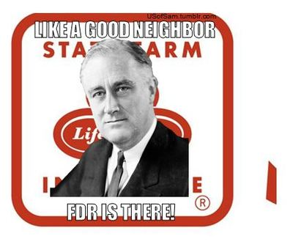
The Good Neighbor Policy
What was it?
  Franklin D. Roosevelt’s plan to limit US intervention in Latin America
Why was it issued?
  To improve relationships between US and LA
What was the impact?
  Relations improved
  Trade between nations increased
  Roosevelt renounced armed intervention
  US withdrew troops from many LA nations

Slide 6
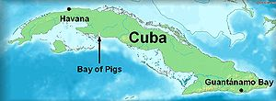
Bay of Pigs
What was it?
  CIA backed plan to invade Cuba overthrow the Castro government
  The invasion failed
Why did this happen?
  Cuba became communist under Castro
  US desire to limit the threat of communism
What was the impact?
  Disaster for US, damaged credibility
  Castro and the Soviet Union become more close
  Helped lead to the Cuban Missile Crisis

Slide 7
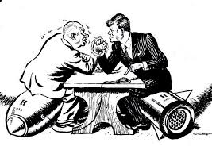
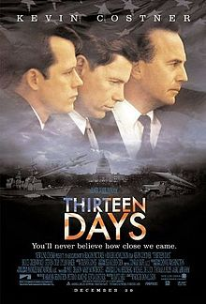
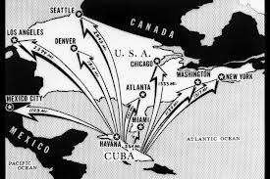
Cuban Missile Crisis
When was it?
  13 days in October, 1962
What was it?
  US discovered Soviet nukes in Cuba
  Missiles had capability of destroying eastern coast
What was the impact?
  Eventually, Khrushchev withdrew the missiles
  US withdrew missiles from Turkey
  US promised not to invade Cuba

Slide 8

That’s it!
Let’s go to www.apushreview.com and settle our differences
  Subscribe to my channel
  Help spread the word
Questions? Comments? Ideas for videos?
  Leave in comments
Subscribe
Down here!

